Slide 1
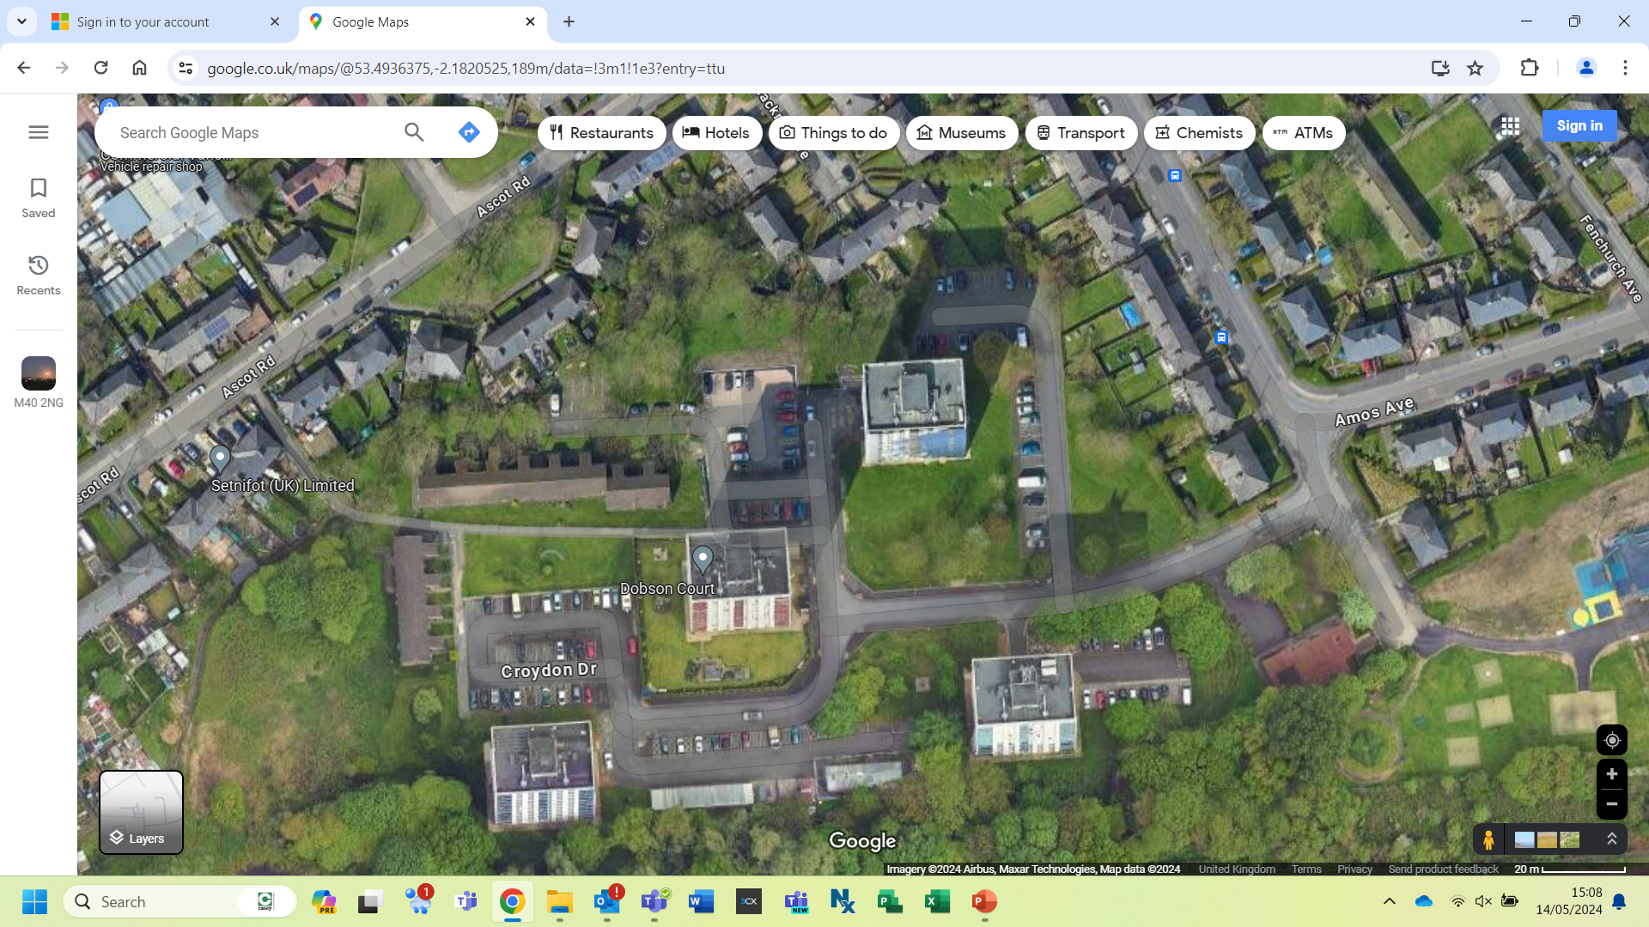


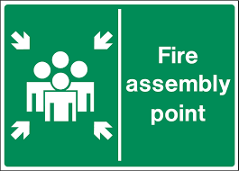






AVRO Hollows. M40 2NG
TRAFFIC MANAGEMENT PLAN
KEY
Lay down area
Storage containers
Site welfare
First Aid Point
Fire Assembly Point
Fire Extinguishers
Traffic / Emergency access routes
Pedestrian Route
Skips
Parking
No Parking Zone
Site Logistics Co-ordinator
Insert Photo of Banks Man
All deliveries must be coordinated prior with
Simon Ogden
SITE SPECIFIC INFORMATION and PPE REQUIREMENTS
Site Speed Limits – 5mph
Delivery Times – 9.15am to 2.30pm
One Way Systems – Two way system in place
Bus Routes - N/A
Notes:
Top of Page – Emergency phone no – Check your local exchange and insert at question mark the No. to access an external line
Right hand middle – A plan or preferably a photograph of the emergency evacuation points should be inserted here
Bottom right – Insert contact phone no.s here
Bottom middle – Insert First Aider names or where details can be found e.g switchboard/reception
Building Hazards – Insert any building hazards here

