Slide 1
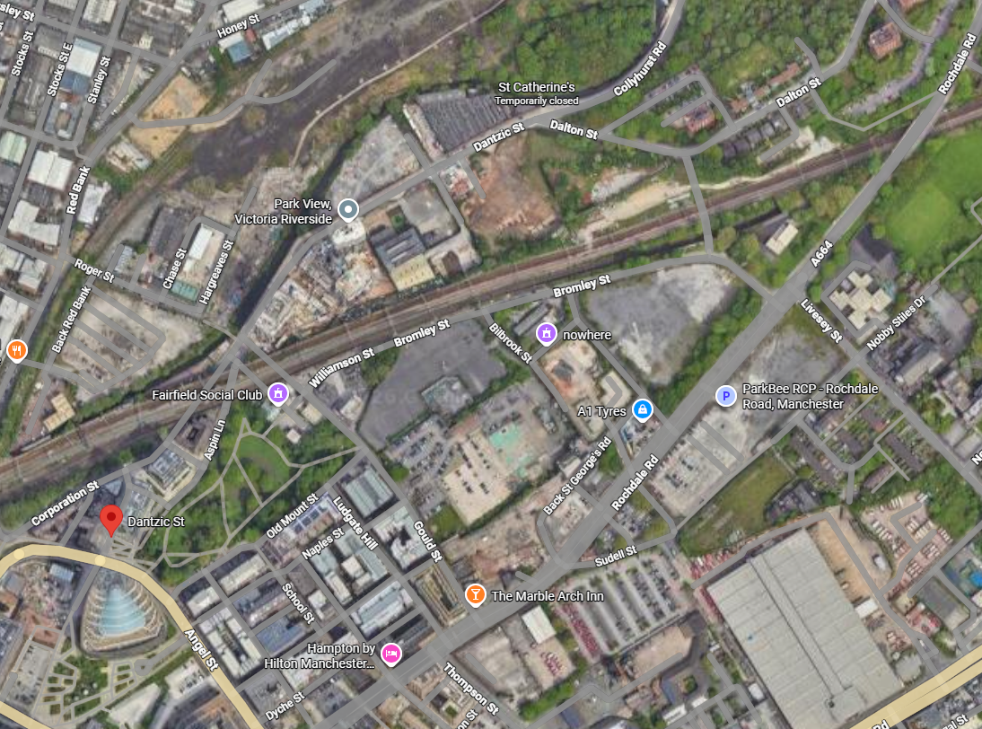

Construction Vehicle Routes to NT02 project off Dantzic Street, Manchester.
Key
Construction Traffic until Project Completion circa late 2028
CRUK Vehicle Routes
No go areas / routes for CRUK construction traffic
NT02 Project location
Phase 1 – Site – NT02 Project from May 2026 until late 2028
CRUK Traffic Routes

