Slide 1
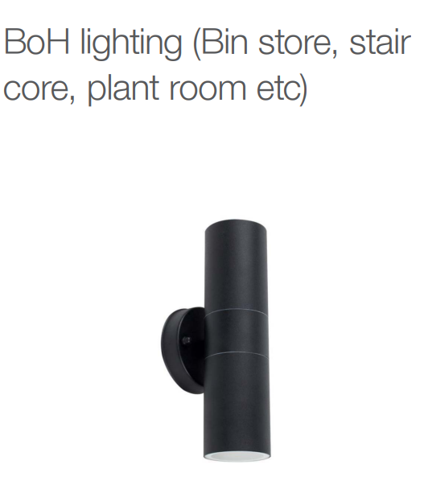
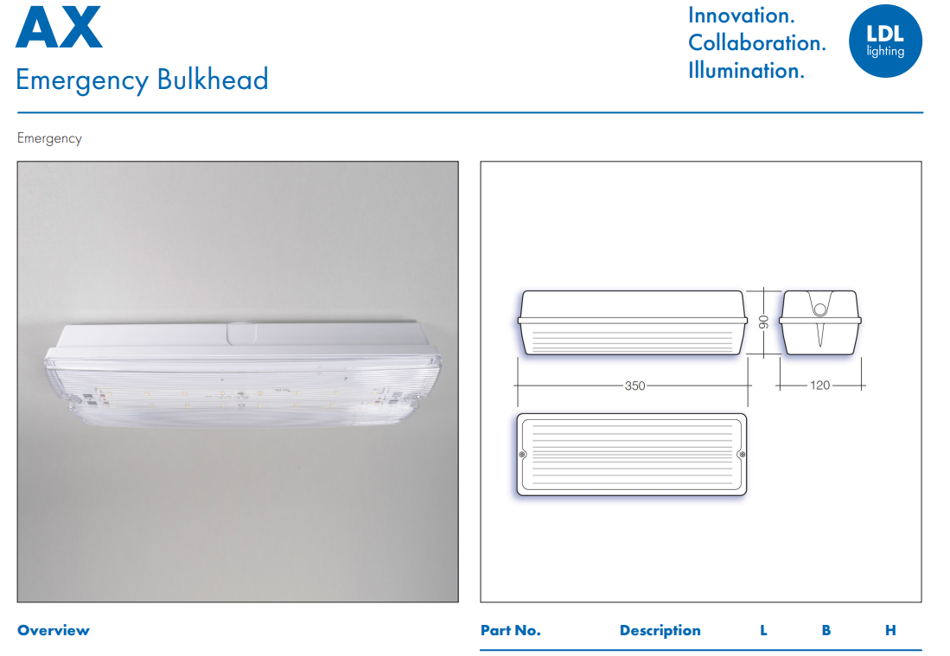
Emergency Bulkhead Lighting to Plant Rooms, Stair Core Emergency Exit

