Slide 1
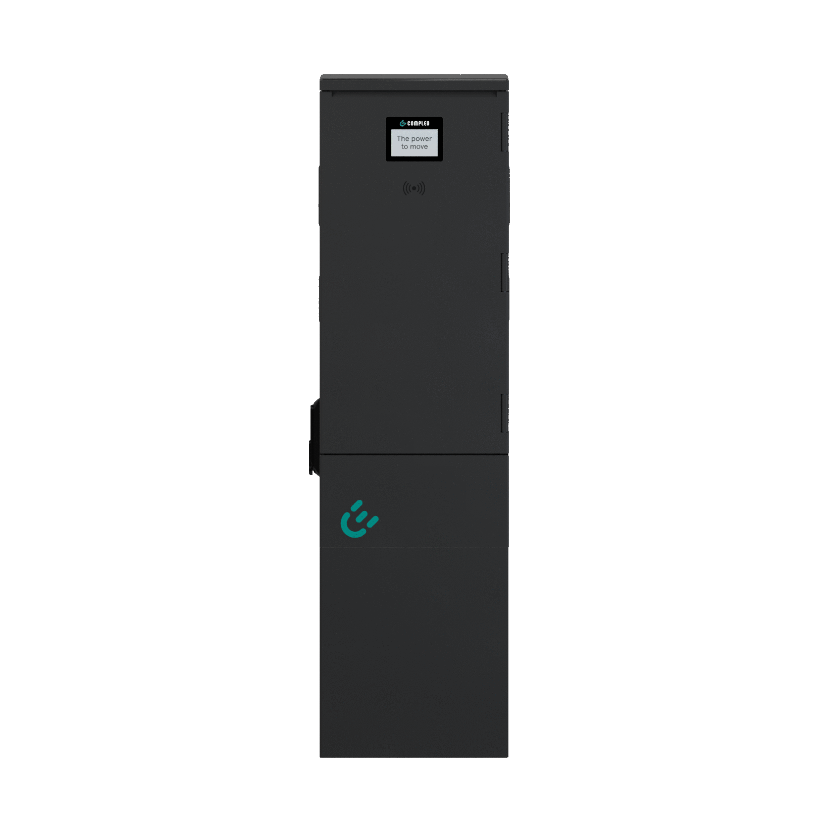
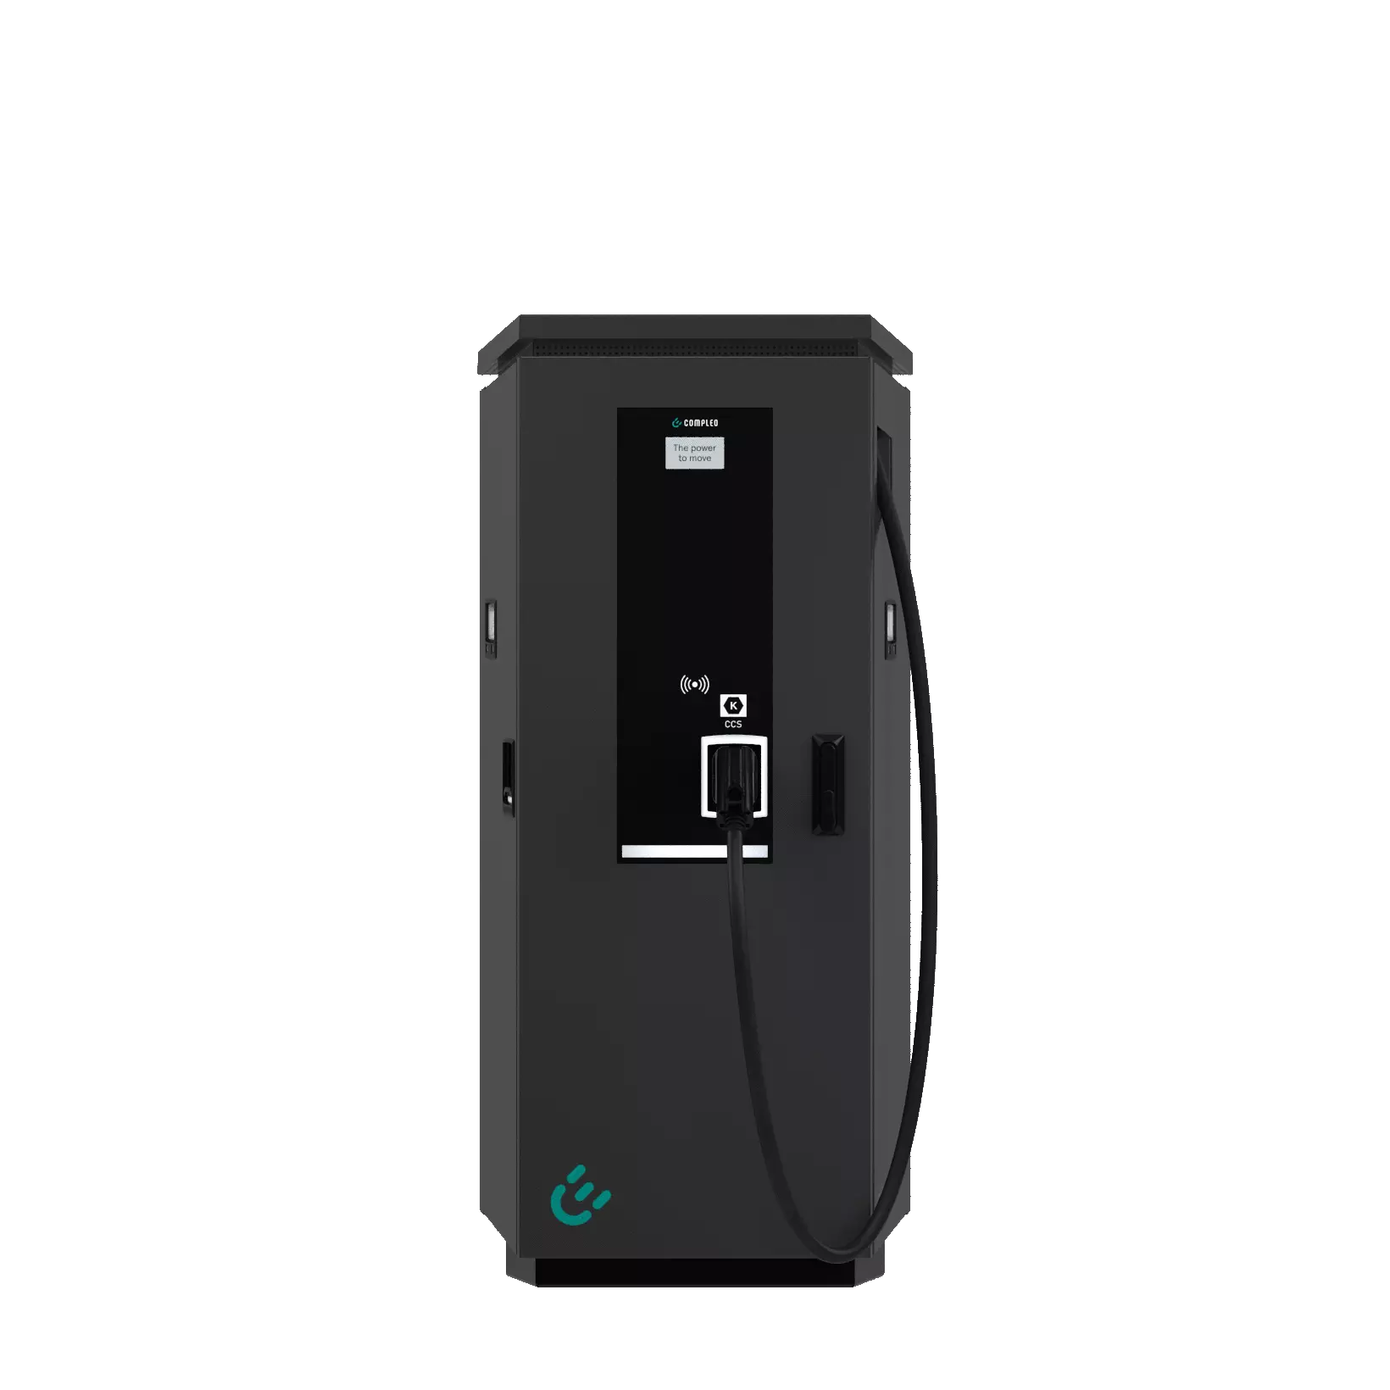
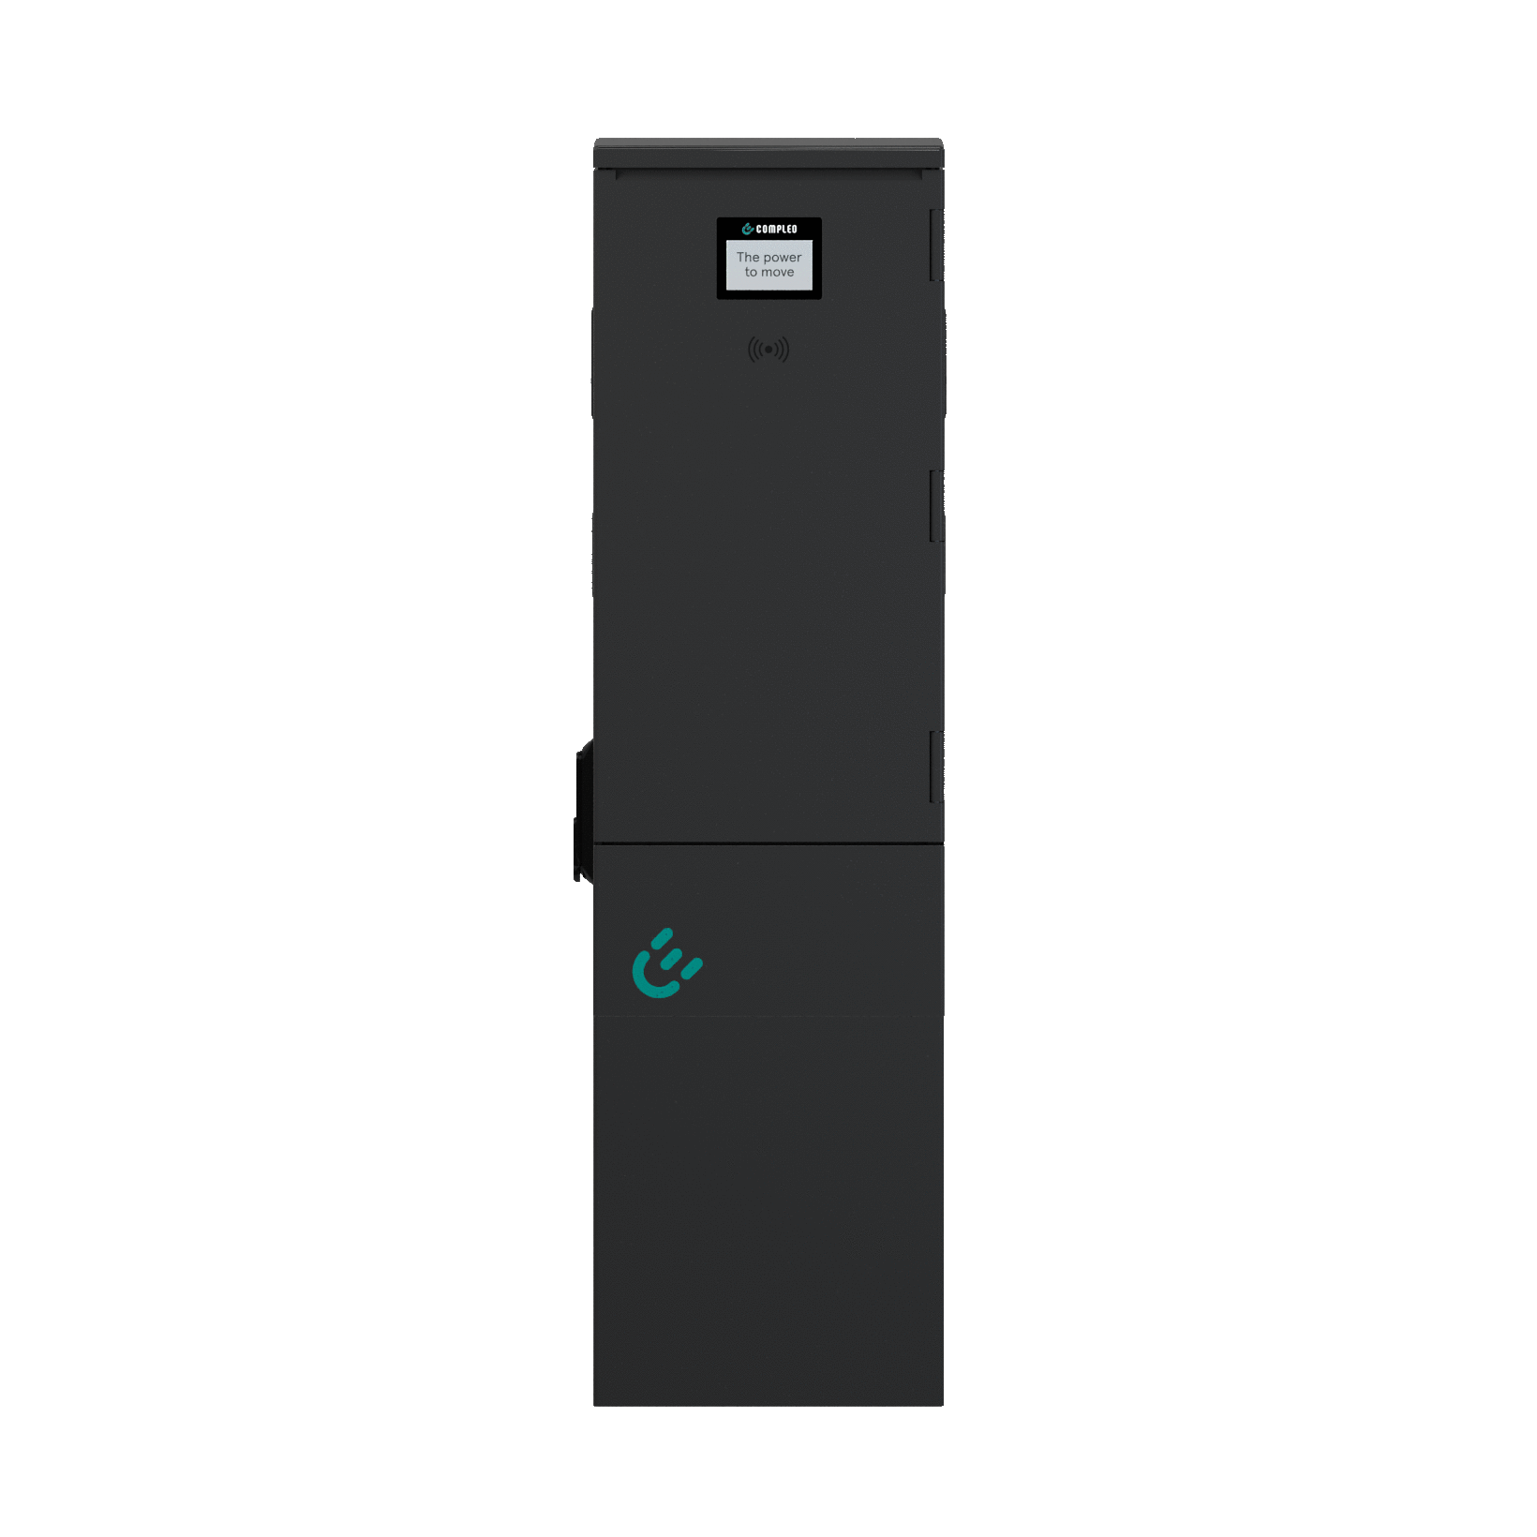
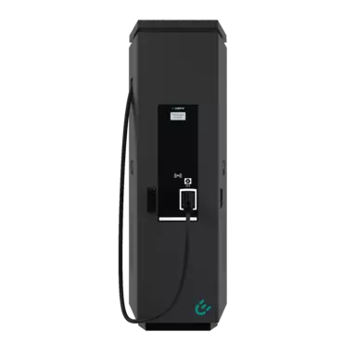
Compare our charging solutions
 | CITO 500 | DUO | CITO 240
Maximum charging power per charging point | AC: 22 kW; DC: 50 kW | 11/22 kW | AC: 22 kW; DC: 24 kW
Number of charging points | 2 - 3 | 2 | 2 - 3
Charging connector | 1x type 2 socket, 1x CCS charging lead (3.4 m); optional CHAdeMO charging lead (3.4 m) | 2x type 2 socket, incl. sliding cover; optional 2x type 2 spiral lead (6.5 m) | 1x type 2 socket, 1x CCS charging lead (3 m); optional CHAdeMO charging lead (3 m)
Compliant with calibration law | AC: MID-compliant smart meter with SAM® storage and display module; DC: with SAM® storage and display module | 2x MID-compliant smart meter; optional with SAM® storage and display module | AC: MID-compliant smart meter with SAM® storage and display module; DC: with SAM® storage and display module
Protection | AC: RCD type A & DC residual current detection 6 mA; DC: LS C100 | 2x RCD type A; 2x DC residual current detection 6 mA; 2x circuit breaker C20 3P or C40 3P; 1x circuit breaker B16 1P | AC: FI-Typ A & DC-Fehlerstromerkennung 6 mA; DC: LS C50
Communication interface to IT backends | OCPP 1.6 JSON | OCPP 1.6 JSON | OCPP 1.6 JSON
Authorisation | Free charging, RFID, smartphone app, optional: Giro-e | Free charging, RFID, smartphone app, optional: Giro-e | Free charging, RFID, smartphone app, optional: Giro-e

