Slide 1
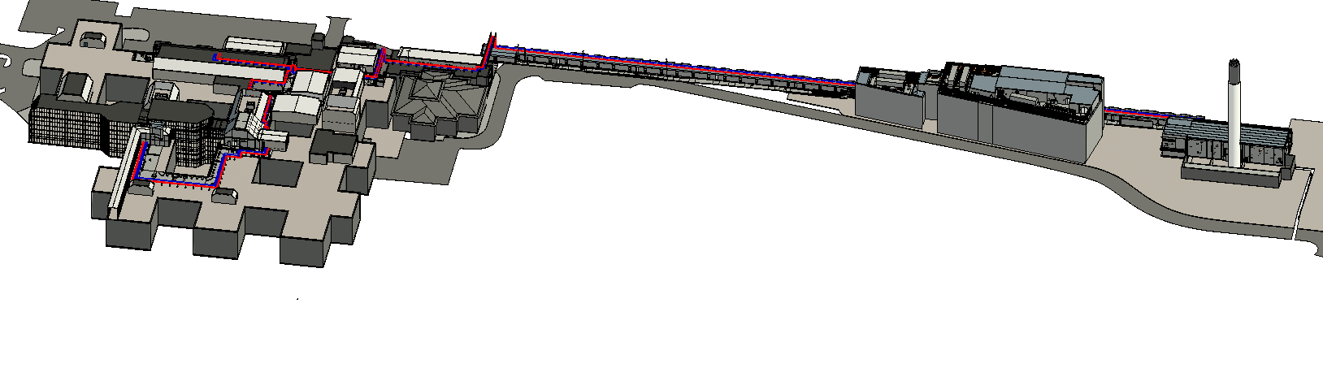
MRI – 2201 – Steam and Condesnate Planning Drawings
3D Visual of the extent of the proposed steam and condensate pipe work routes

Slide 2
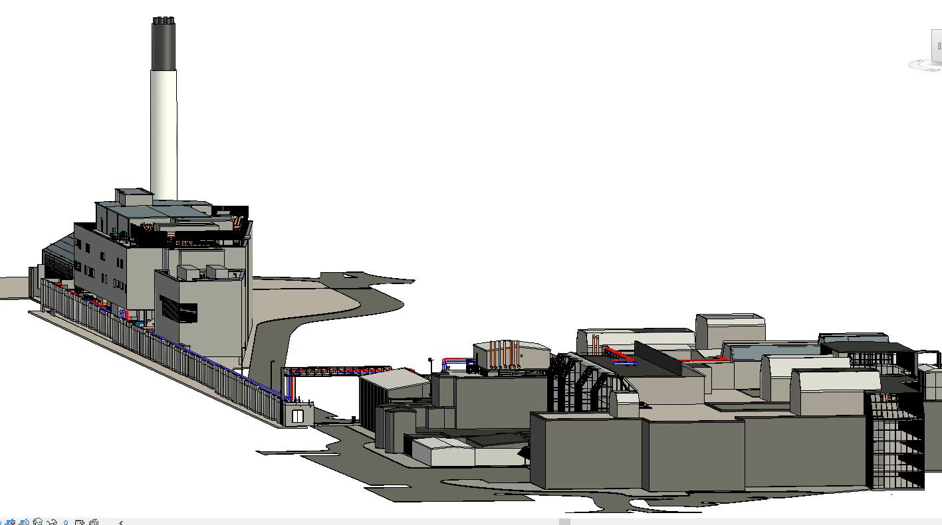
MRI – 2201 – Steam and Condesnate Planning Drawings
3D Visual of the extent of the proposed steam and condensate pipe work routes

Slide 3
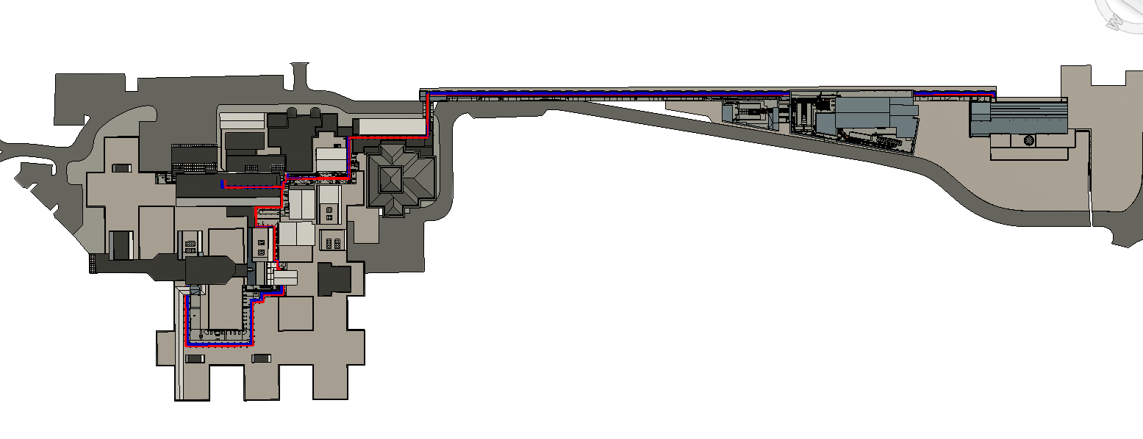
North Road
Crossing
ICON building
Rood Route
FMC Building
Energy centre
Crinkly Tin
Crinkly Tin
Phase I&II Roof
Mounted Pipework
MRI – 2201 – Steam and Condensate Planning Drawings
Plan of the extent of the proposed steam and condensate pipe work routes

Slide 4
Section AA
Section BB
Section CC
MRI – 2201 – Steam and Condensate Planning Drawings
Plan of the extent of the proposed steam and condensate pipe work routes

Slide 5
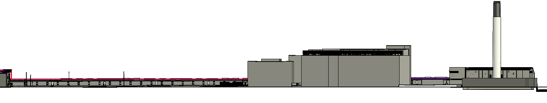
MRI – 2201 – Steam and Condensate Planning Drawings
Section

