Slide 1
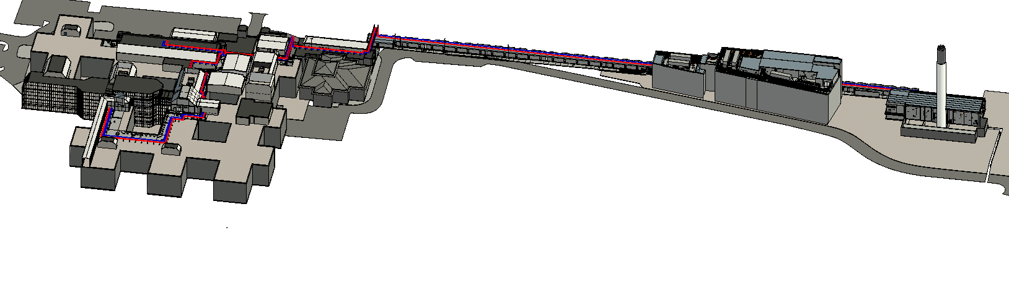
MRI – 2201 – Steam and Condensate Planning Drawings
3D Visual of the extent of the proposed steam and condensate pipe work routes

Slide 2
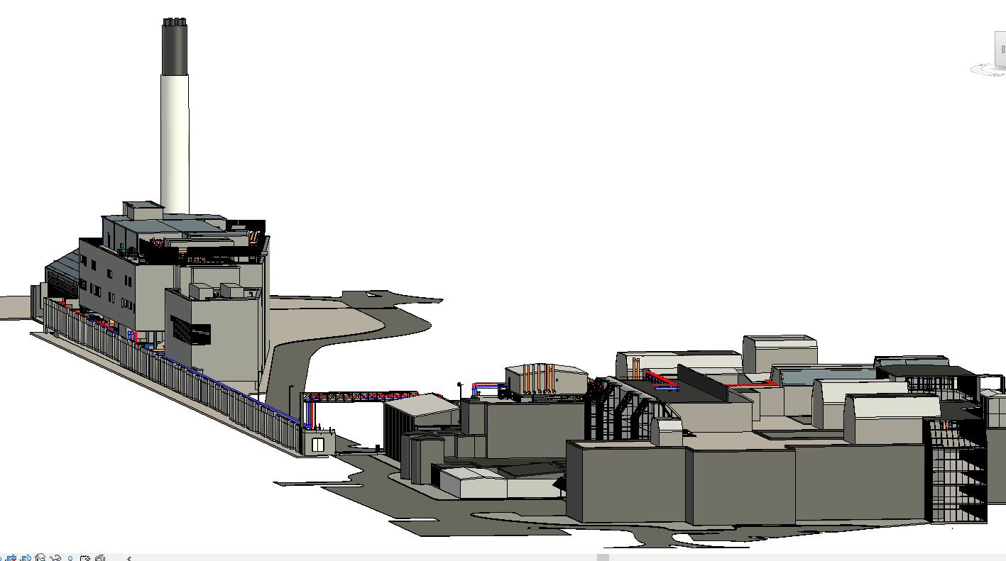
MRI – 2201 – Steam and Condensate Planning Drawings
3D Visual of the extent of the proposed steam and condensate pipe work routes

Slide 3
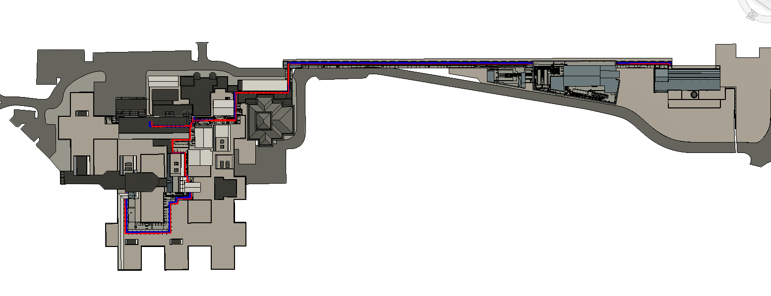
North Road
Crossing
ICON building
Rood Route
FMC Building
Energy centre
Crinkly Tin
Crinkly Tin
Phase I&II Roof
Mounted Pipework
MRI – 2201 – Steam and Condensate Planning Drawings
Plan of the extent of the proposed steam and condensate pipe work routes

Slide 4
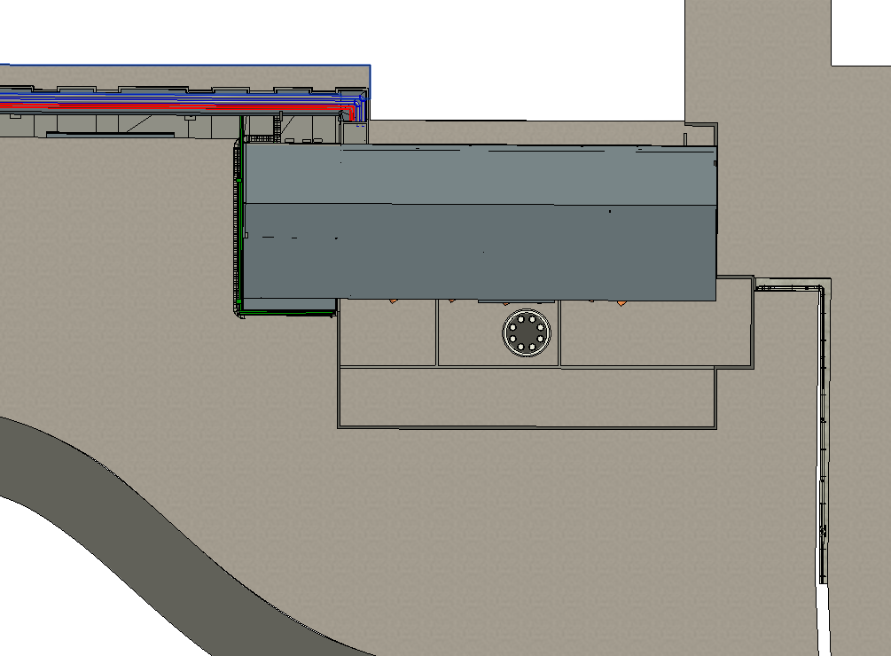
MRI – 2201 – Steam and Condensate Planning Drawings
Energy Centre

Slide 5
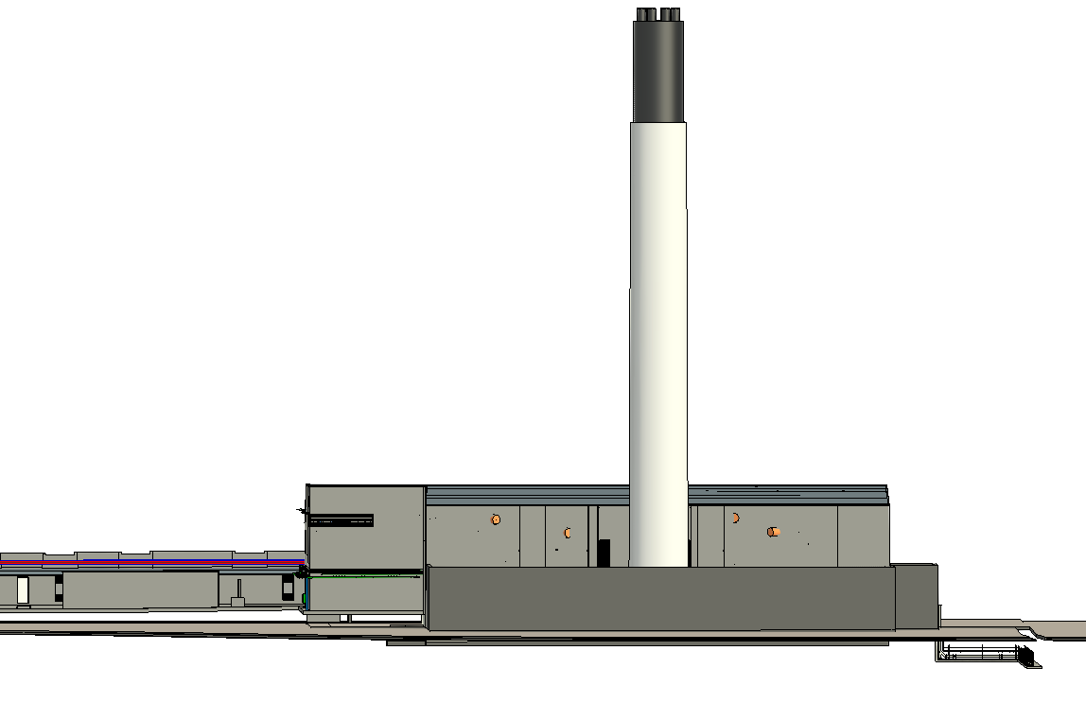
MRI – 2201 – Steam and Condensate Planning Drawings
Energy Centre

Slide 6
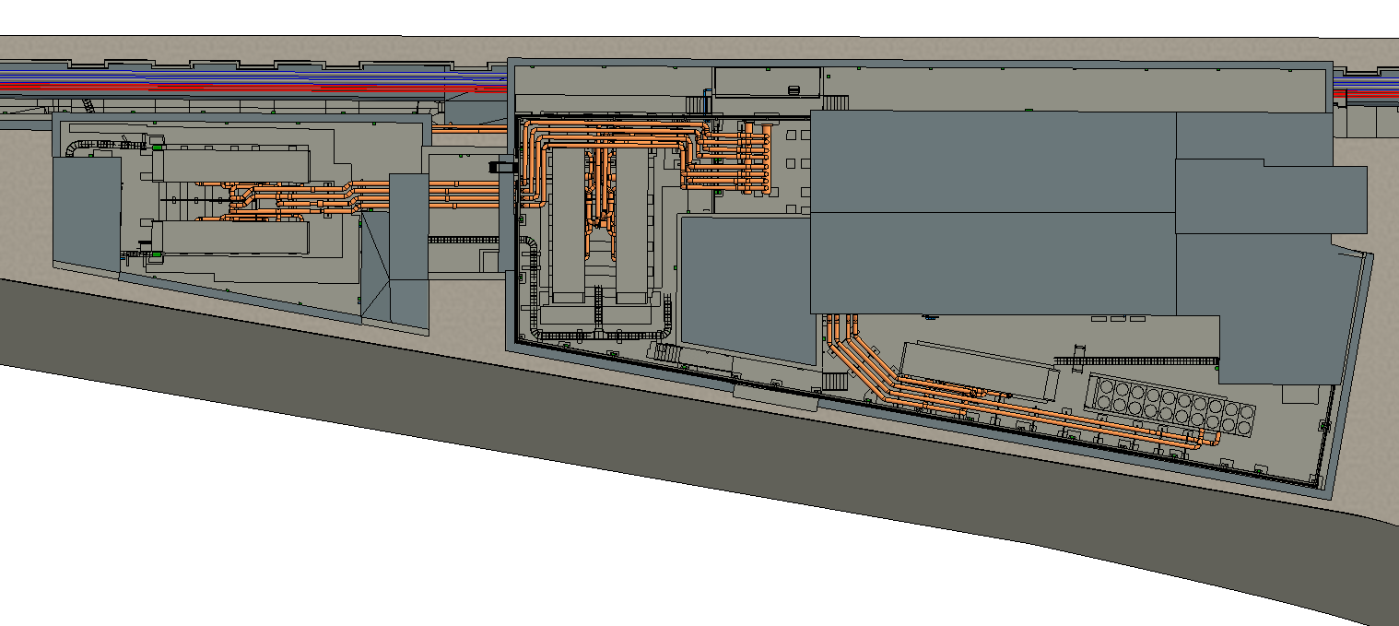
MRI – 2201 – Steam and Condensate Planning Drawings
FMC Building

Slide 7
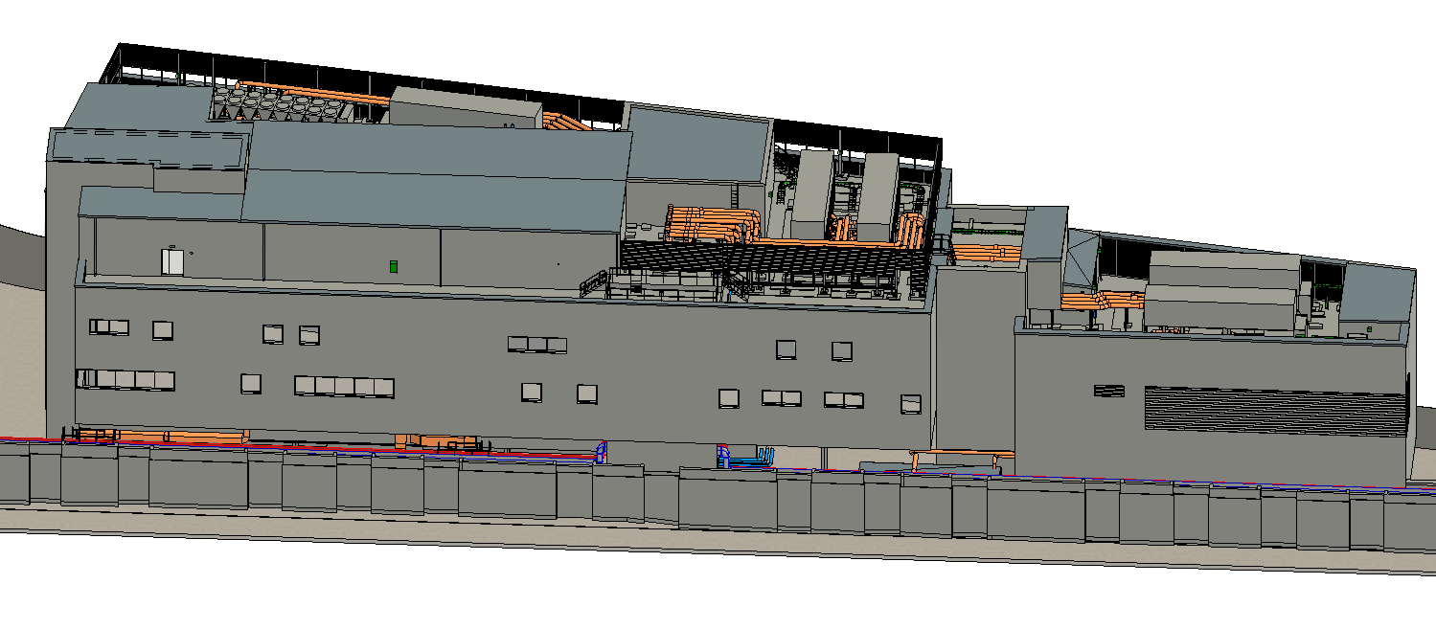
MRI – 2201 – Steam and Condensate Planning Drawings
FMC Building

Slide 8
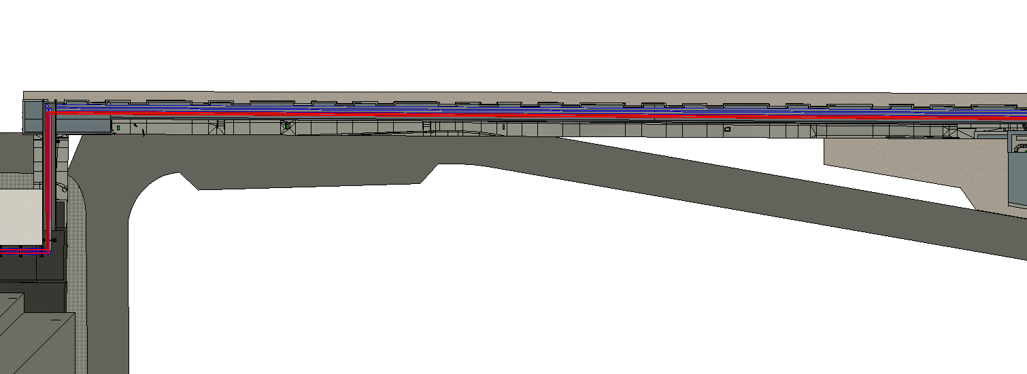
MRI – 2201 – Steam and Condensate Planning Drawings
Crinkly Tin

Slide 9
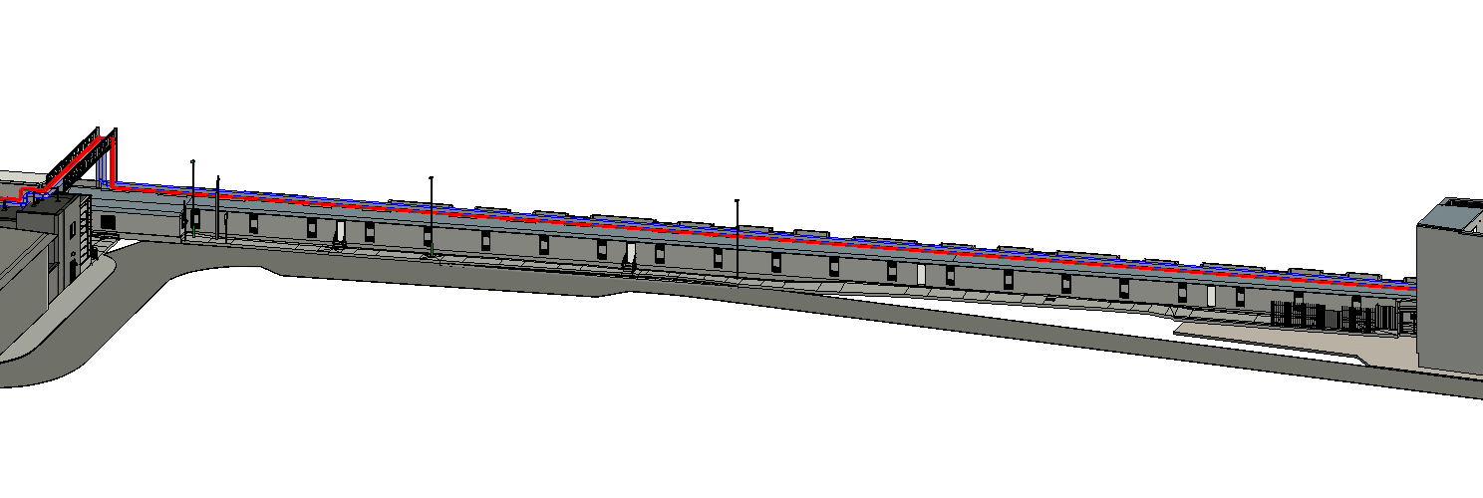
MRI – 2201 – Steam and Condensate Planning Drawings
Crinkly Tin

Slide 10
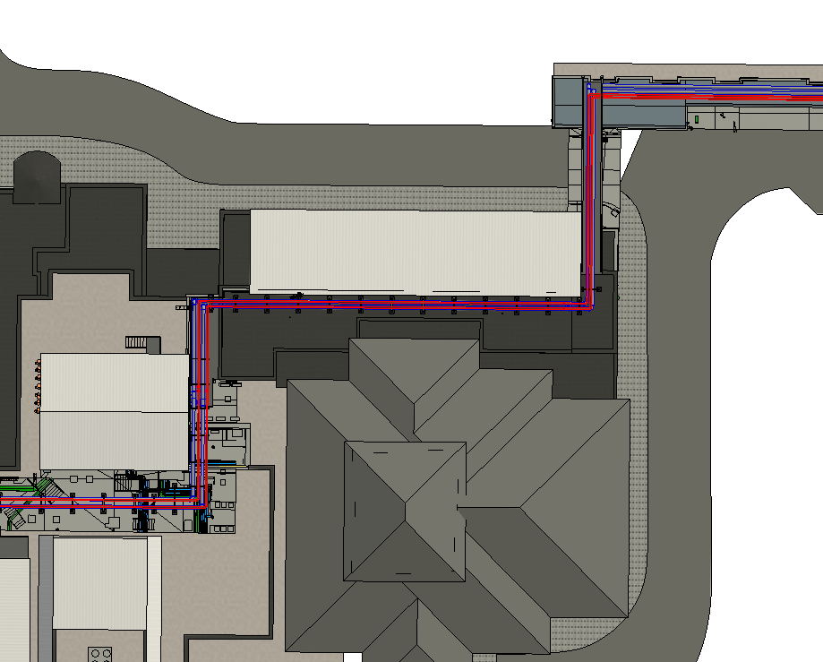
MRI – 2201 – Steam and Condensate Planning Drawings
North Road Crossing

Slide 11
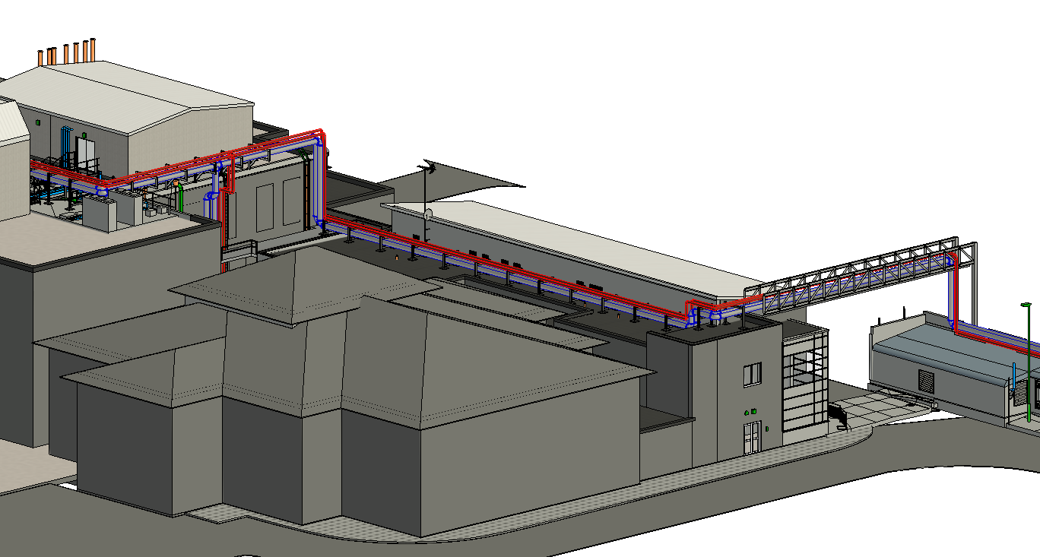
MRI – 2201 – Steam and Condensate Planning Drawings
North Road Crossing

Slide 12
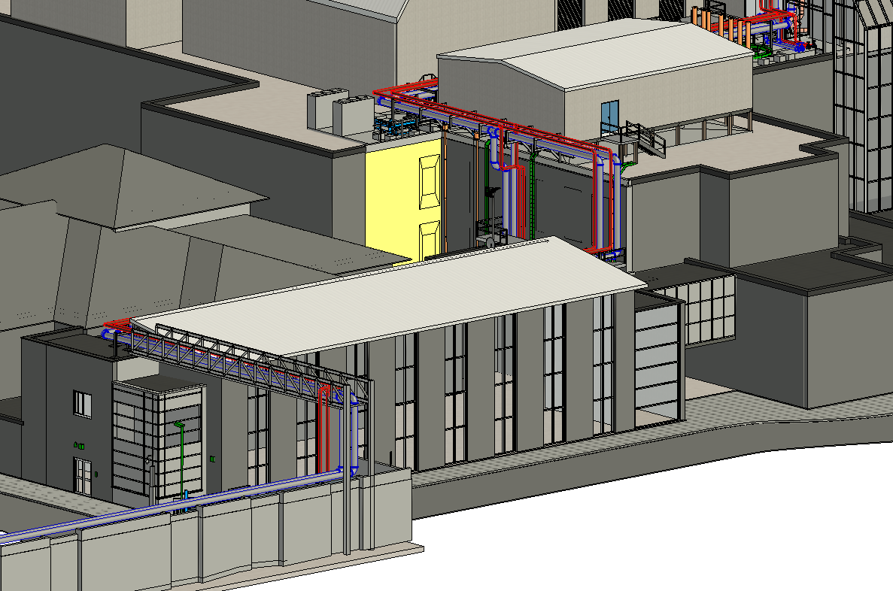
MRI – 2201 – Steam and Condensate Planning Drawings
North Road Crossing

Slide 13
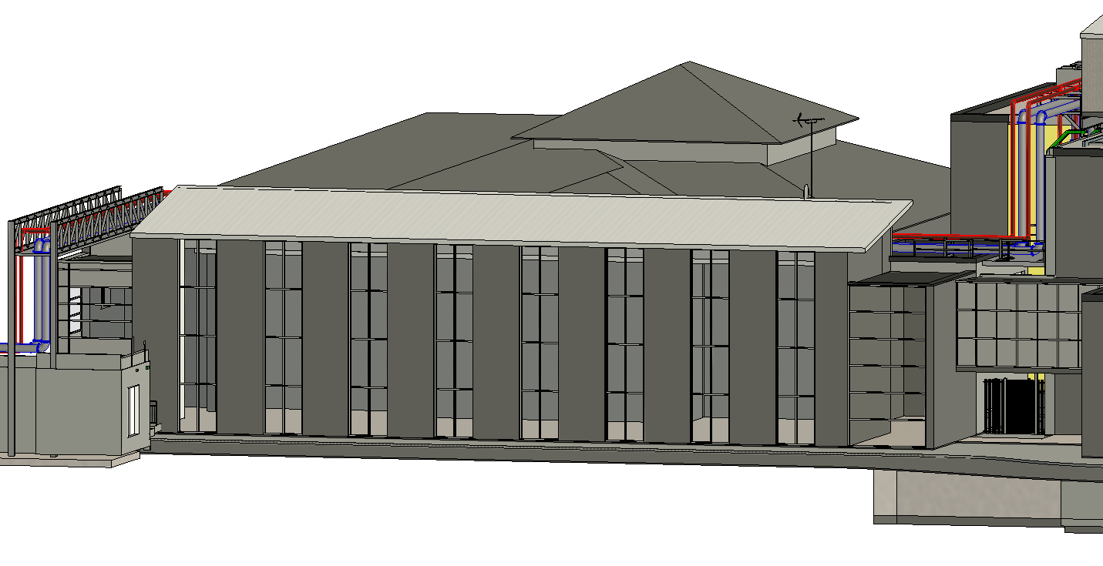
MRI – 2201 – Steam and Condensate Planning Drawings
North Road Crossing

Slide 14
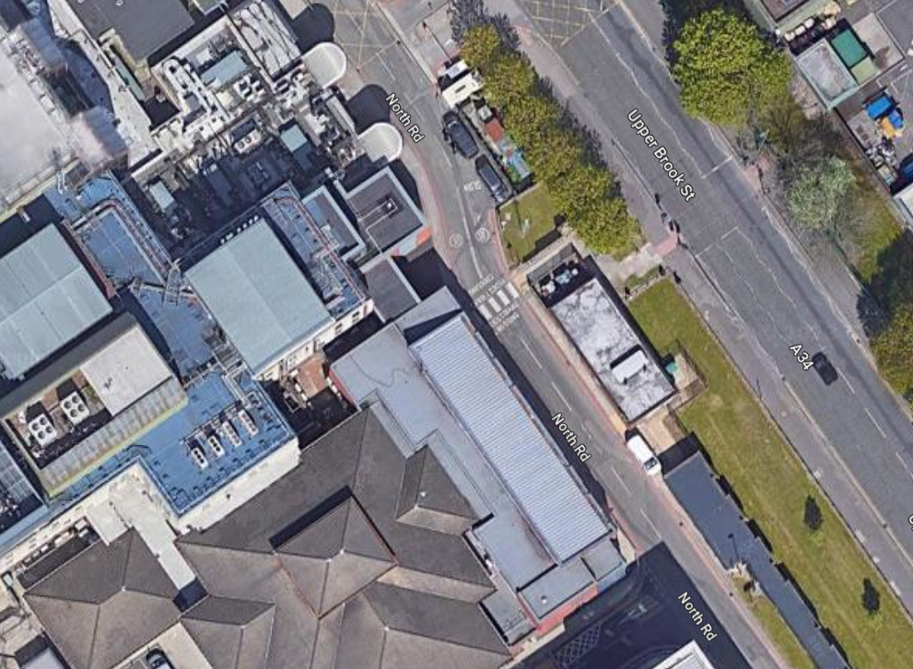
MRI – 2201 – Steam and Condensate
Discuss North Road Crossing

Slide 15
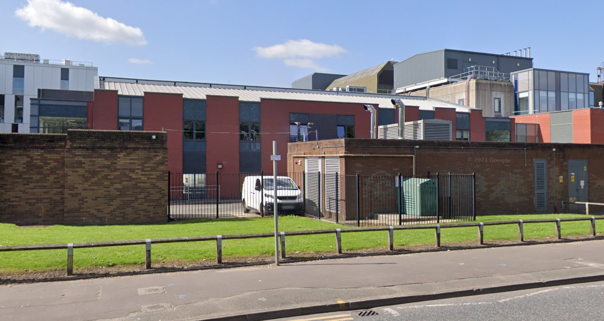
MRI – 2201 – Steam and Condensate
Discuss North Road Crossing

Slide 16
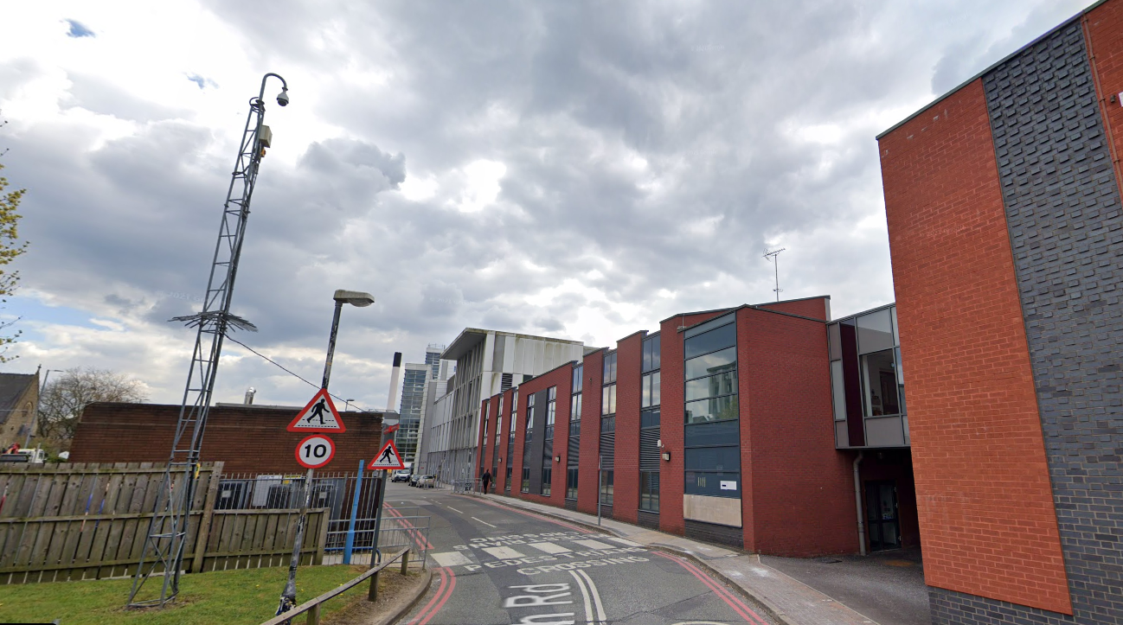

Slide 17
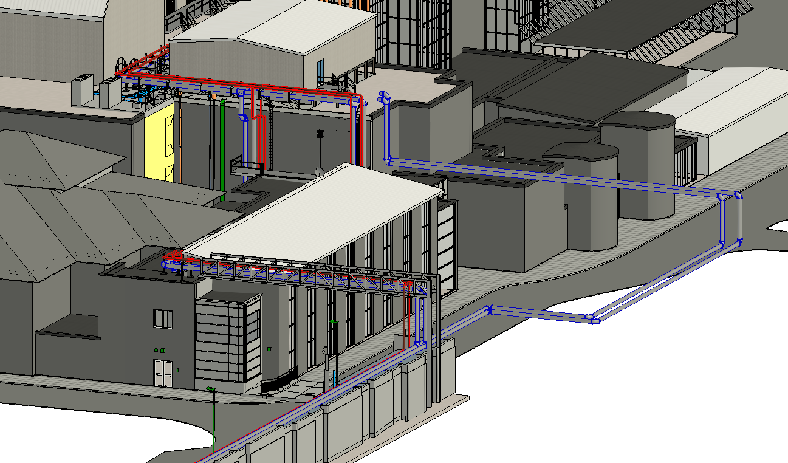
MRI – 2201 – Steam and Condensate
Discuss North Road Crossing

Slide 18
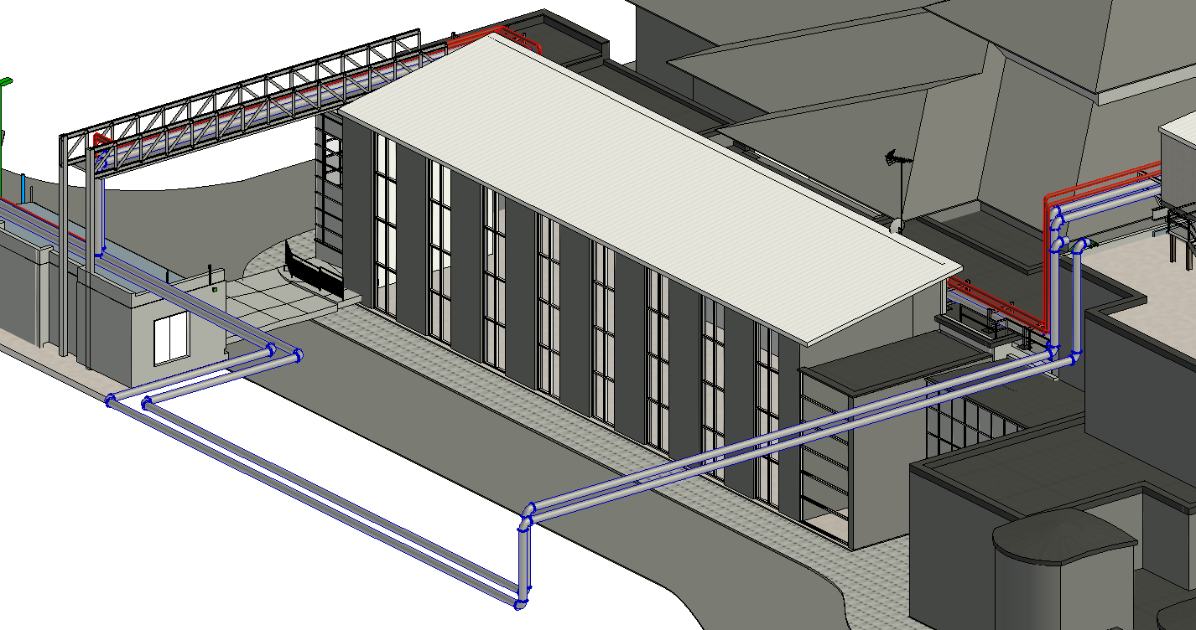
MRI – 2201 – Steam and Condensate
Discuss North Road Crossing

Slide 19
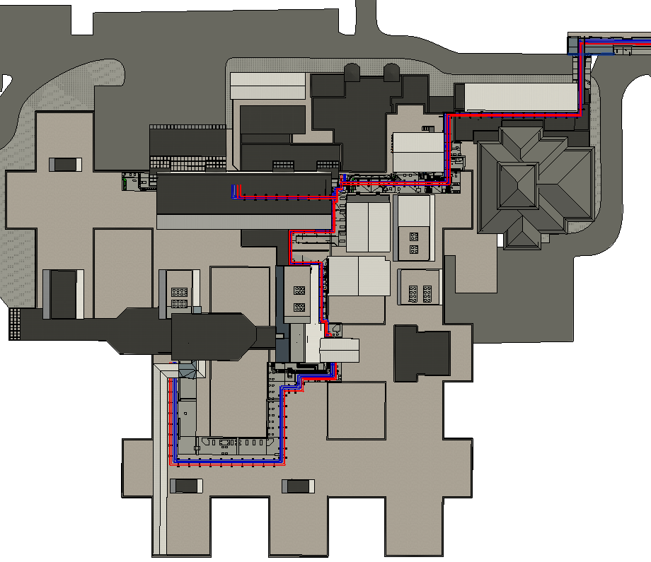
MRI – 2201 – Steam and Condensate
Phase I&II

Slide 20
Phase I&II Roof
Drop to Plantroom 10
- ICON
- Xray
CT Scan
Phase I&II Roof
Plantroom 9 Proposed
New Kit
Phase I&II Roof
Drop to Plantroom 10
- FMC
- West Side of Site
MRI – 2201 – Steam and Condensate
Phase I&II

