Slide 1
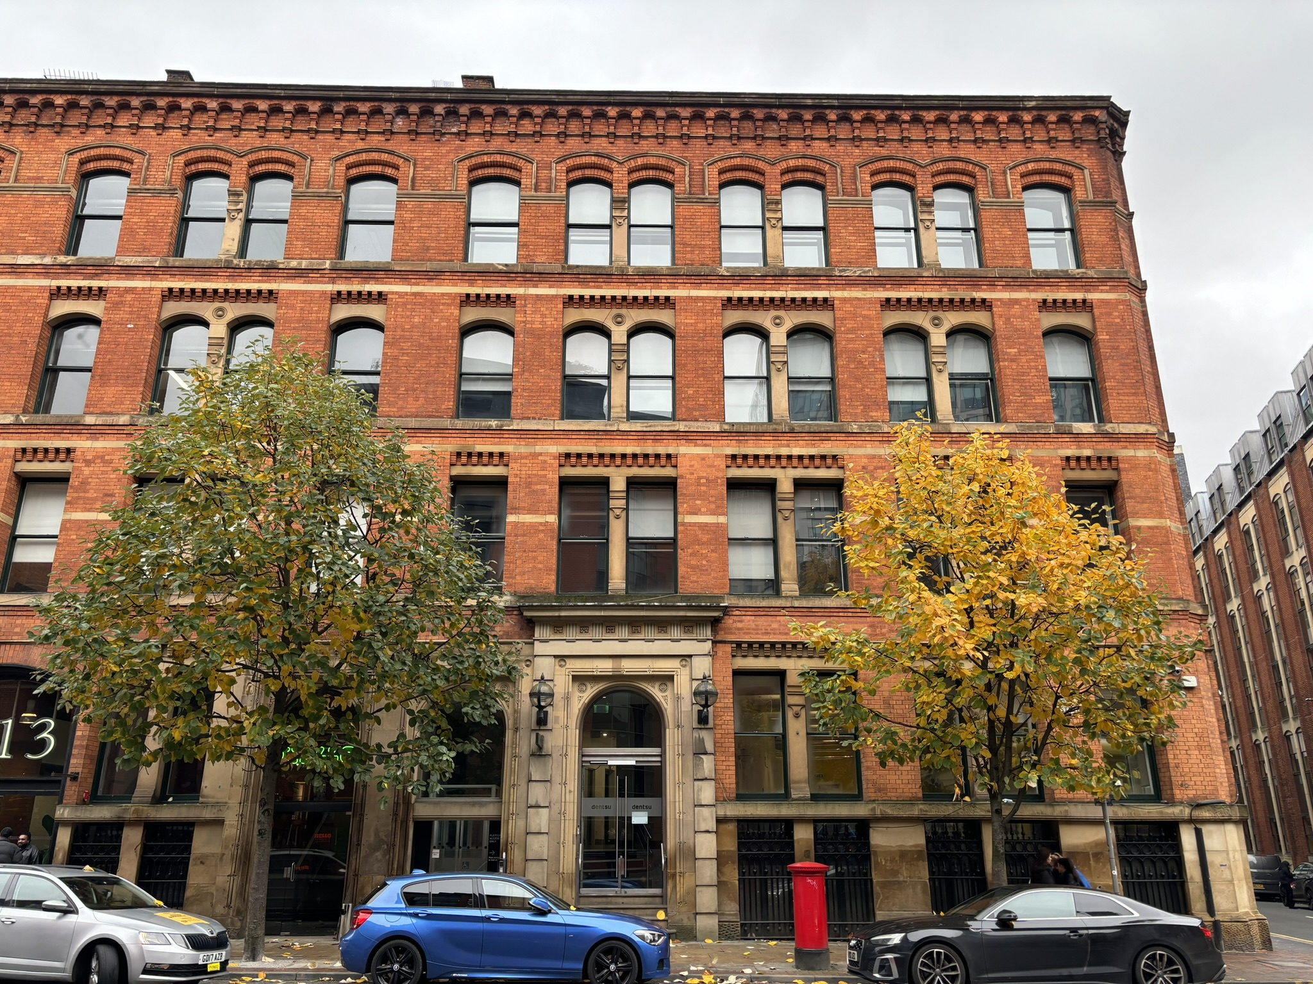
Portland Street
Lighting & Security
Kaizen Consulting engineers

Slide 2
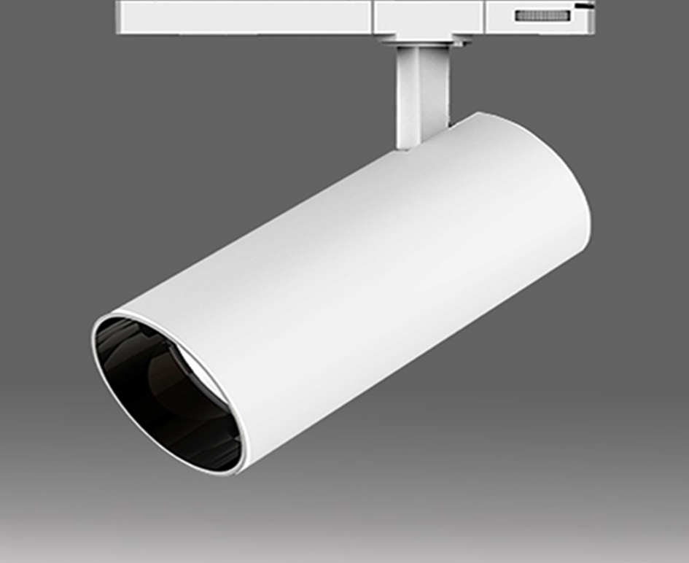
Fitting: Leila

Slide 3
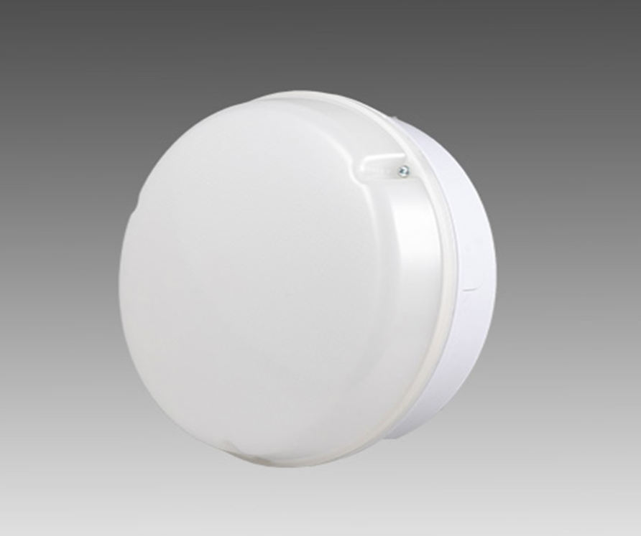
Fitting: LDB

Slide 4
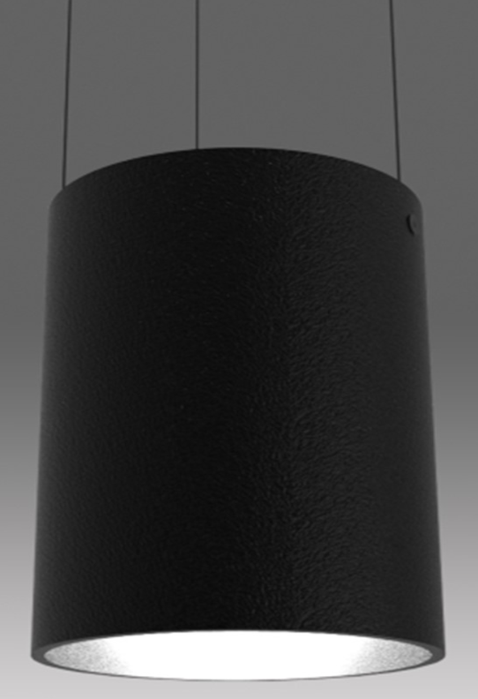
Fitting: Dominique
Suspended

Slide 5
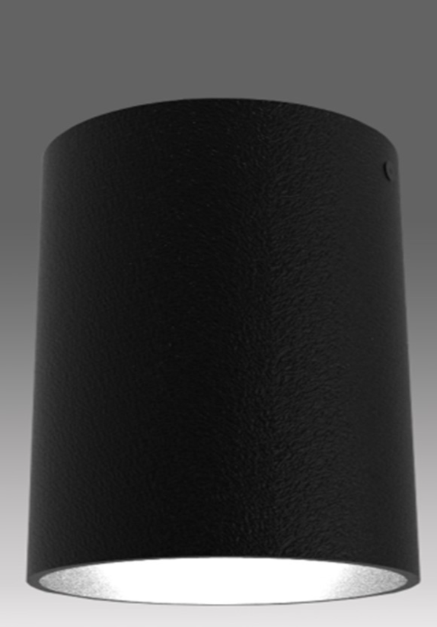
Fitting: Dominique

Slide 6
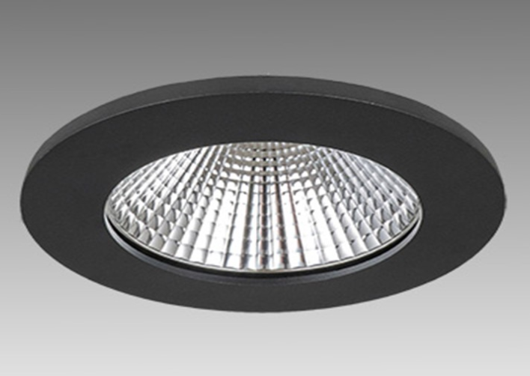
Fitting: Juna

Slide 7
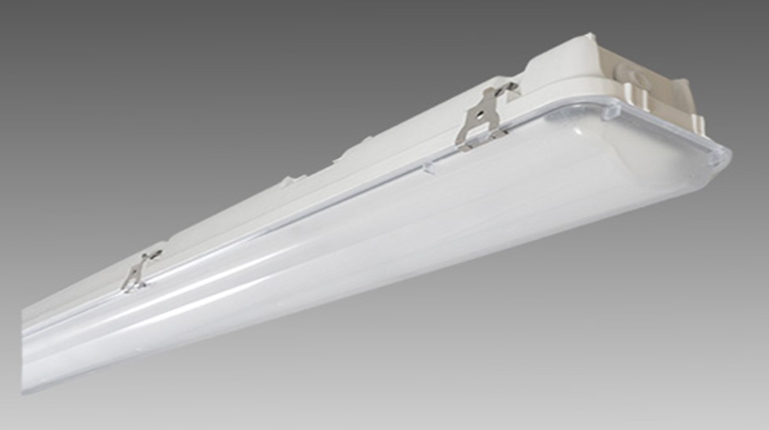
Fitting: WPZ

Slide 8
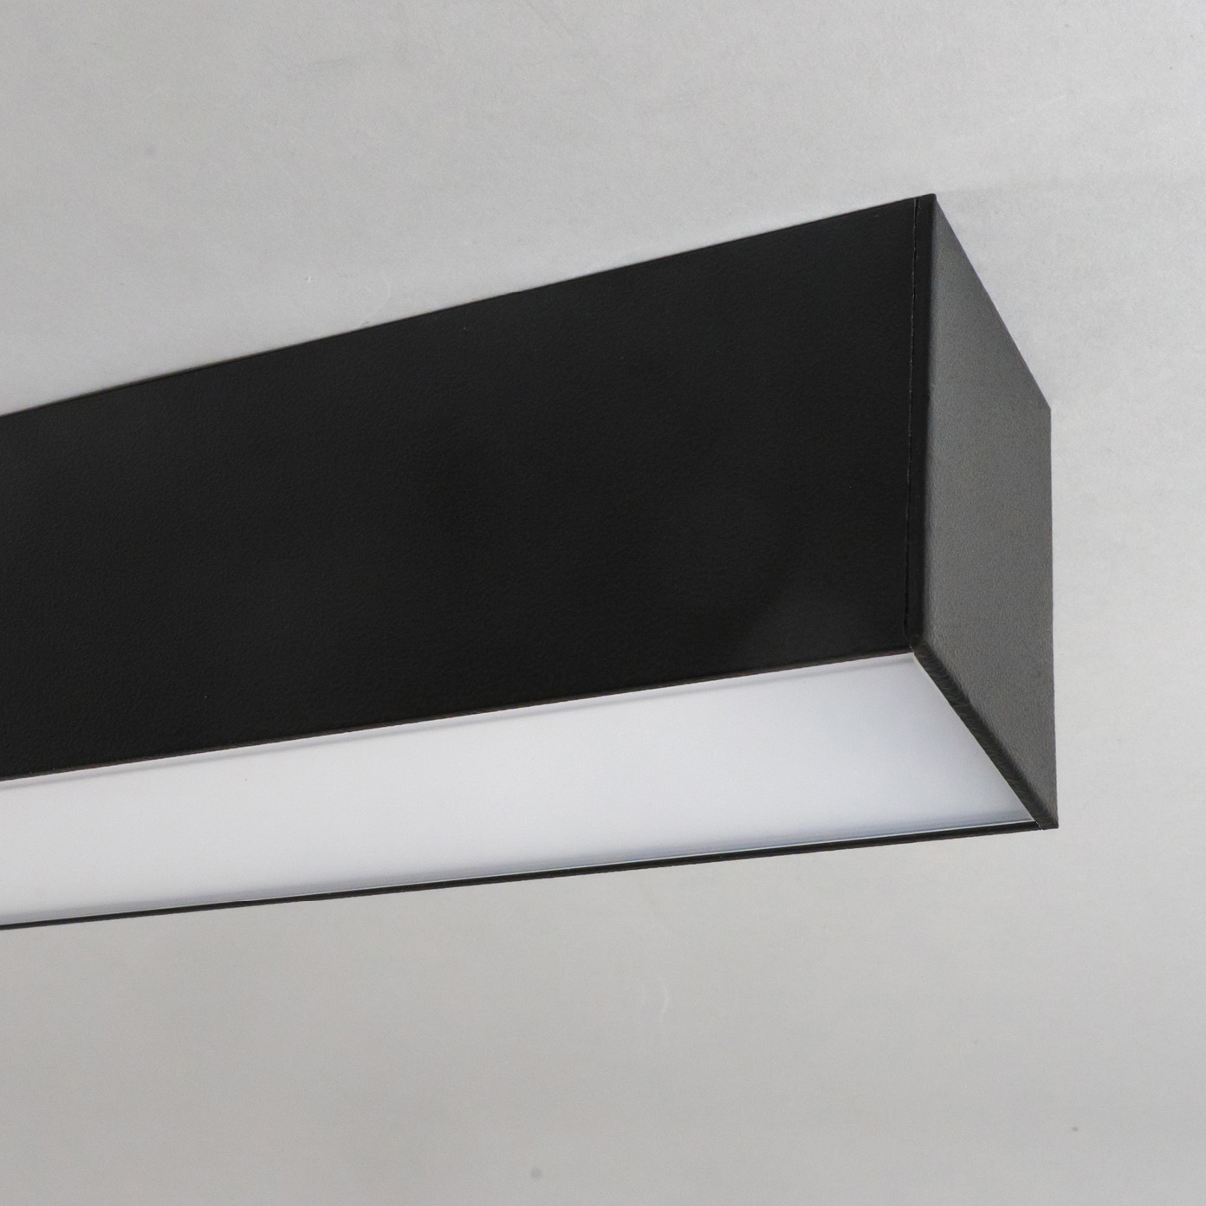
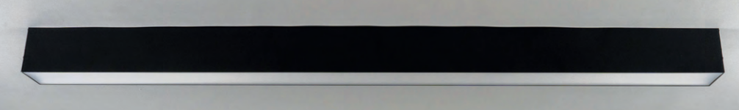
Fitting: Millie Suspended

Slide 9
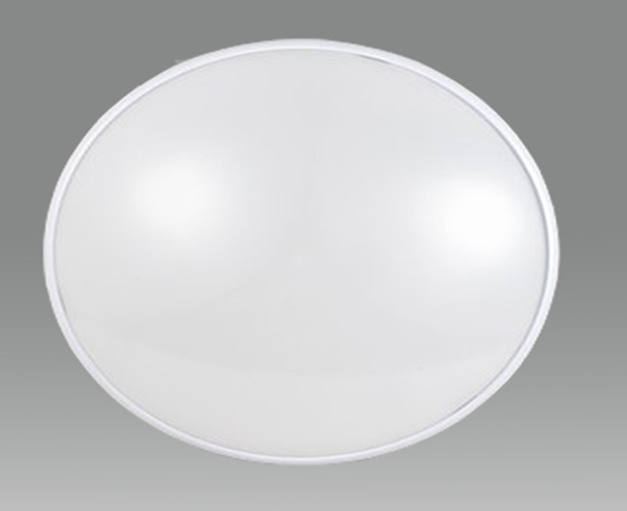
Fitting: ZMP

Slide 10
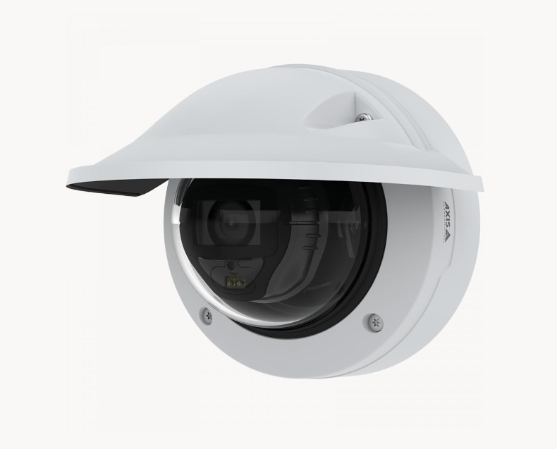
Camera: P32 Dome

Slide 11
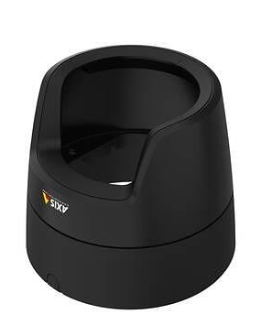
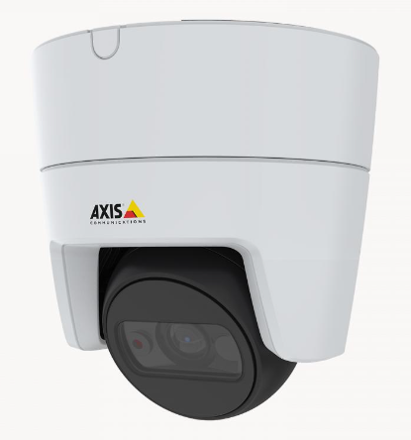
Camera: M31 Dome

Slide 12
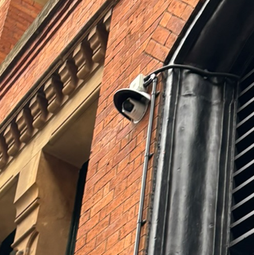
Camera: Existing External

