Slide 1
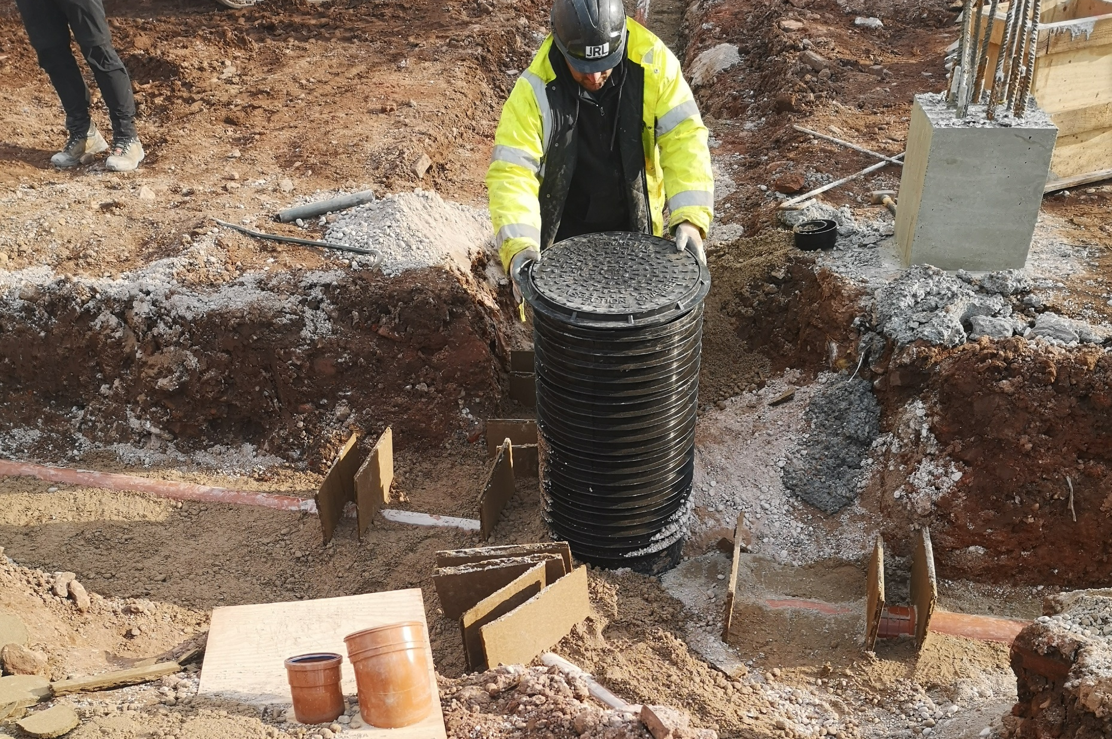
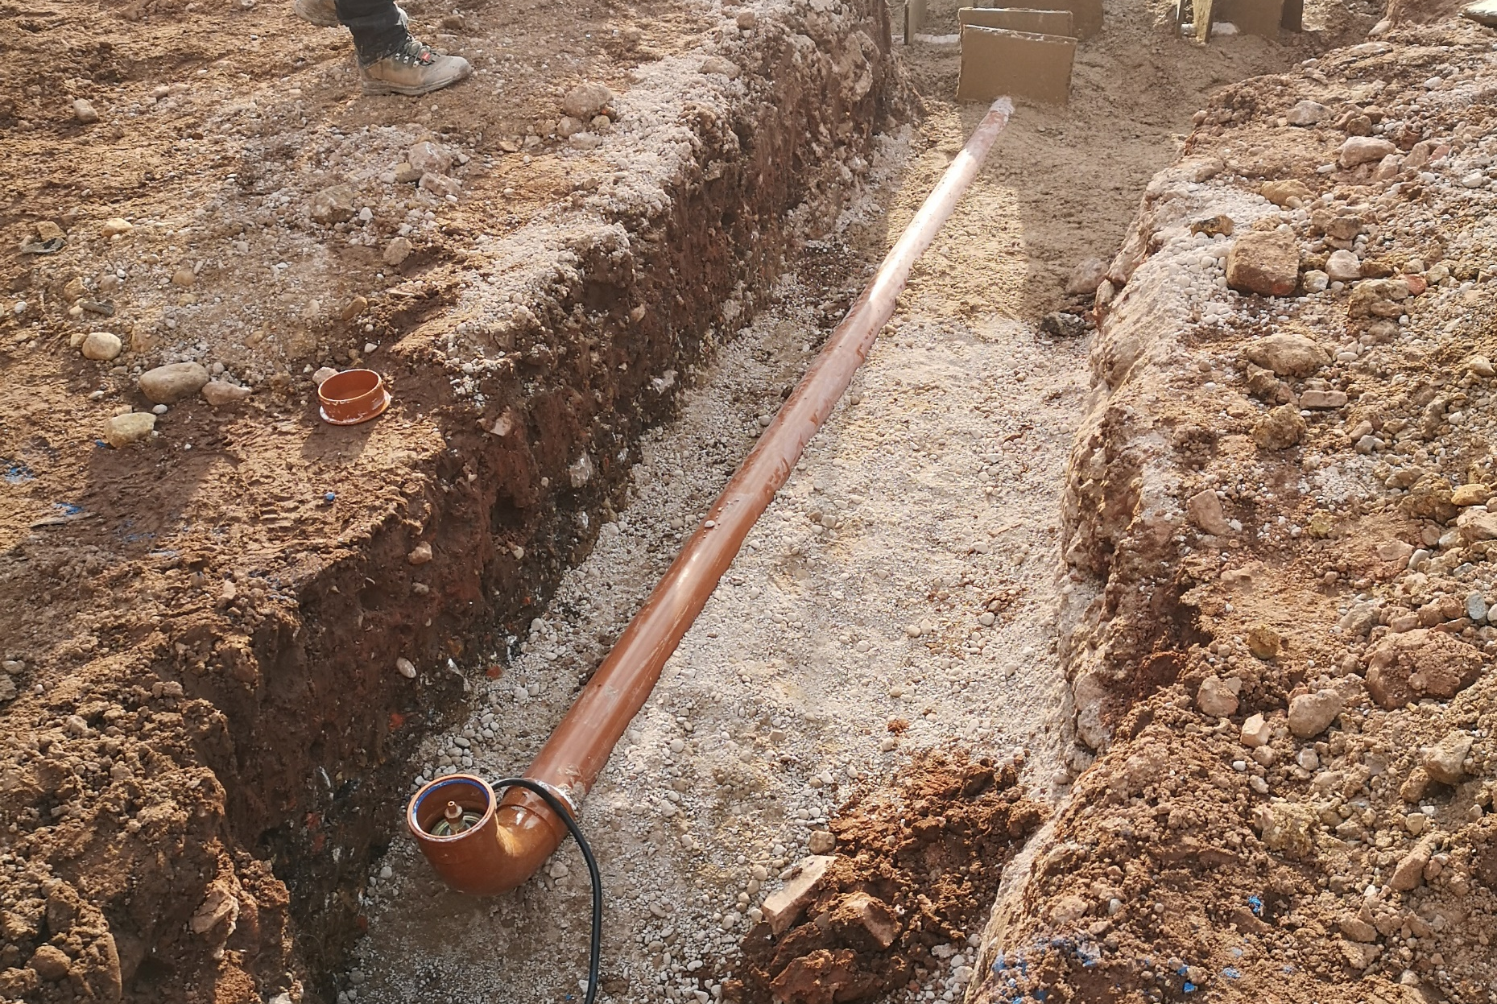
4212 Victoria Riverside
IMAGE SIZE
08.03.2022
IMAGE SIZE
08.03.2022

Slide 2
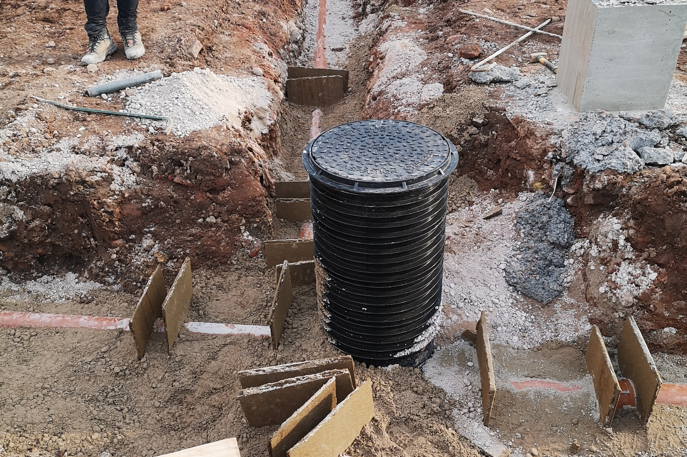
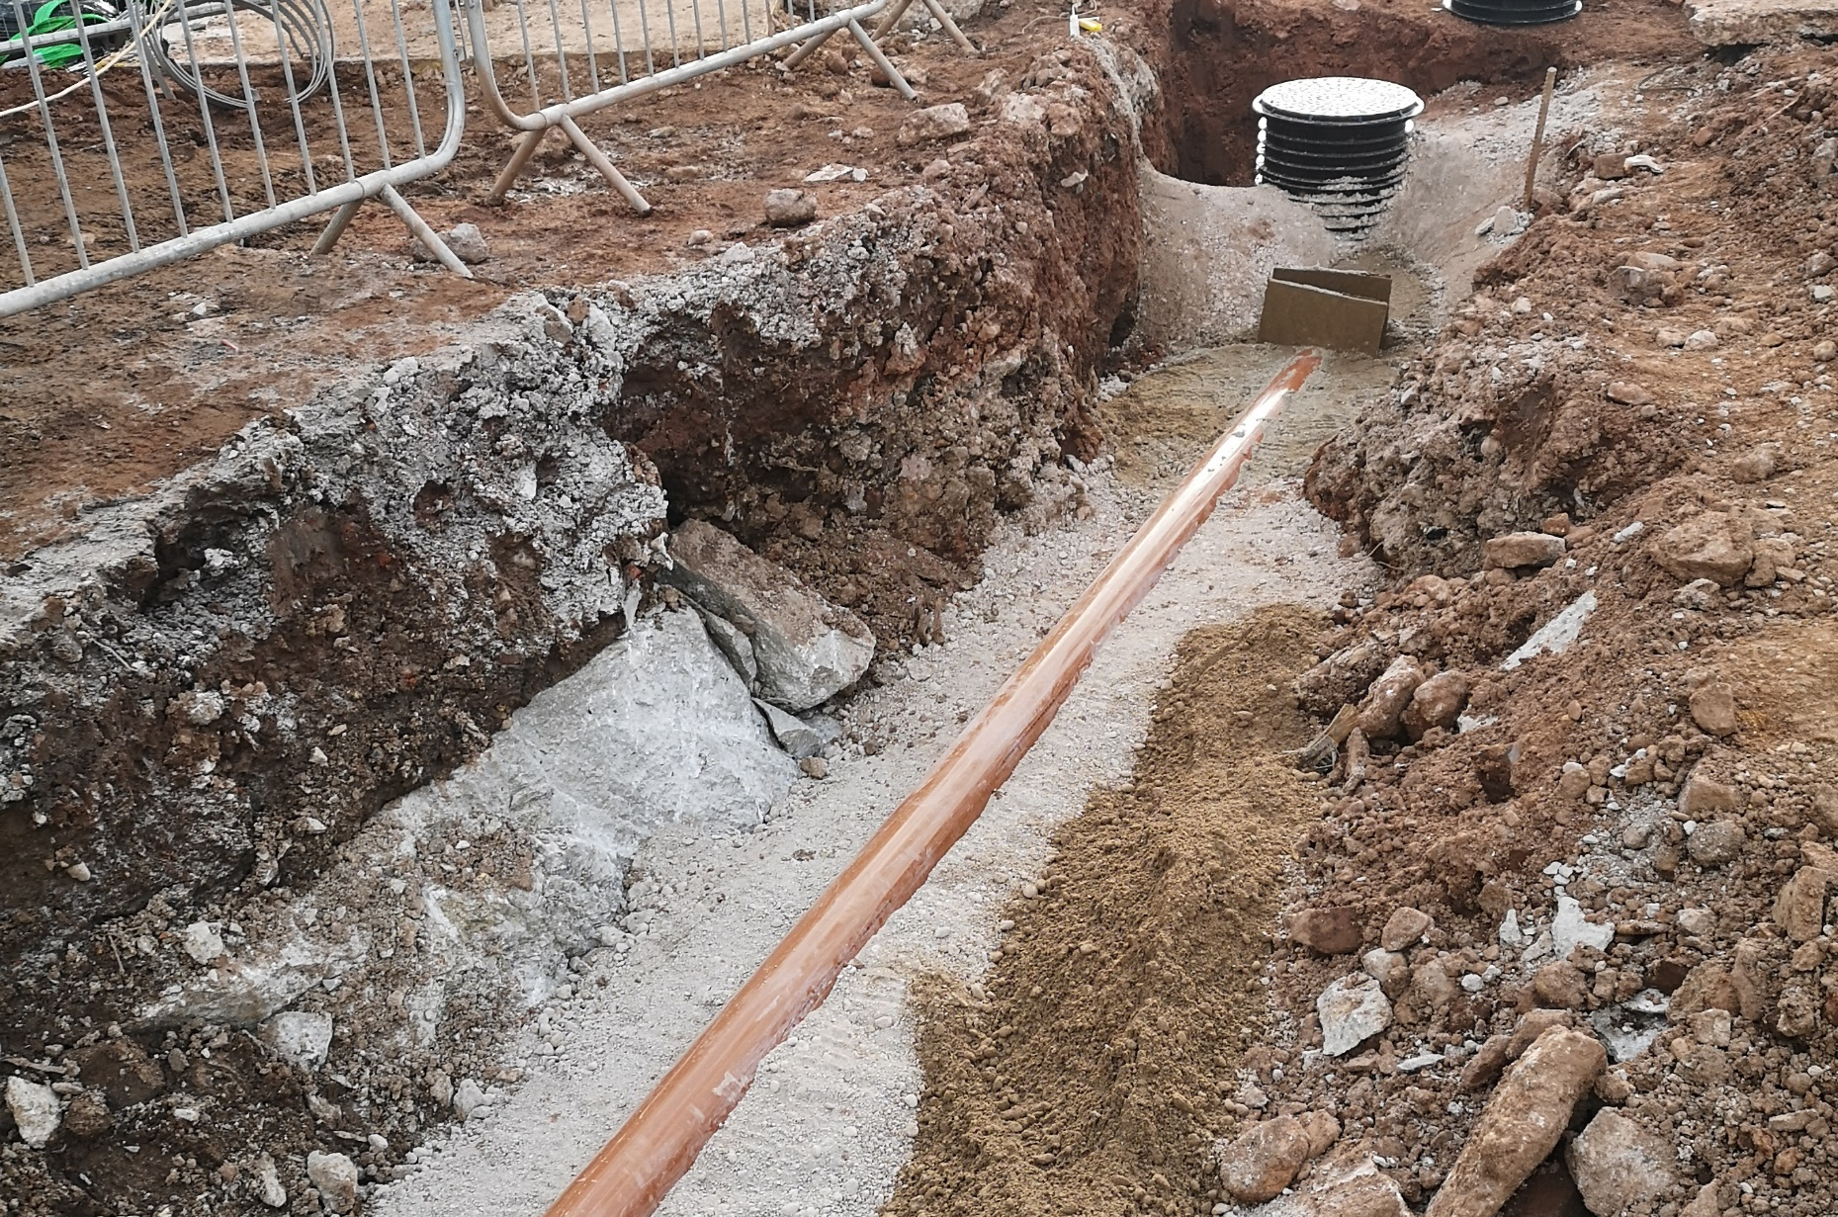
4212 Victoria Riverside
IMAGE SIZE
08.03.2022
IMAGE SIZE
08.03.2022

Slide 3
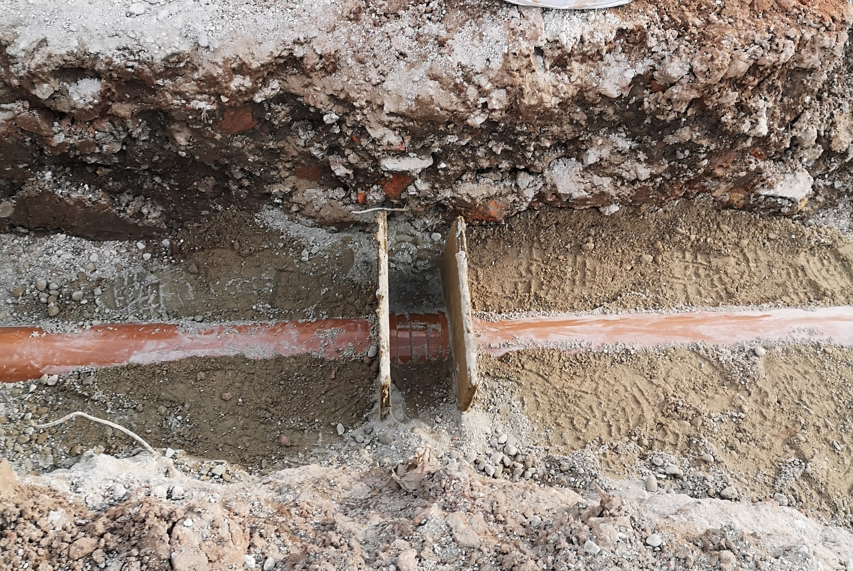
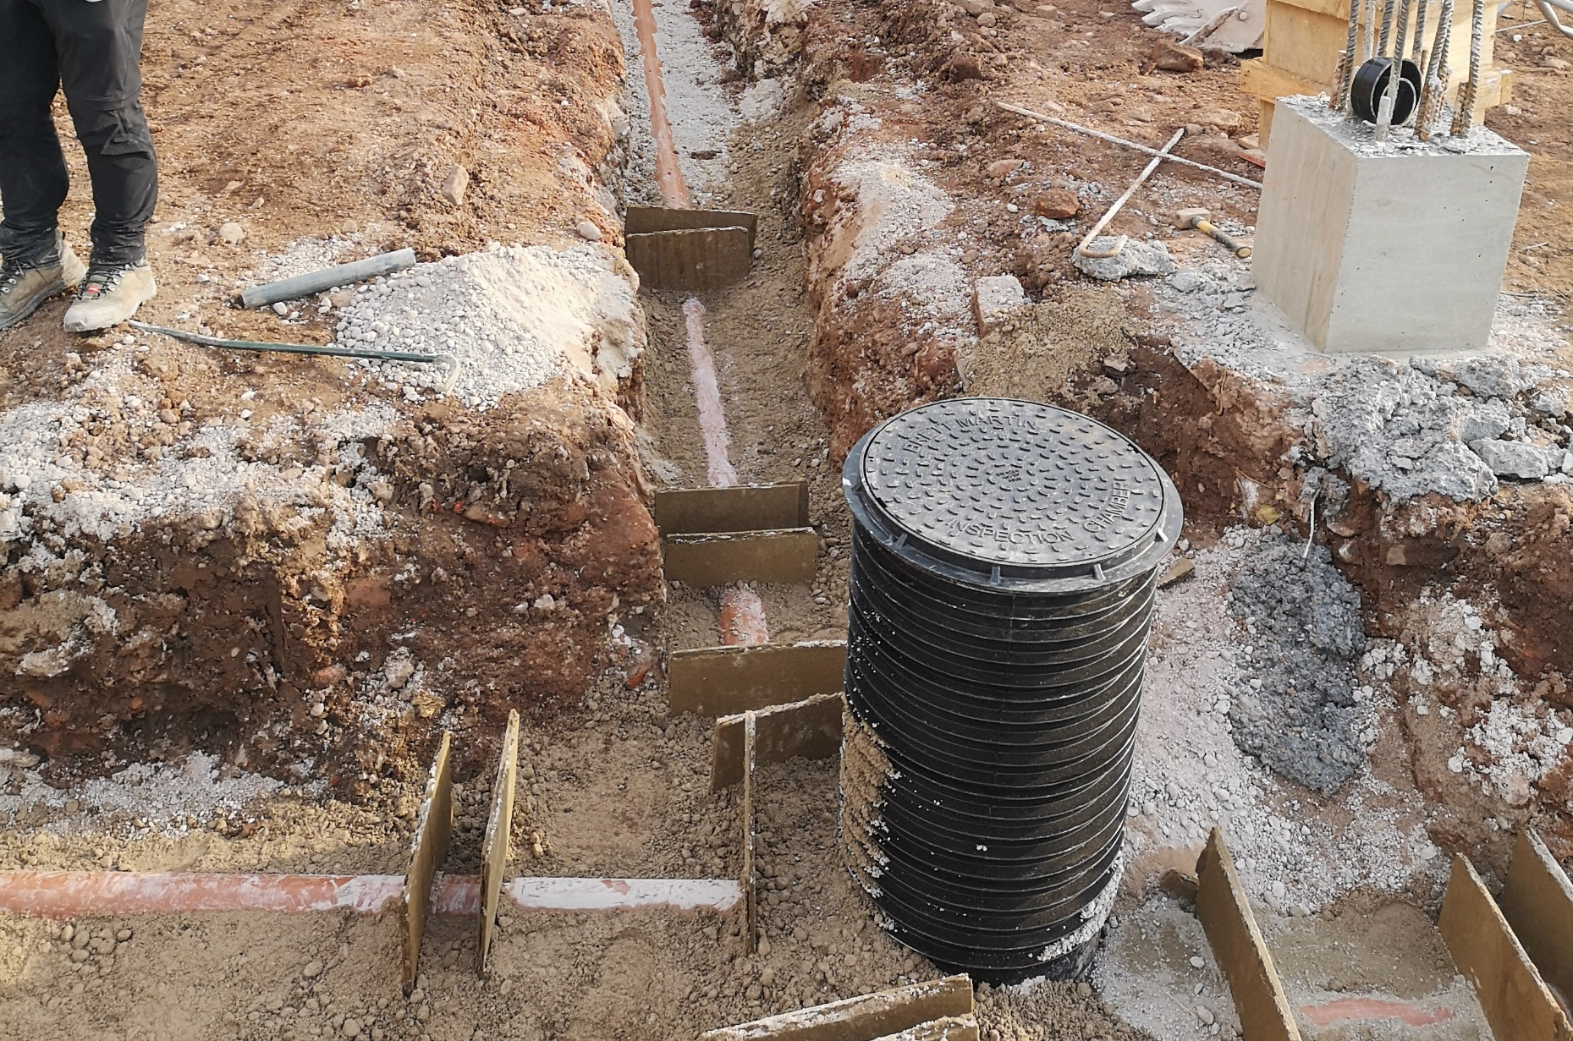
4212 Victoria Riverside
IMAGE SIZE
08.03.2022
IMAGE SIZE
08.03.2022

Slide 4
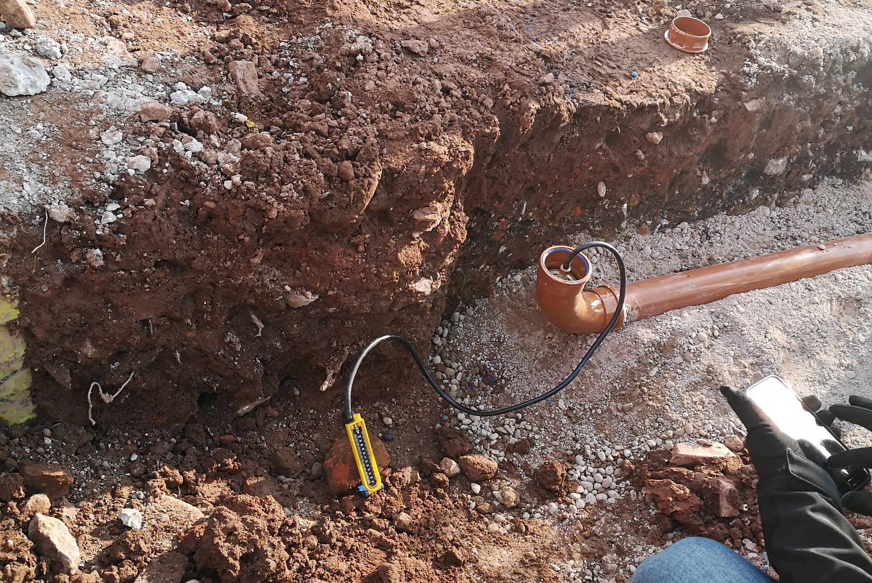
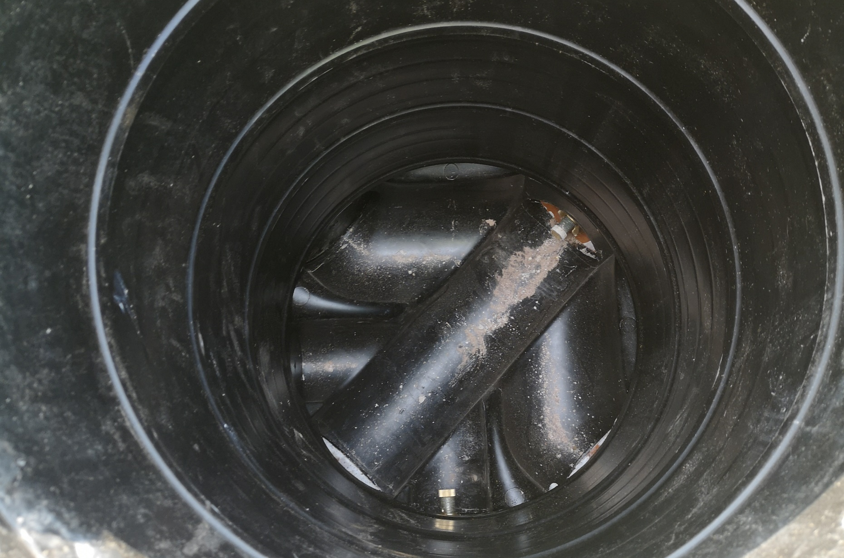
4212 Victoria Riverside
IMAGE SIZE
08.03.2022
IMAGE SIZE
08.03.2022

Slide 5
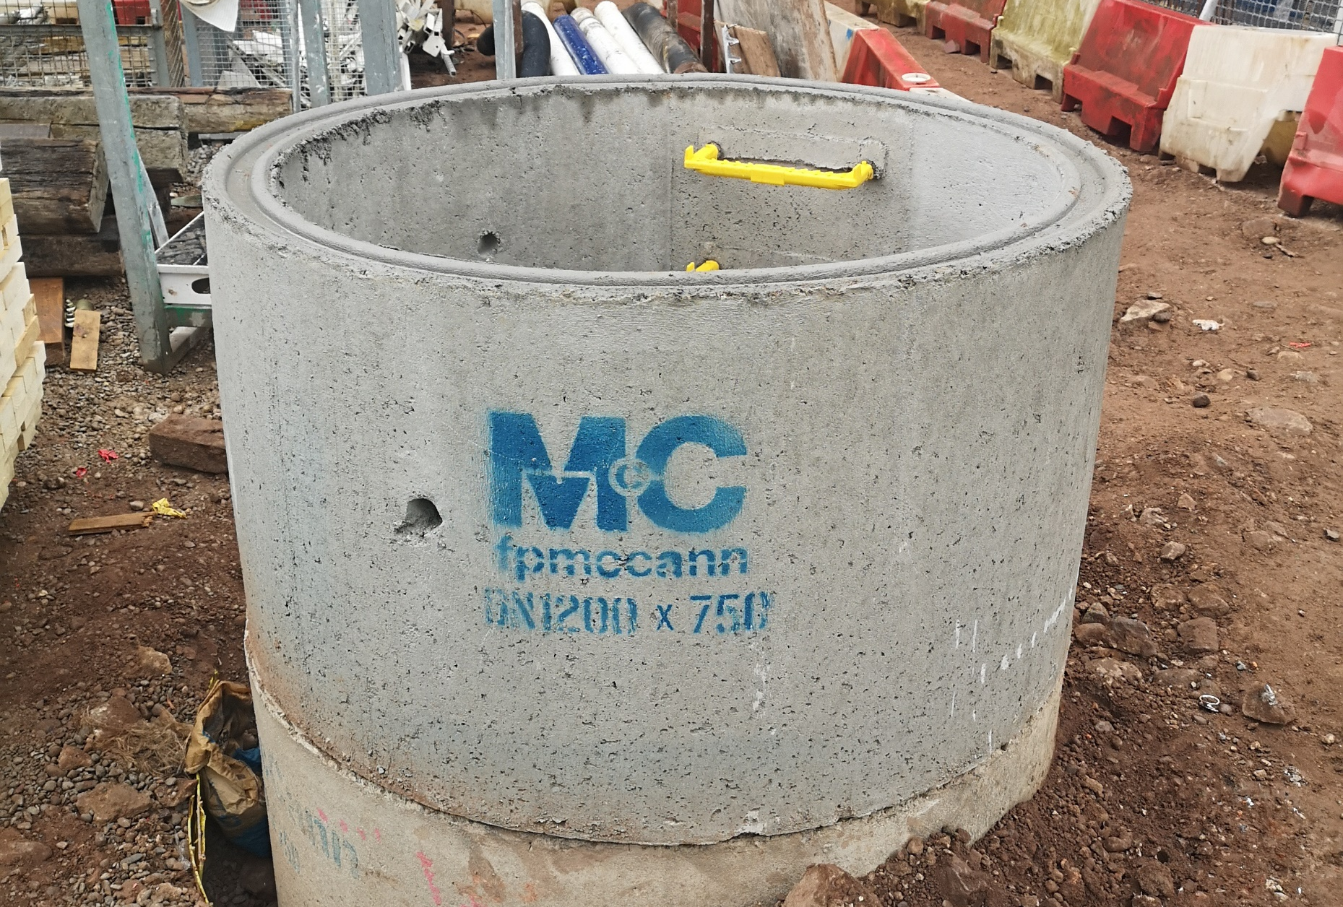
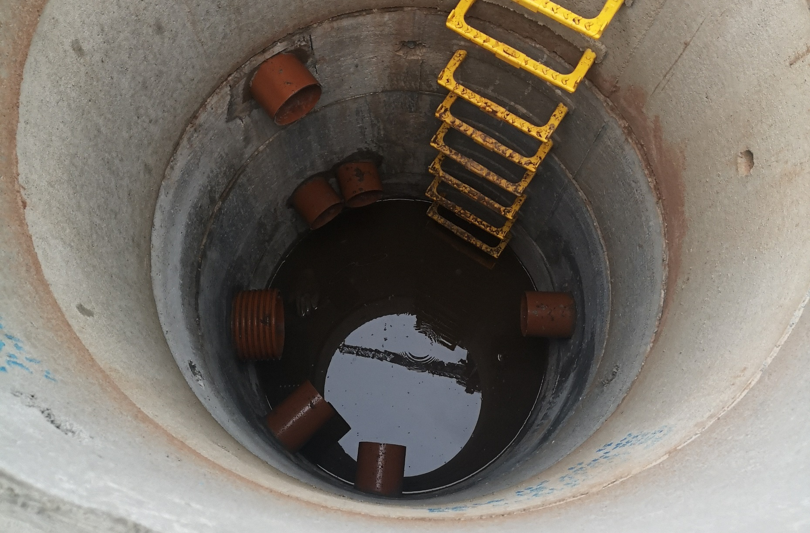
4212 Victoria Riverside
IMAGE SIZE
26.05.2022
IMAGE SIZE
26.05.2022

Slide 6
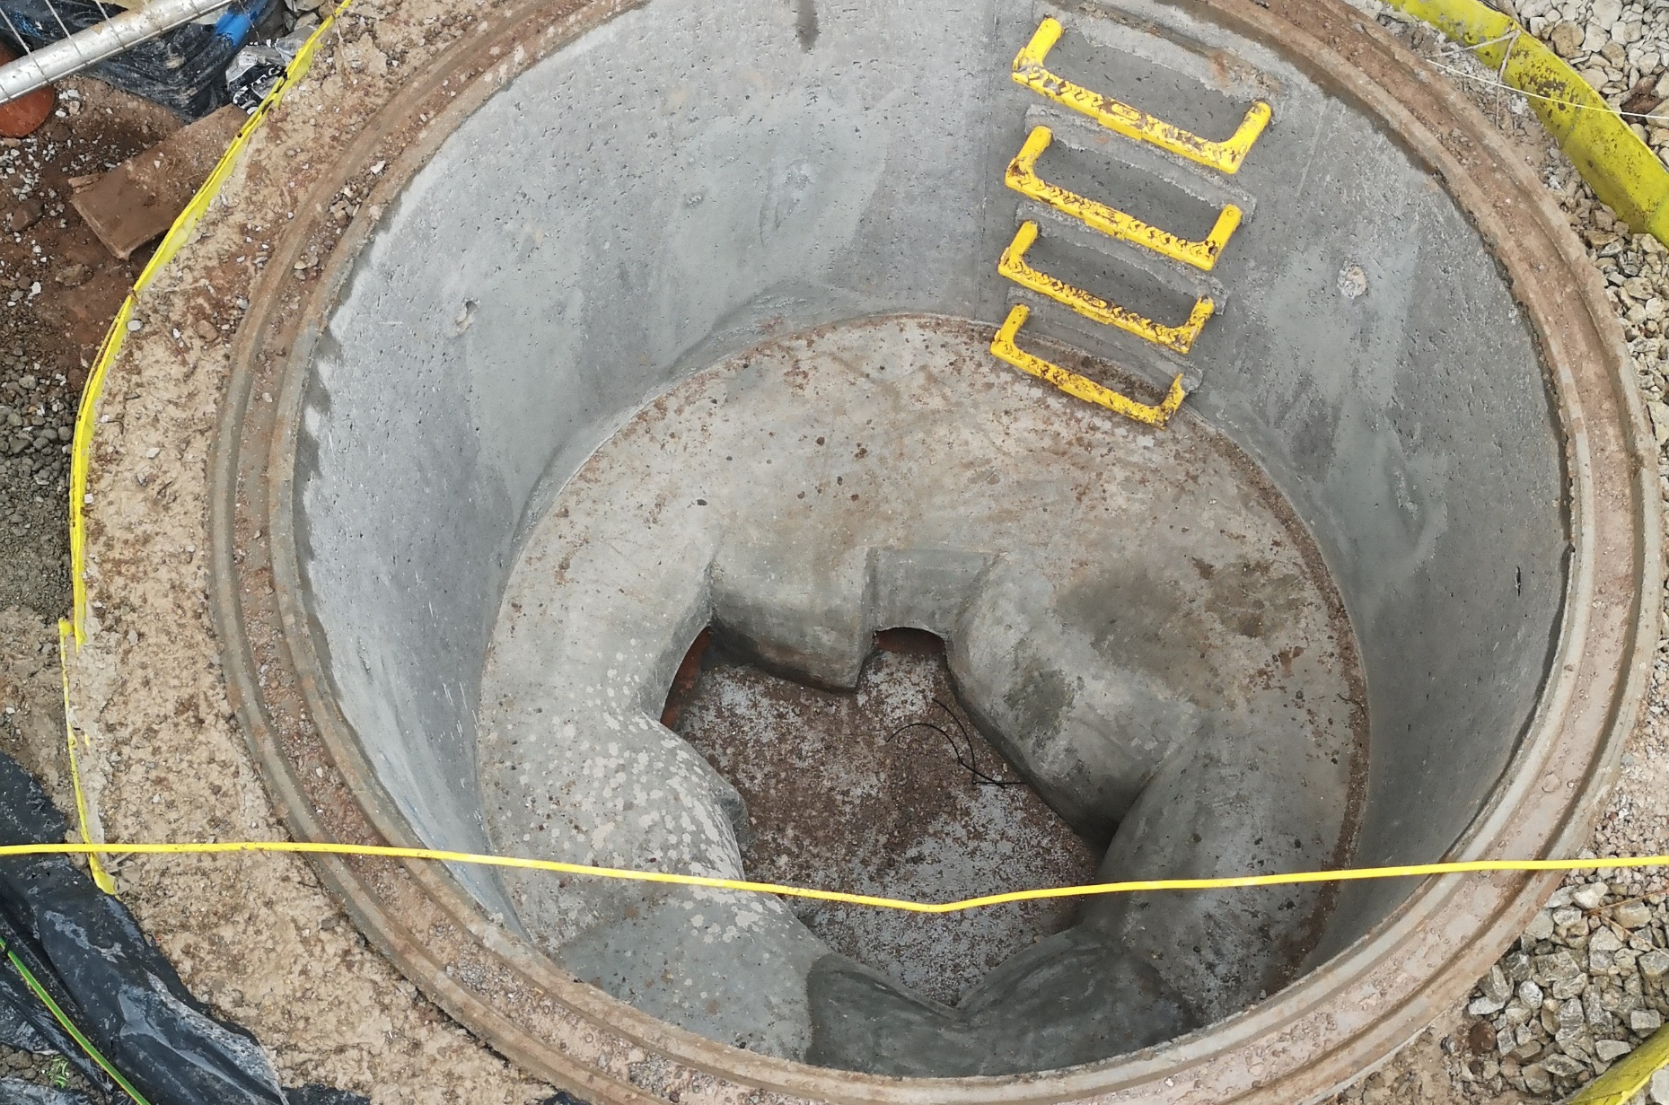
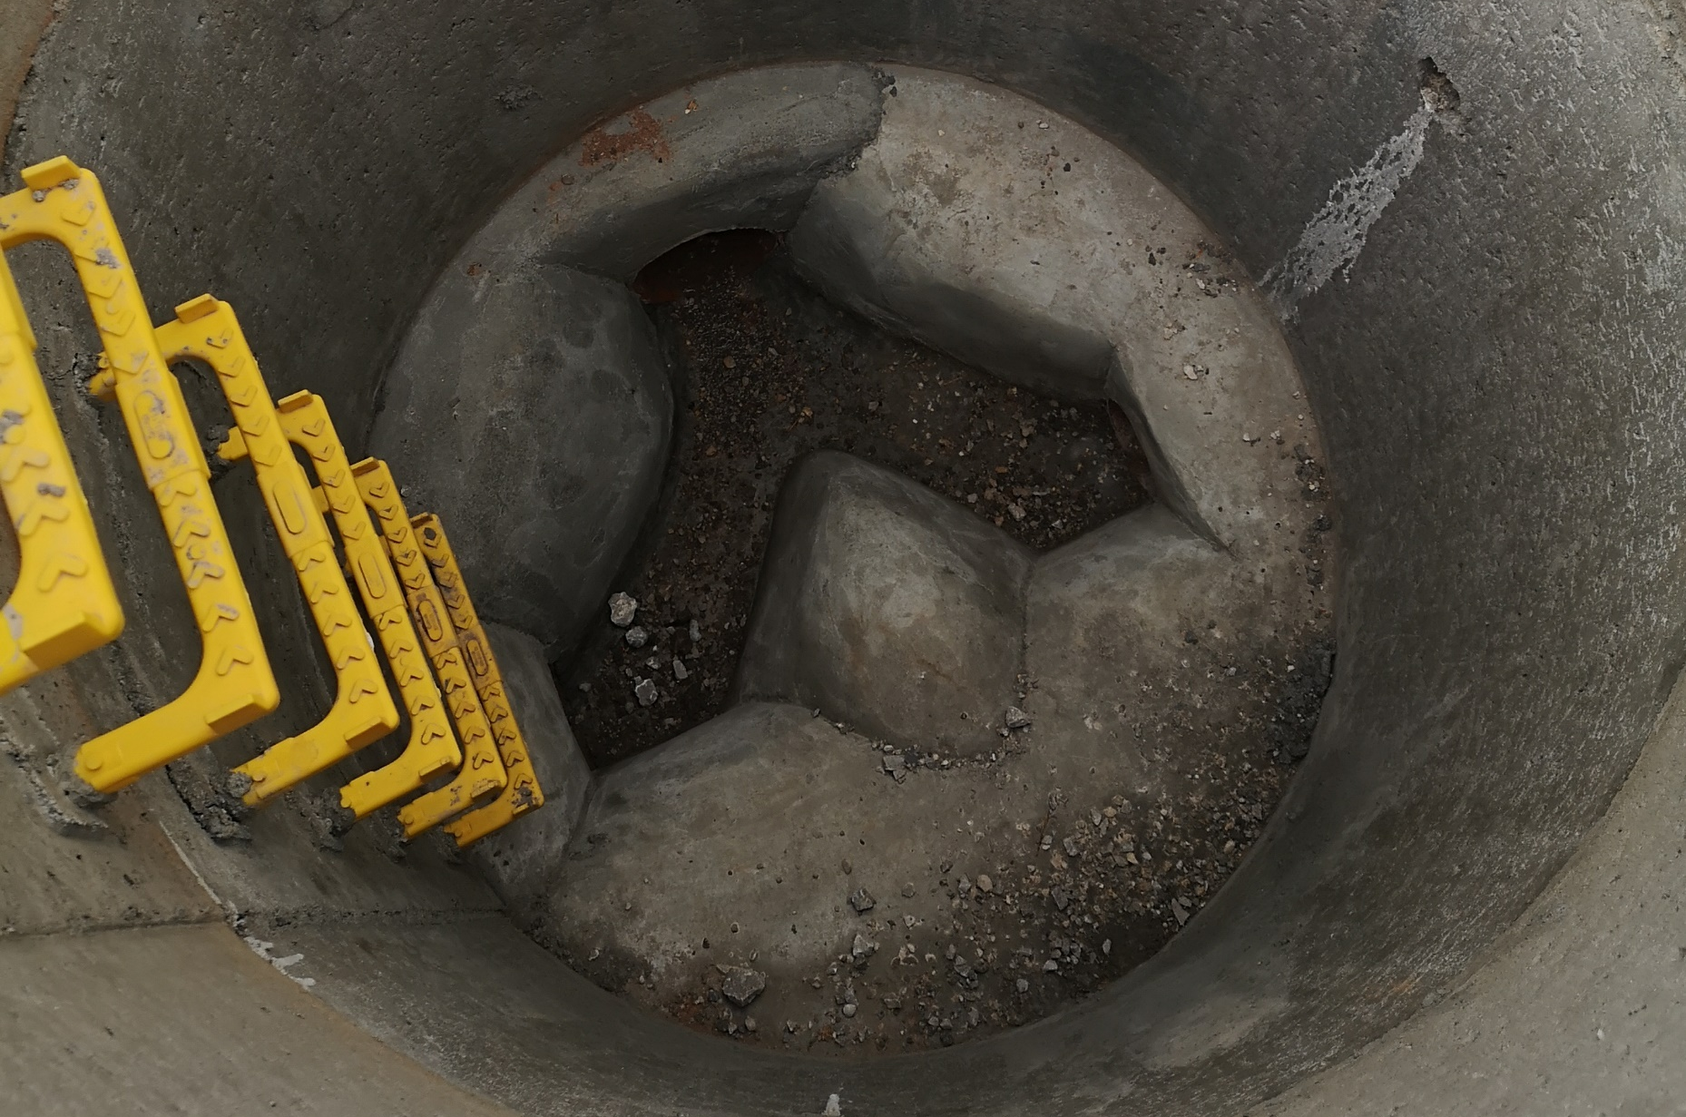
4212 Victoria Riverside
IMAGE SIZE
26.05.2022
IMAGE SIZE
09.06.2022

Slide 7
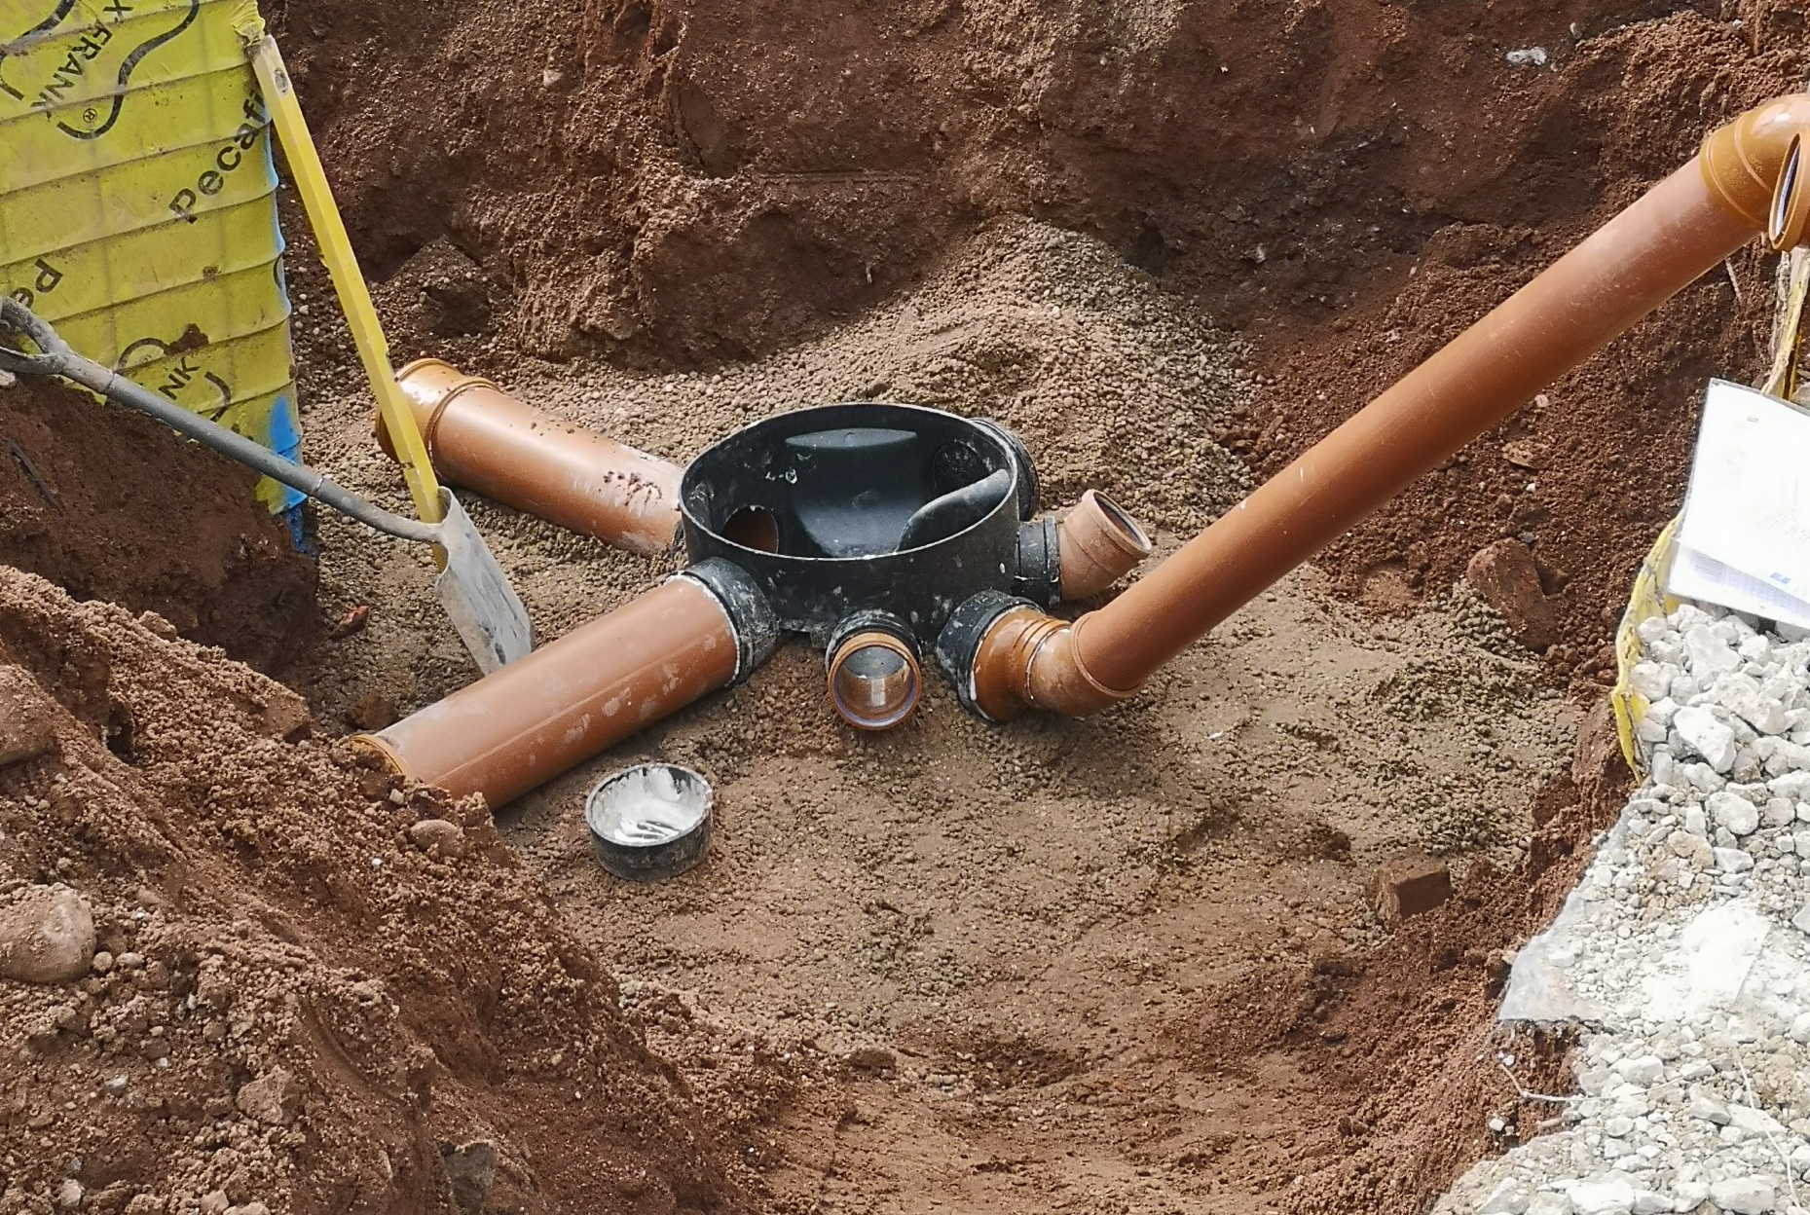
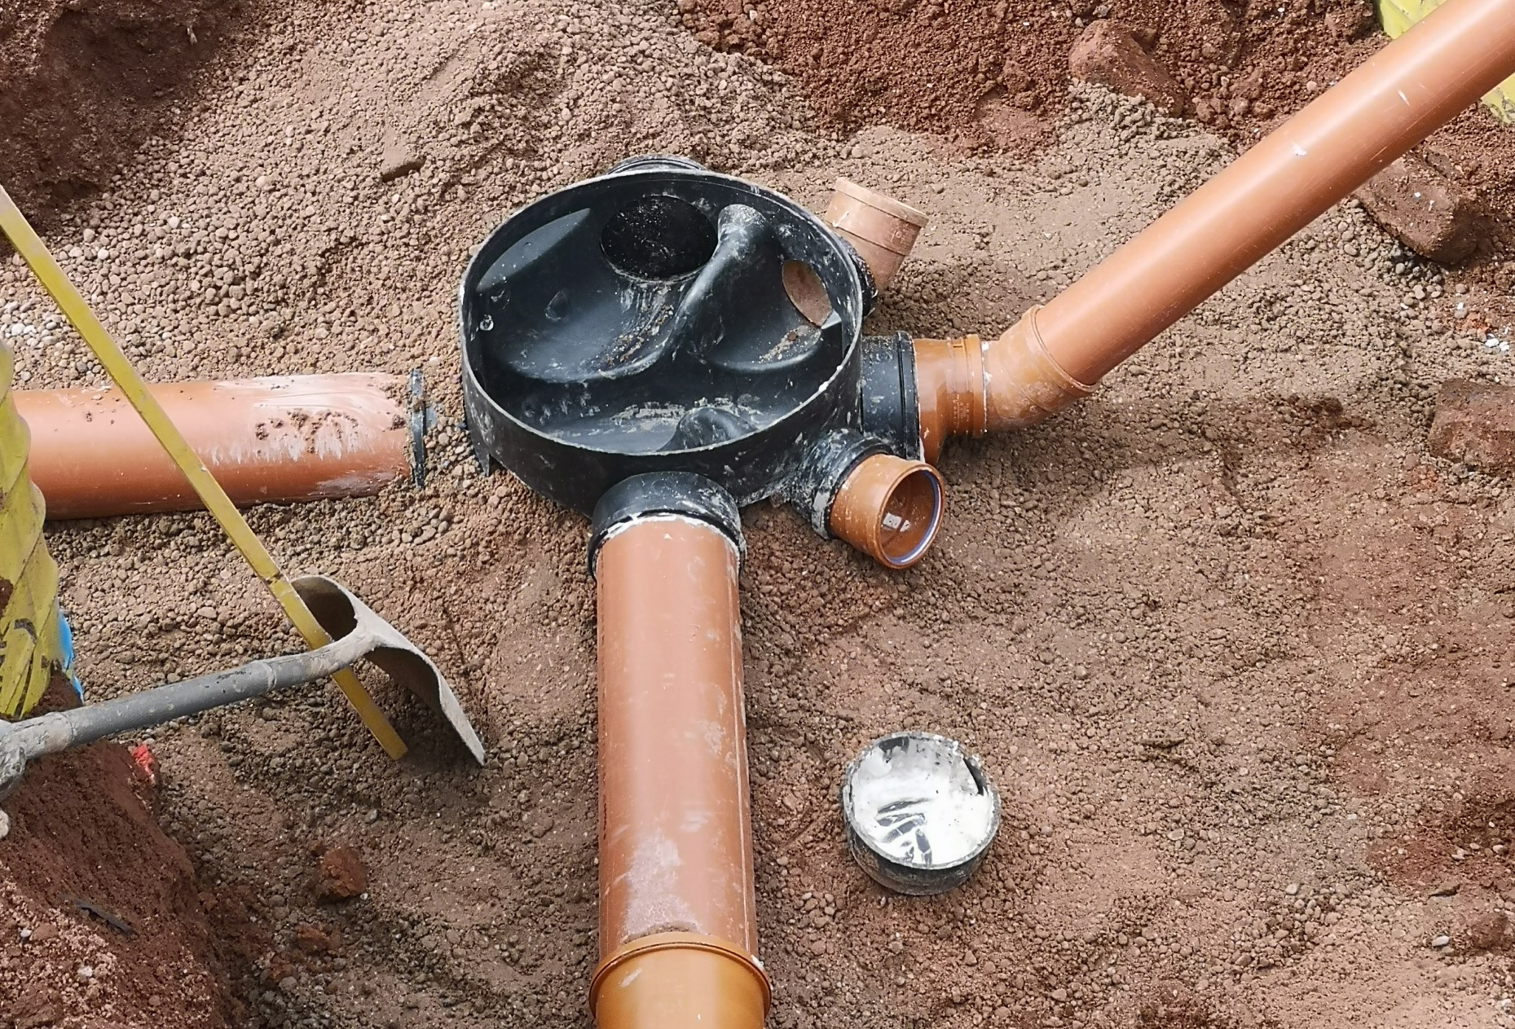
4212 Victoria Riverside
IMAGE SIZE
09.06.2022
IMAGE SIZE
09.06.2022

Slide 8
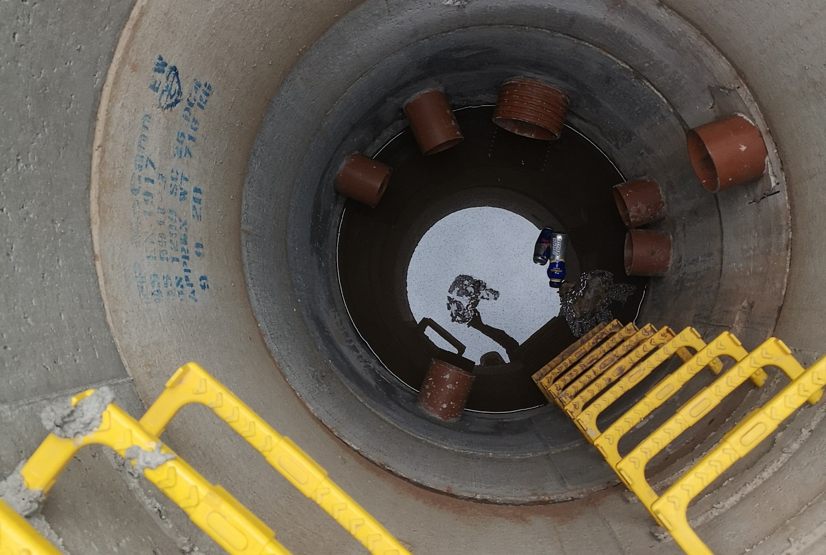
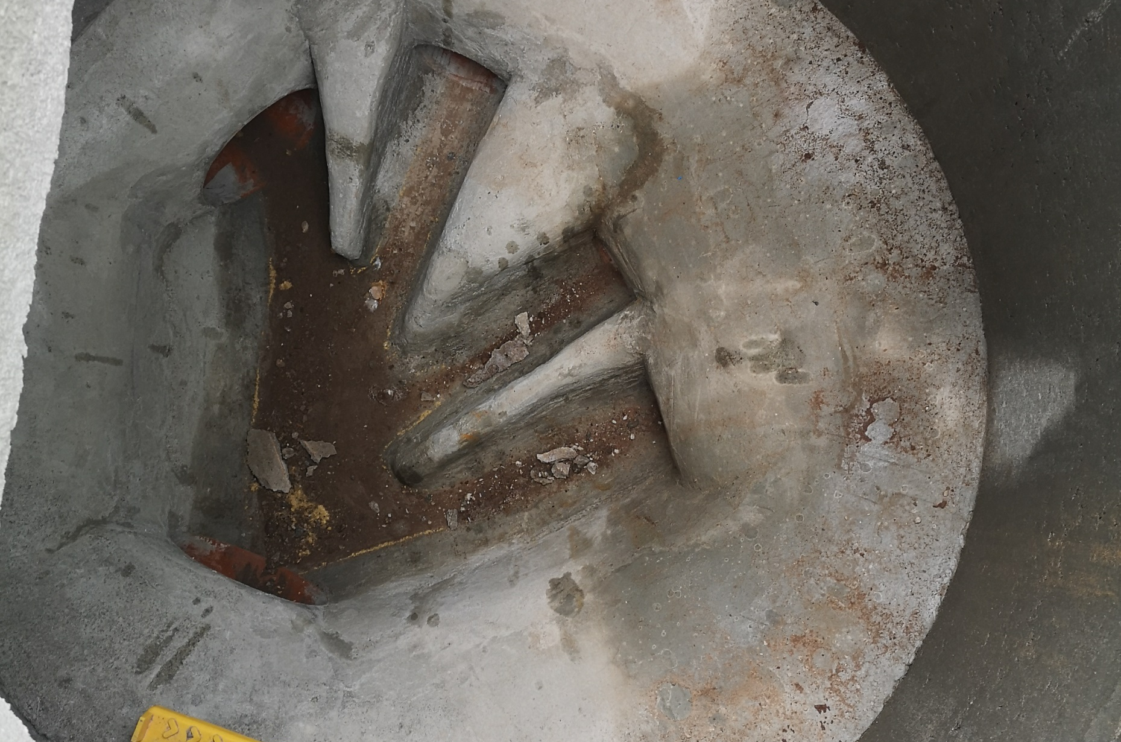
4212 Victoria Riverside
IMAGE SIZE
30.06.2022
IMAGE SIZE
30.06.2022

Slide 9
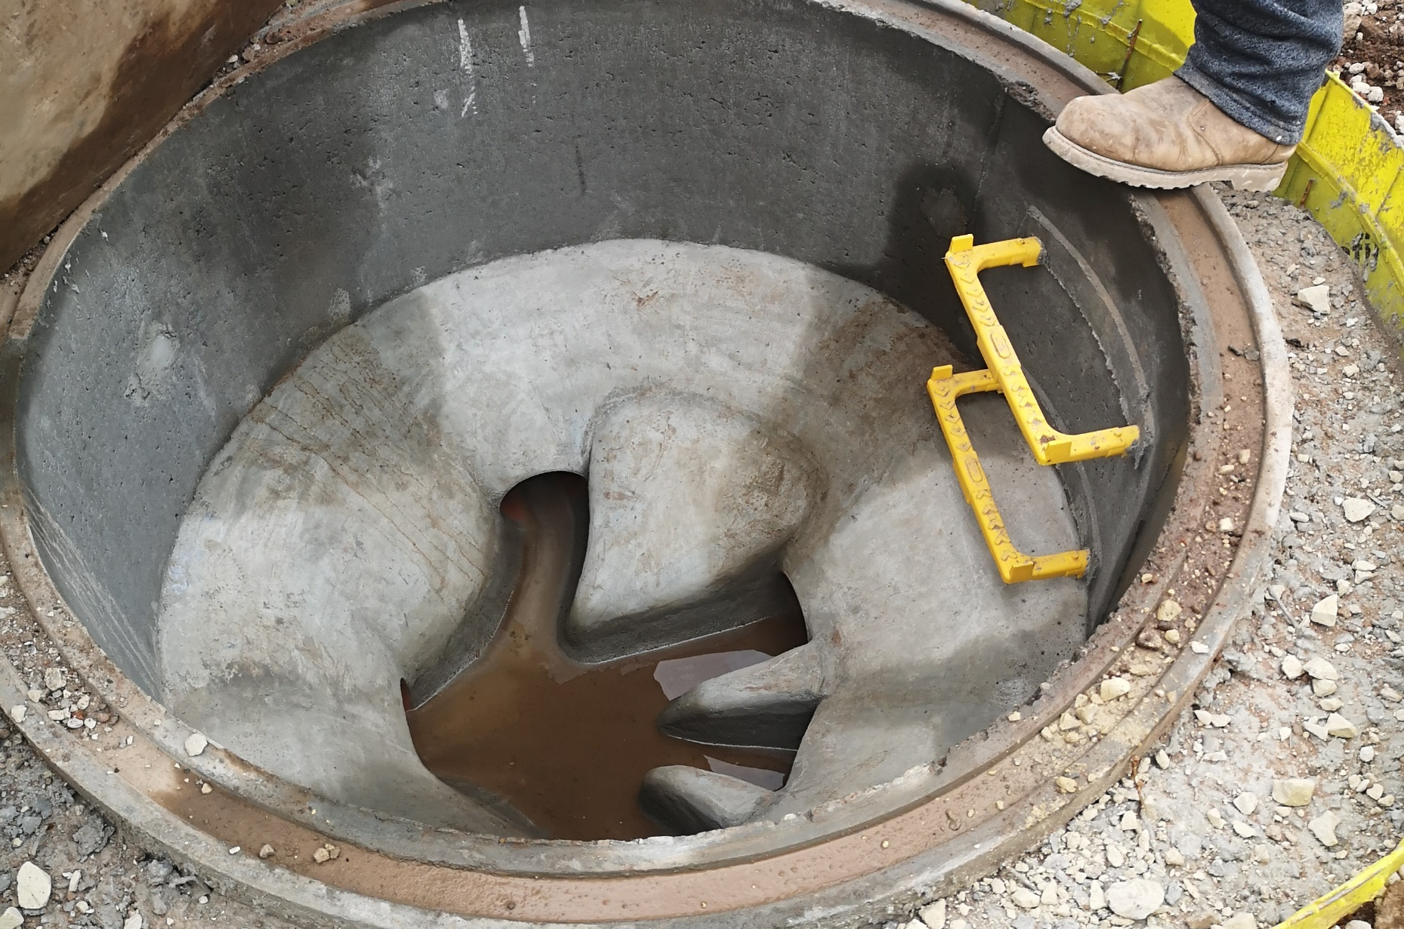
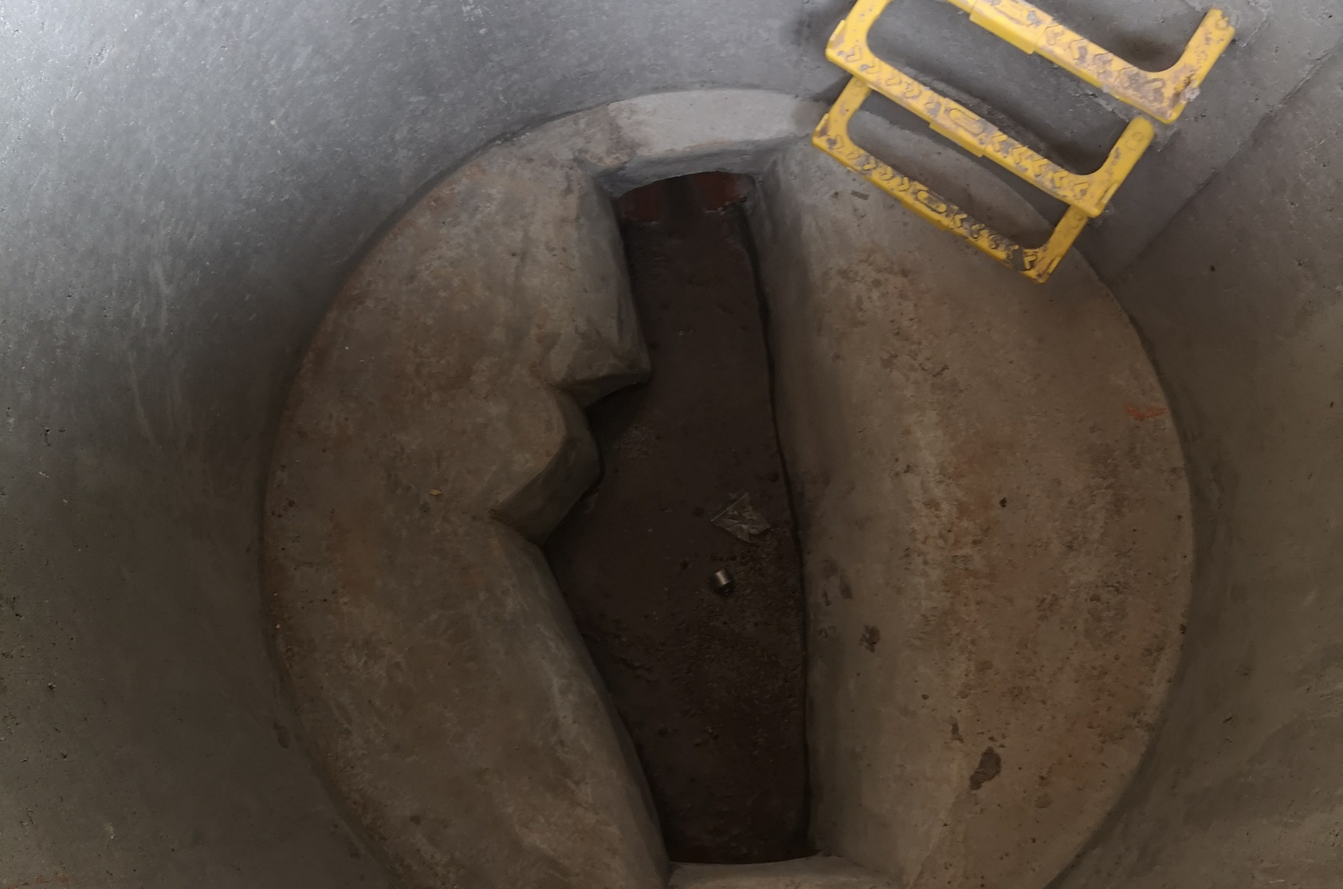
4212 Victoria Riverside
IMAGE SIZE
30.06.2022
IMAGE SIZE
30.06.2022

Slide 10
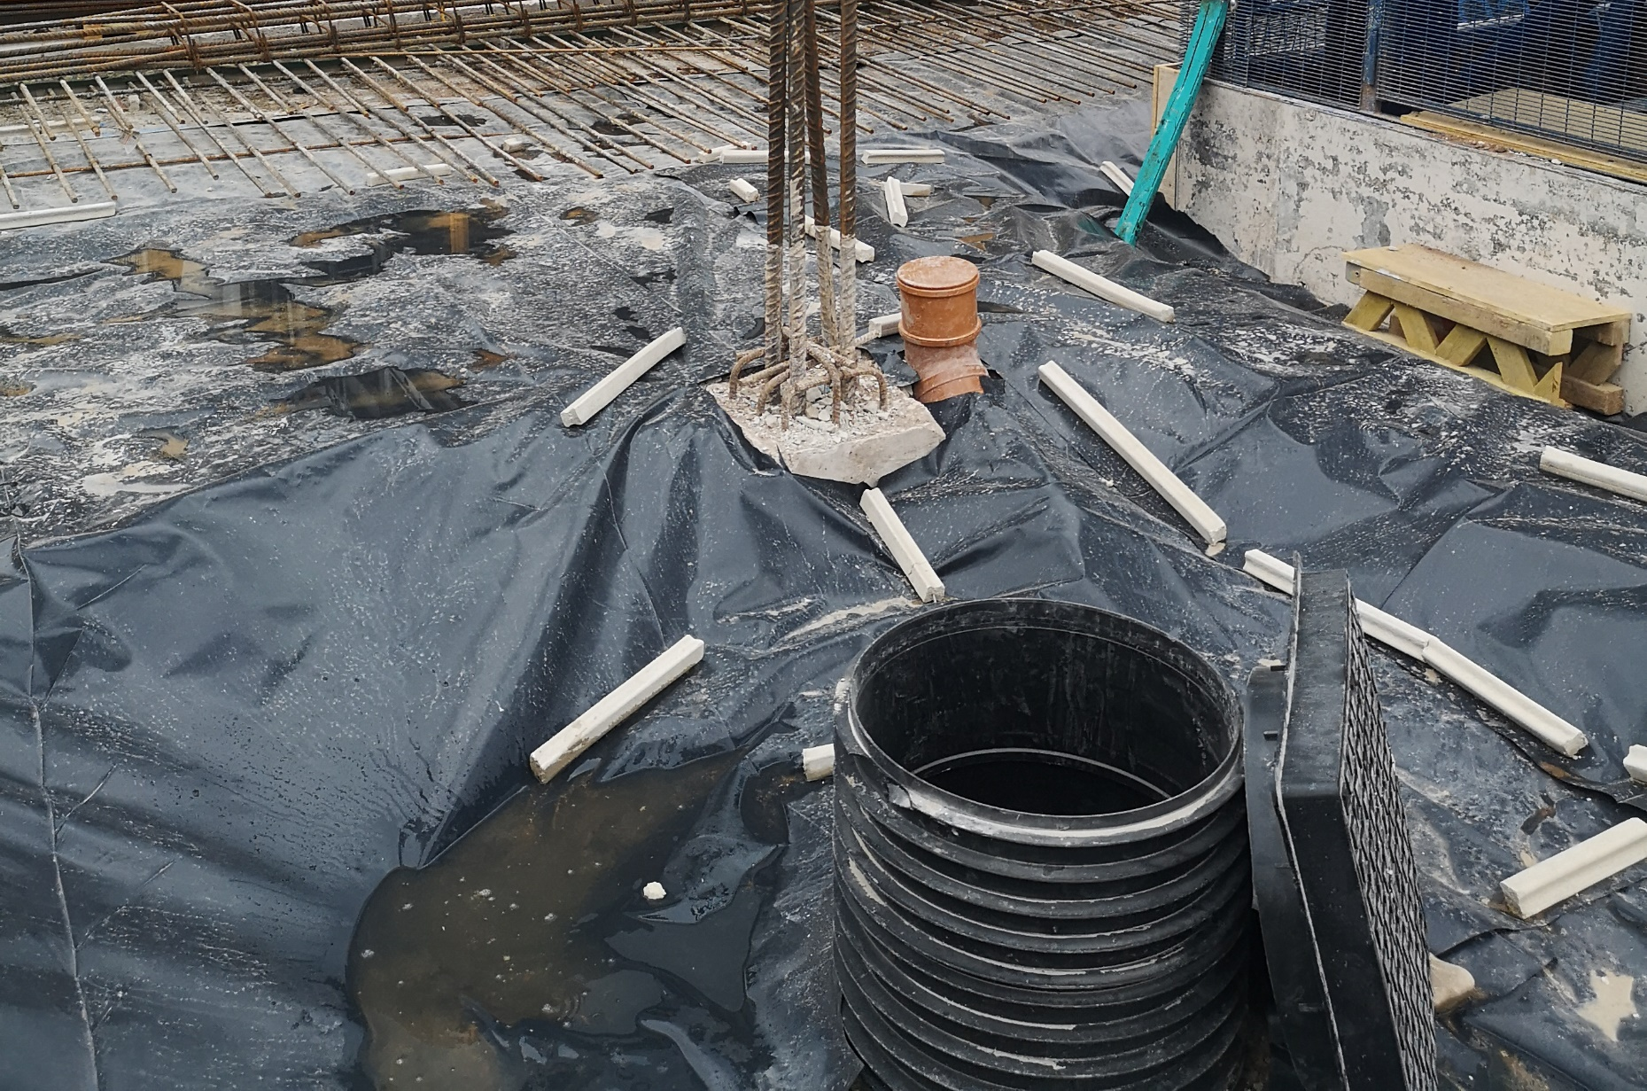
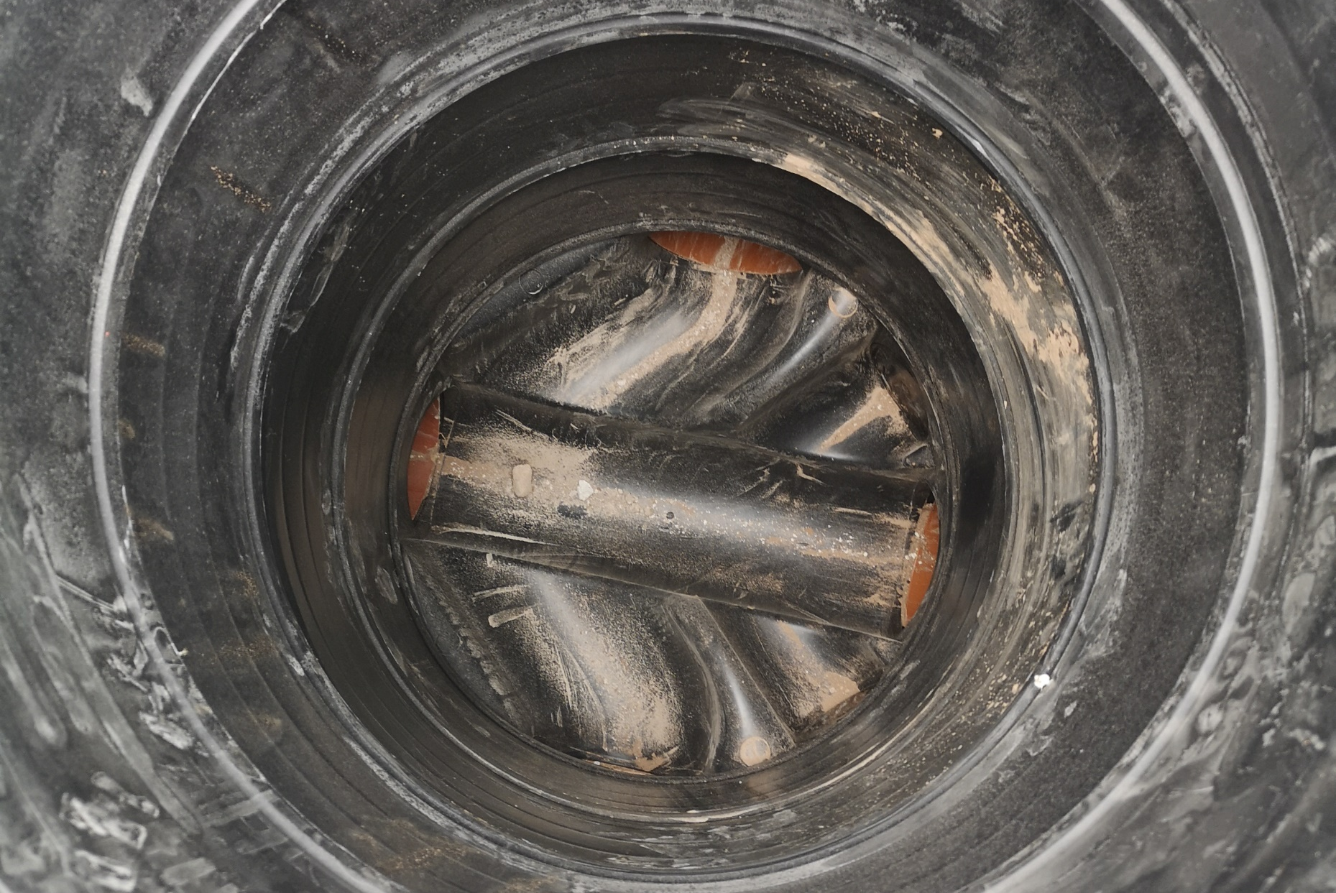
4212 Victoria Riverside
IMAGE SIZE
21.07.2022
IMAGE SIZE
21.07.2022

Slide 11
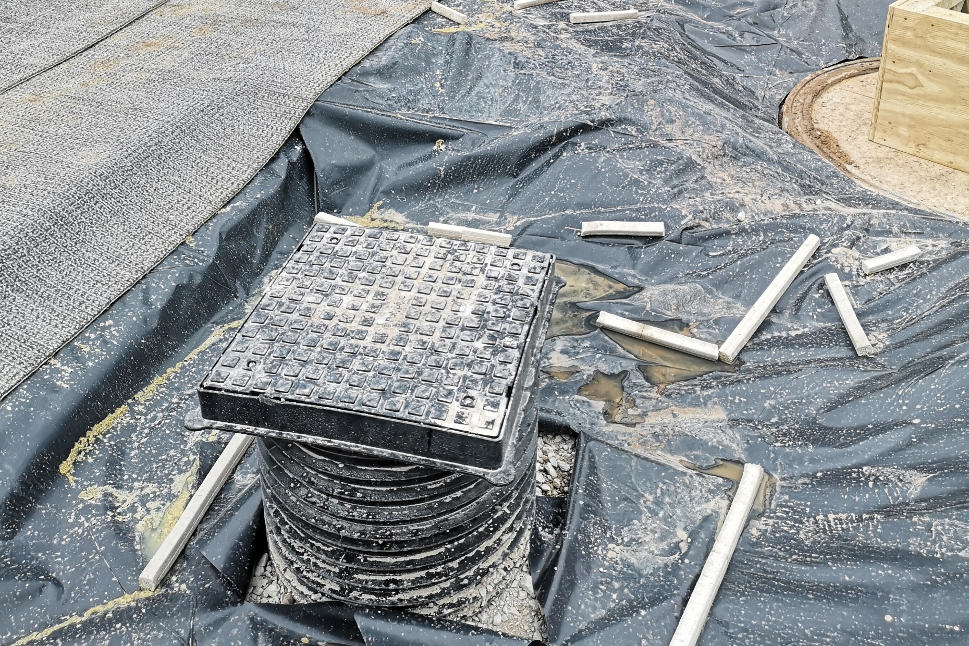
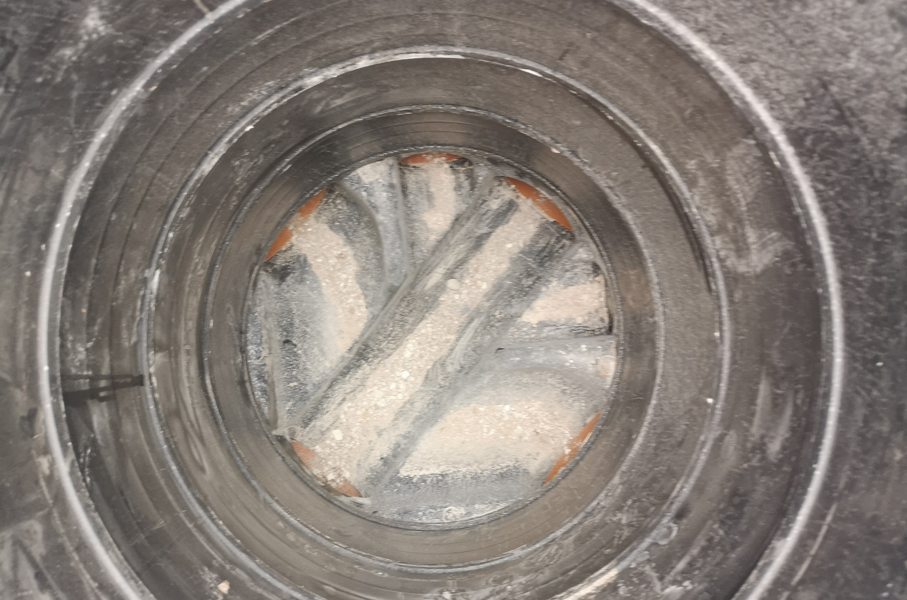
4212 Victoria Riverside
IMAGE SIZE
21.07.2022
IMAGE SIZE
21.07.2022

Slide 12
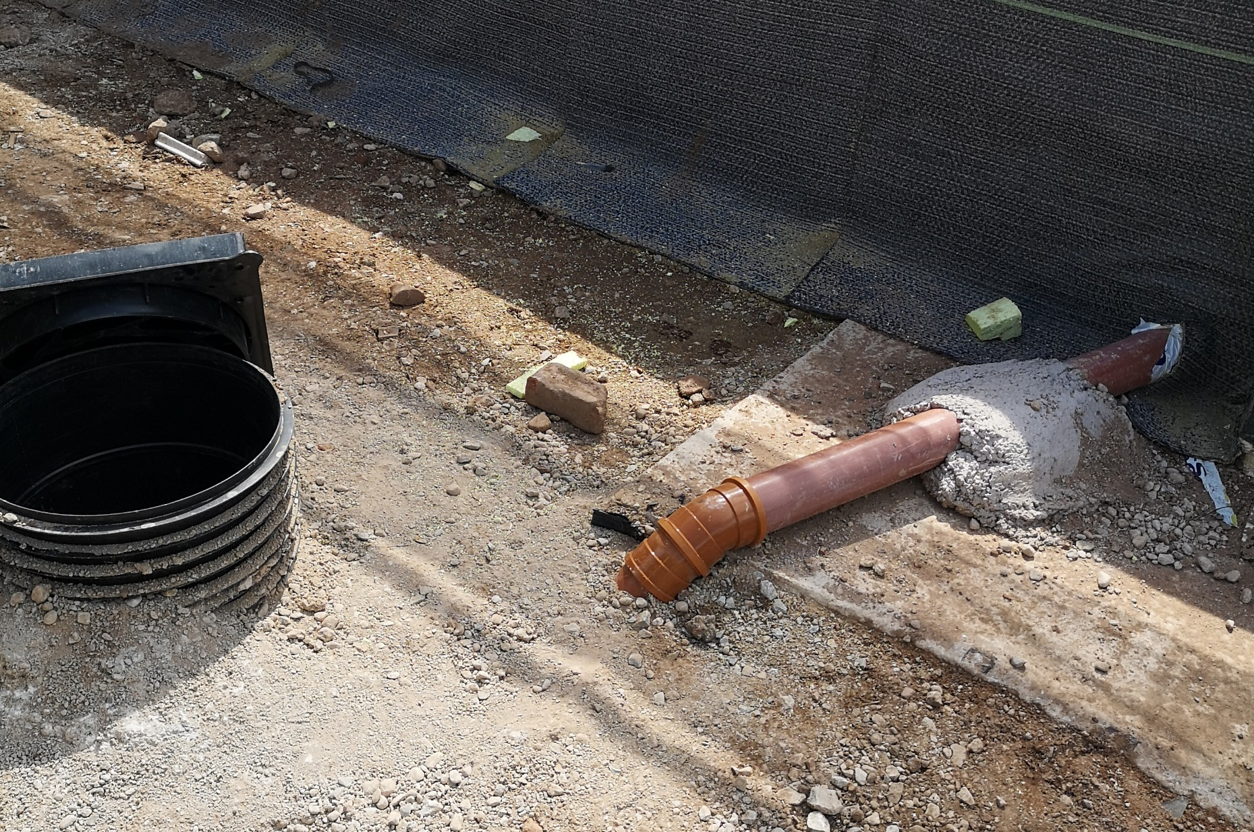
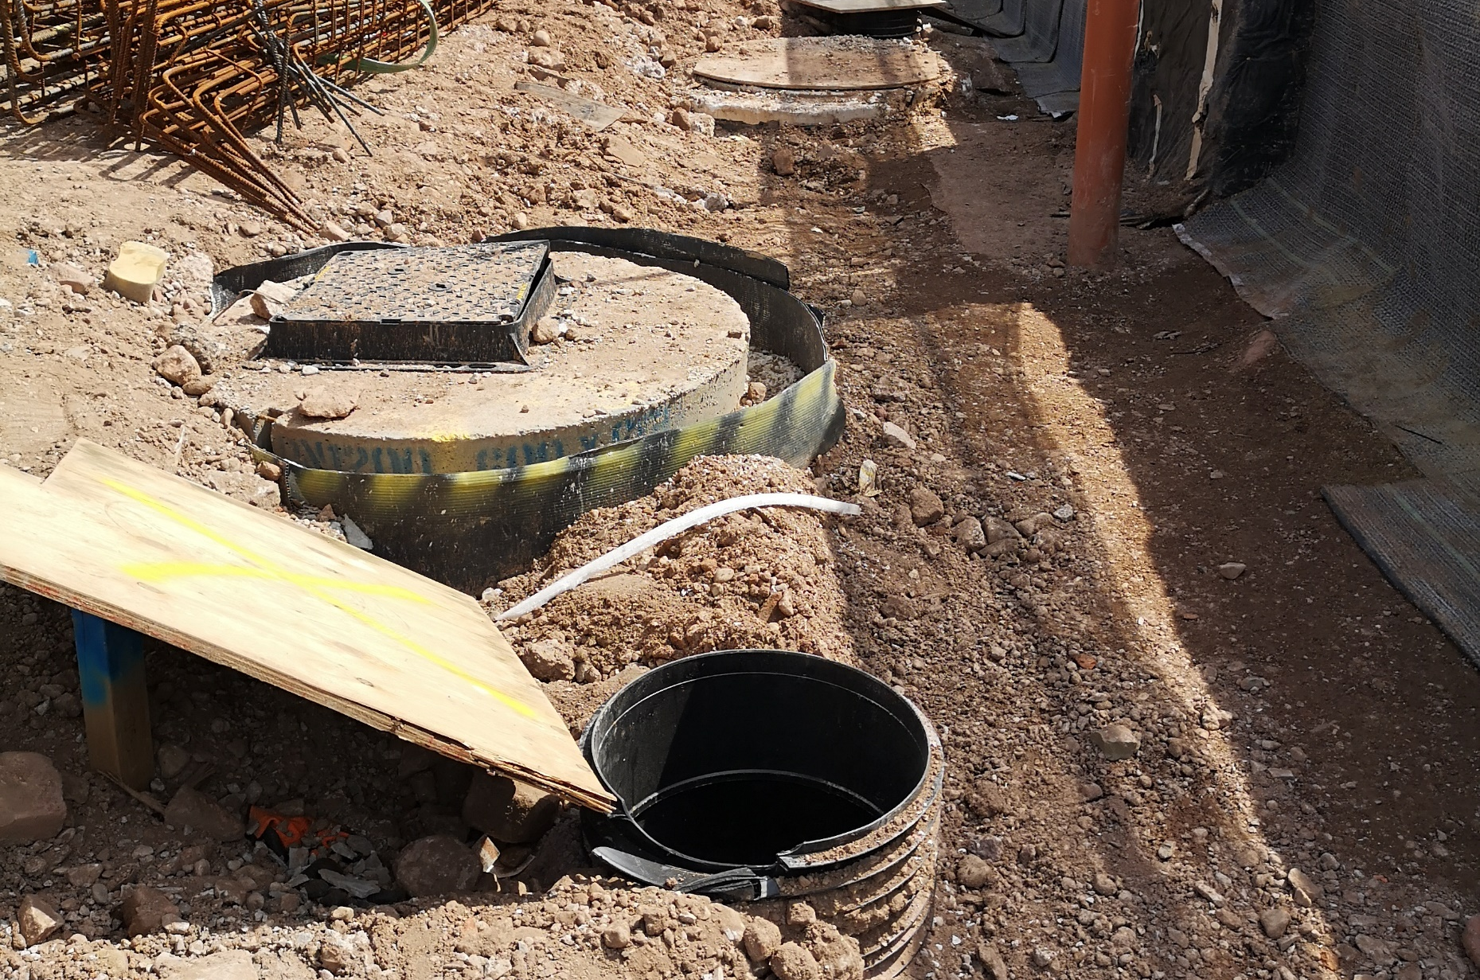
4212 Victoria Riverside
IMAGE SIZE
09.08.2022
IMAGE SIZE
09.08.2022

Slide 13
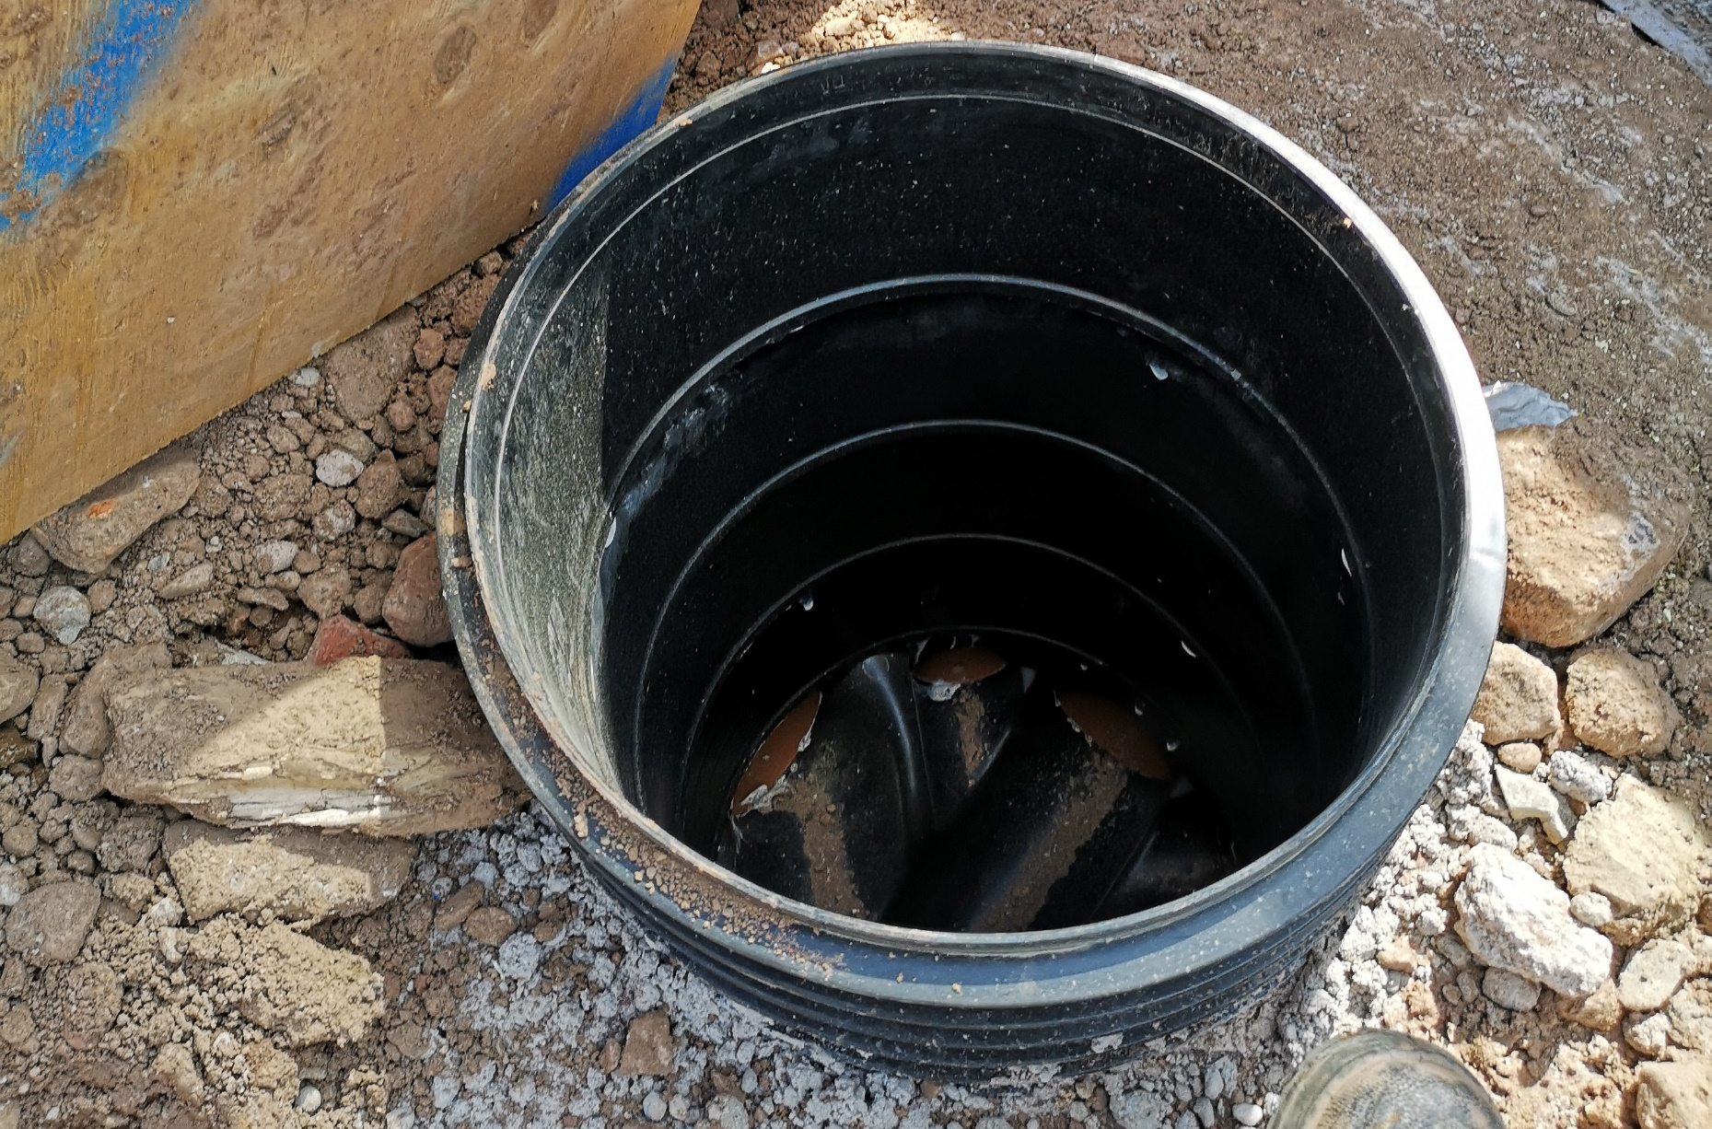
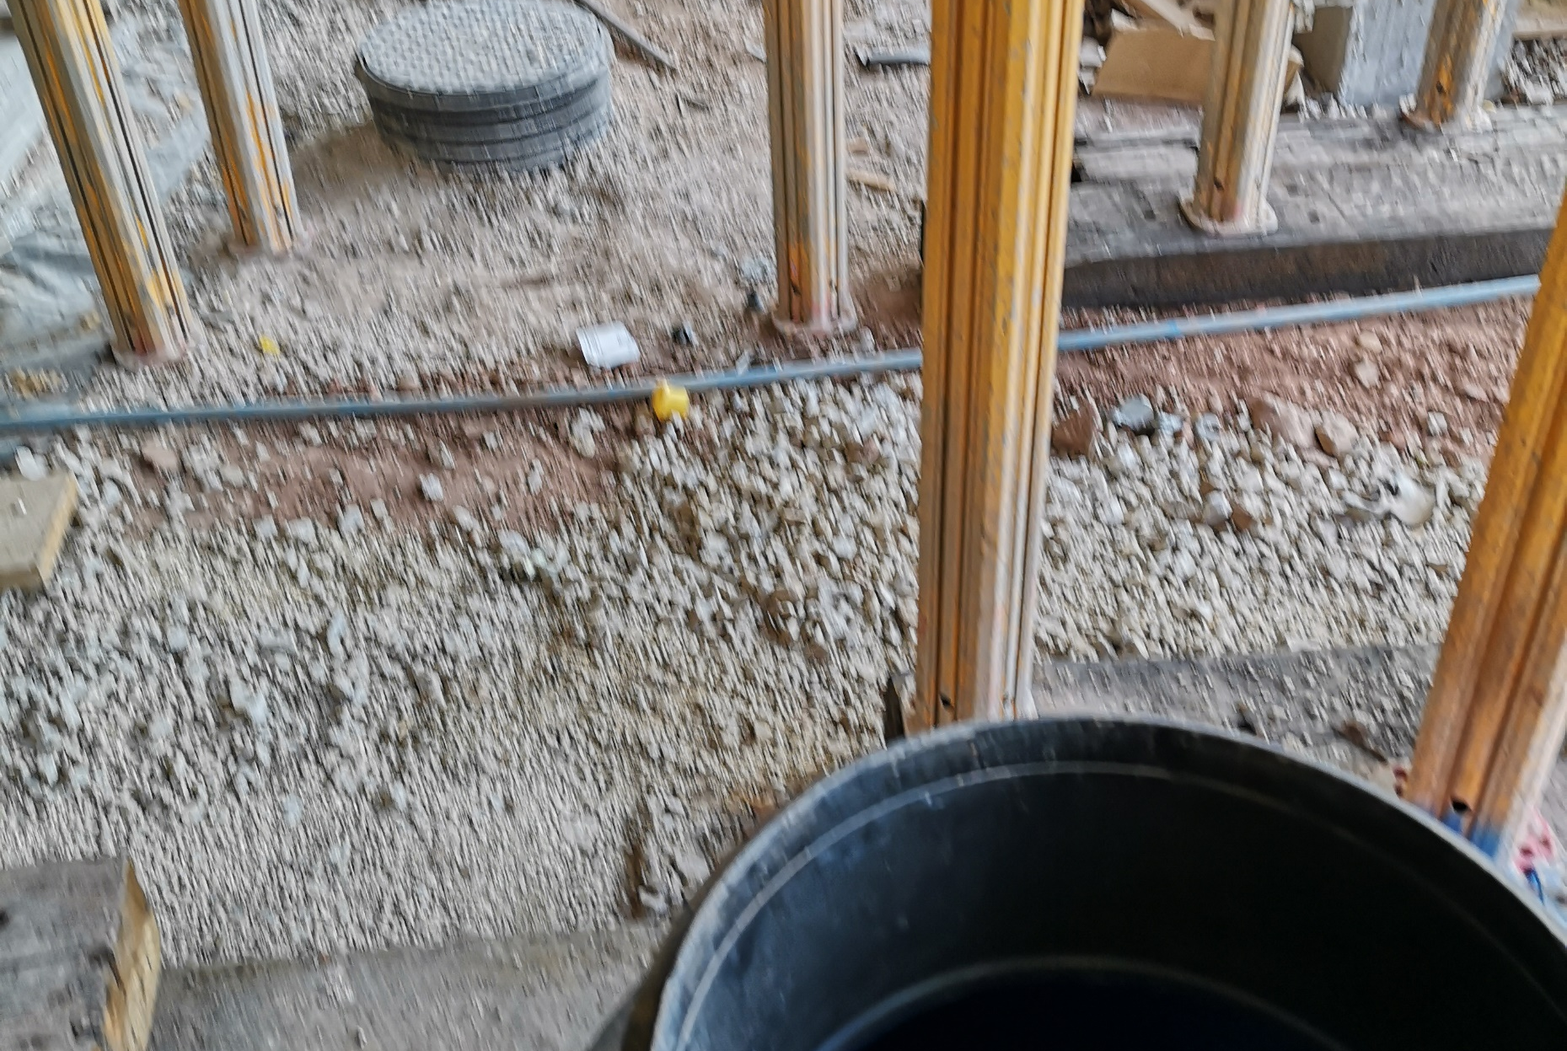
4212 Victoria Riverside
IMAGE SIZE
09.08.2022
IMAGE SIZE
09.08.2022

Slide 14
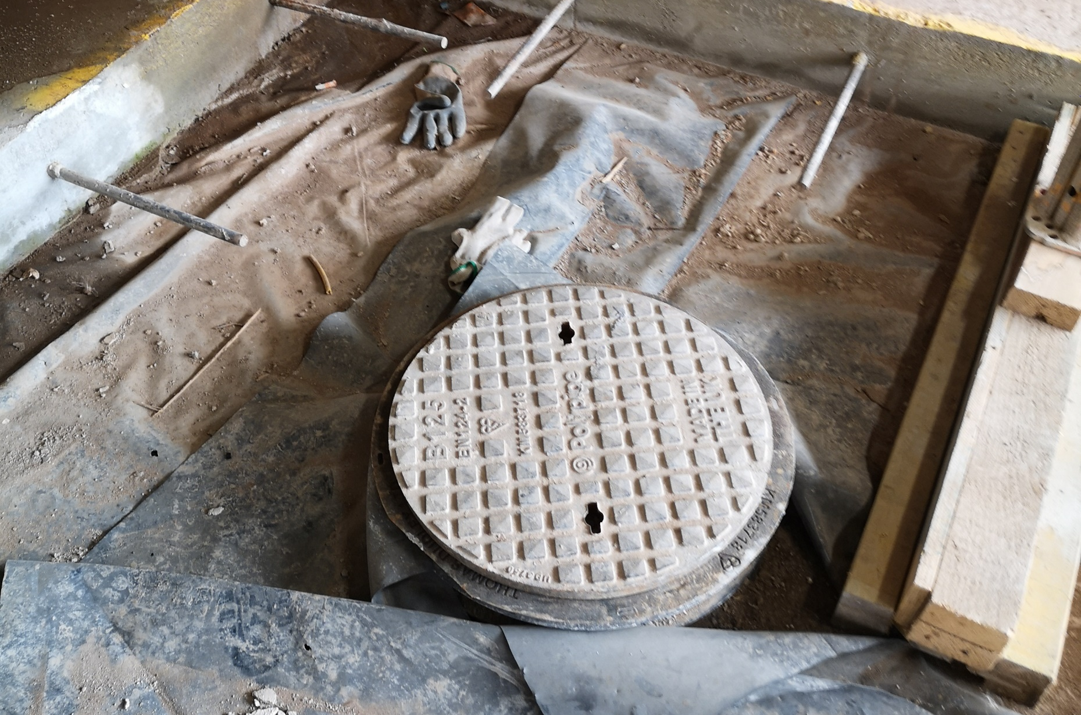
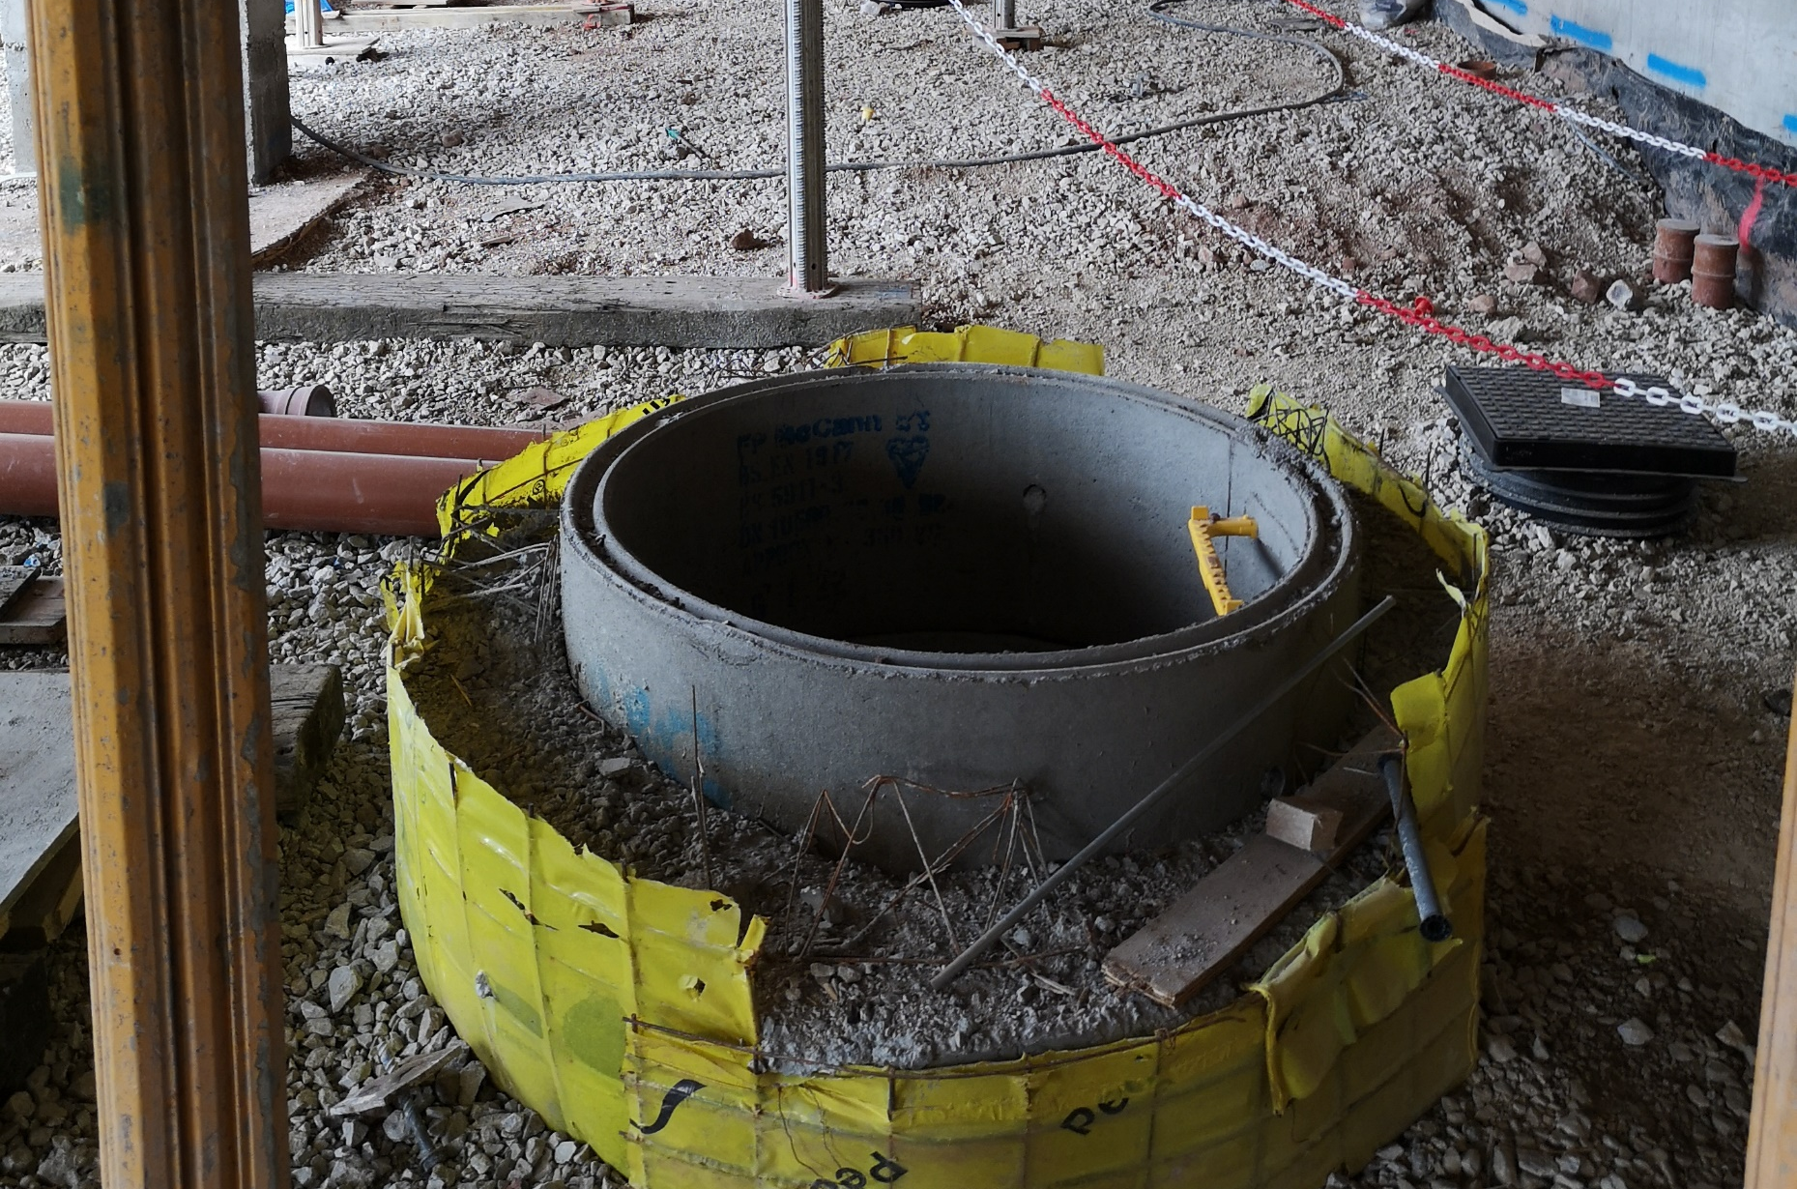
4212 Victoria Riverside
IMAGE SIZE
09.08.2022
IMAGE SIZE
09.08.2022

Slide 15
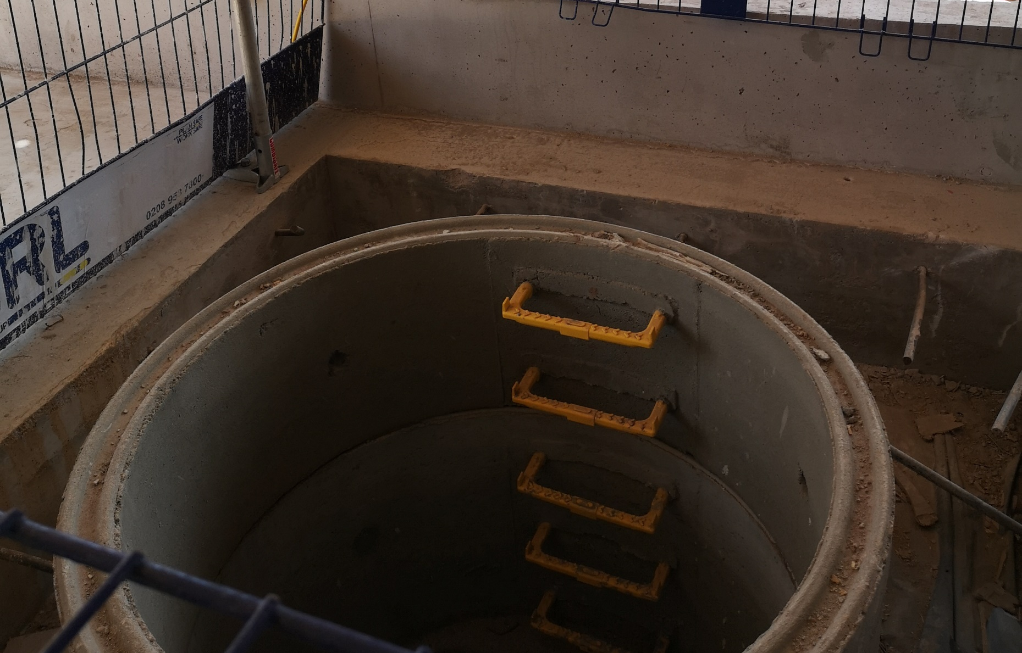
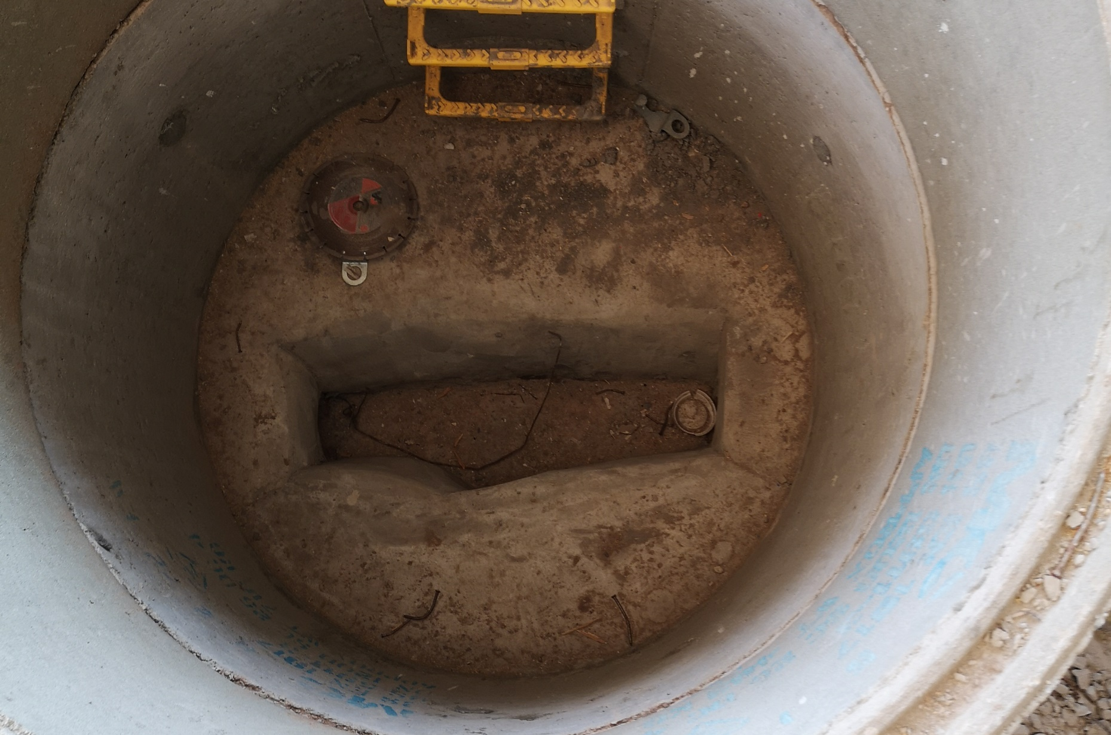
4212 Victoria Riverside
IMAGE SIZE
09.08.2022
IMAGE SIZE
09.08.2022

Slide 16
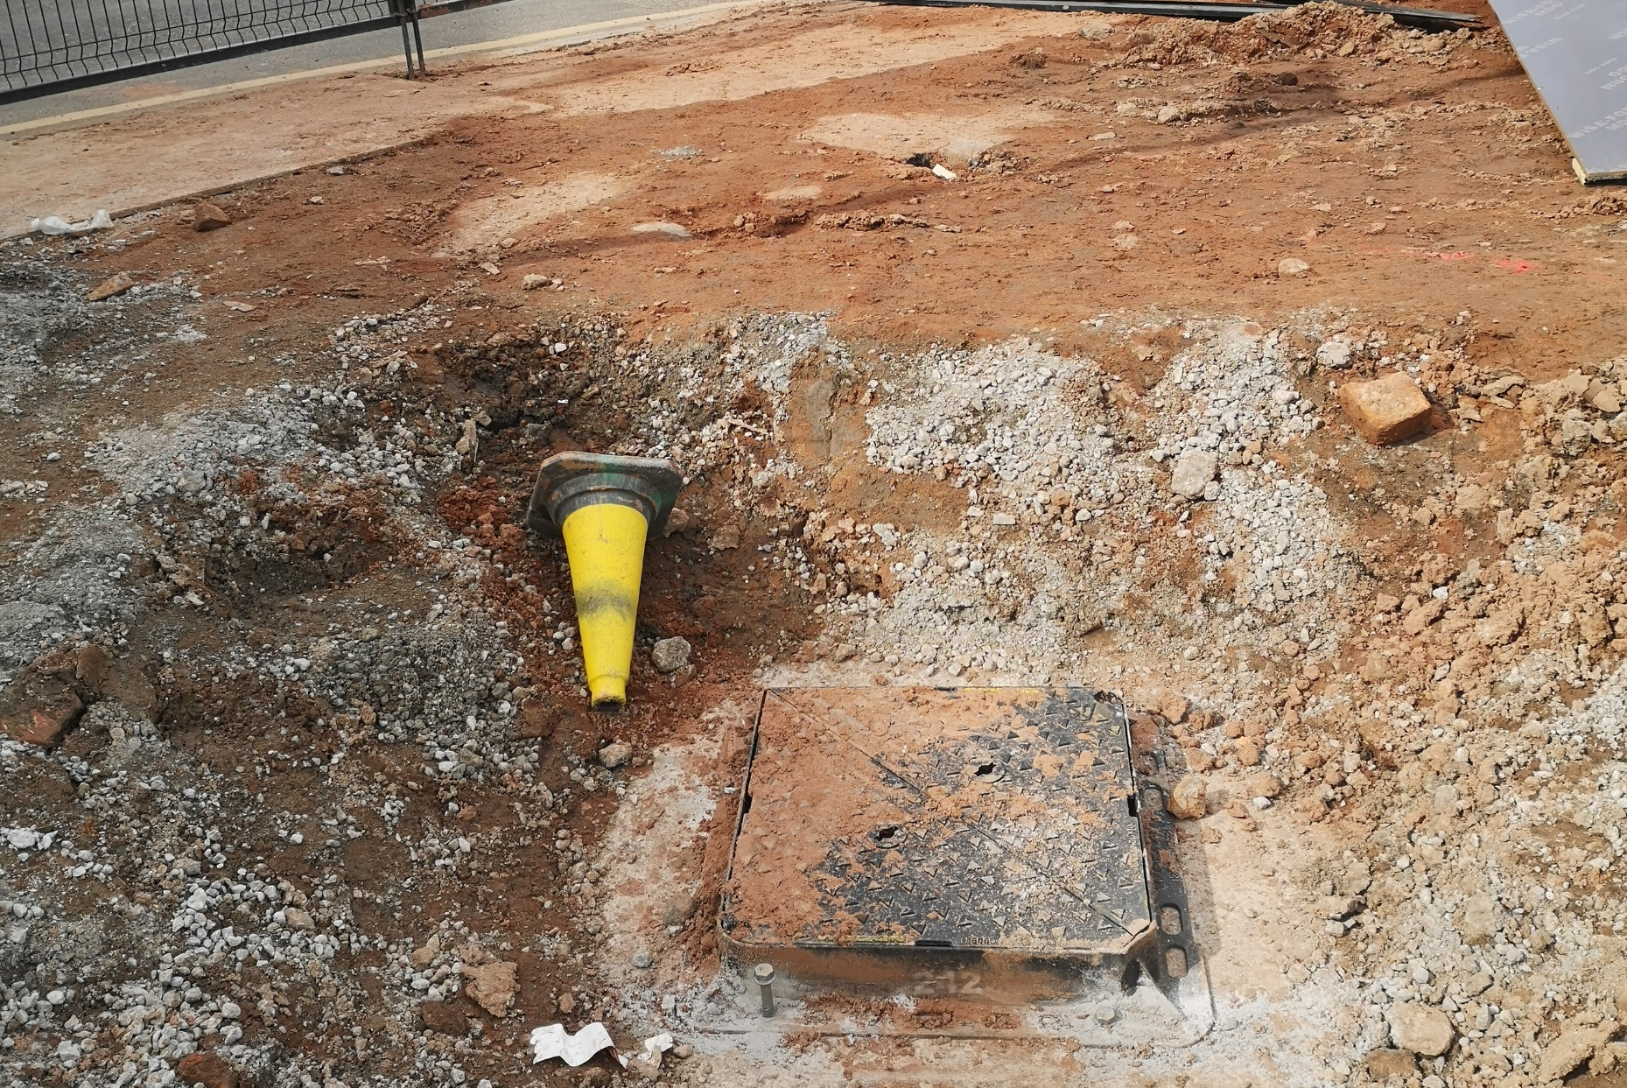
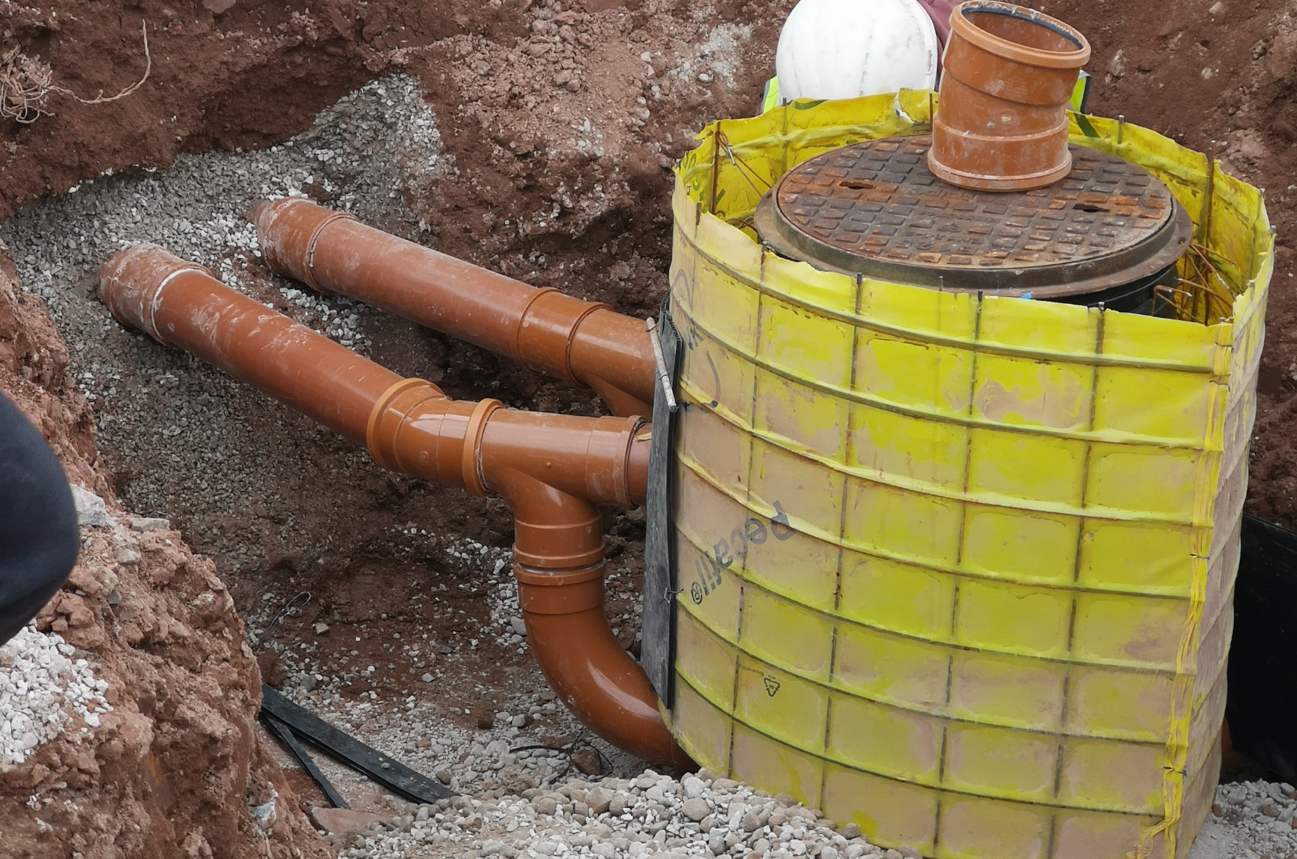
4212 Victoria Riverside
IMAGE SIZE
09.08.2022
IMAGE SIZE
09.08.2022

Slide 17
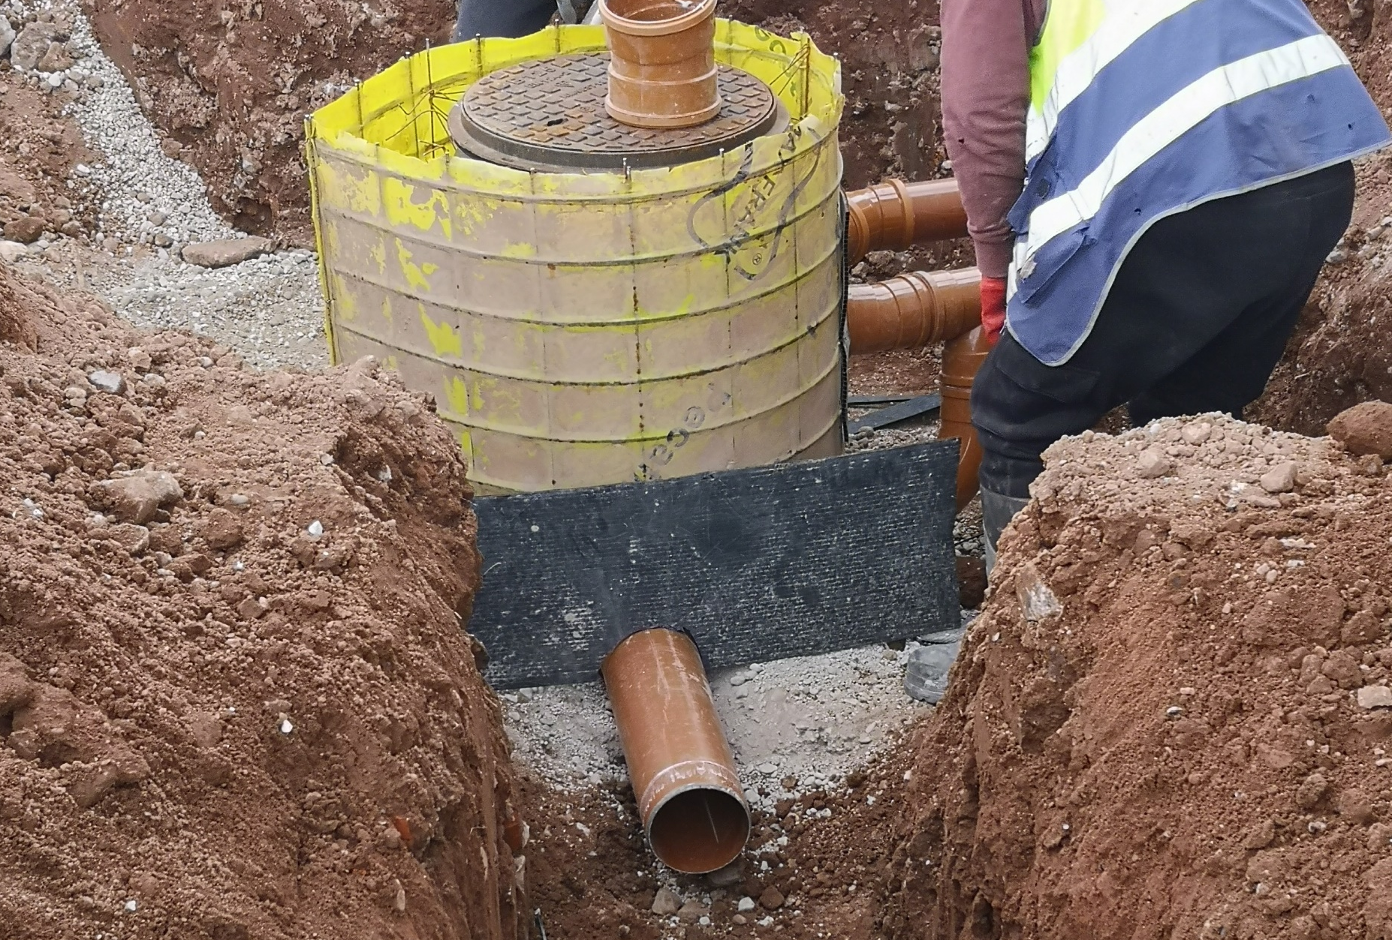
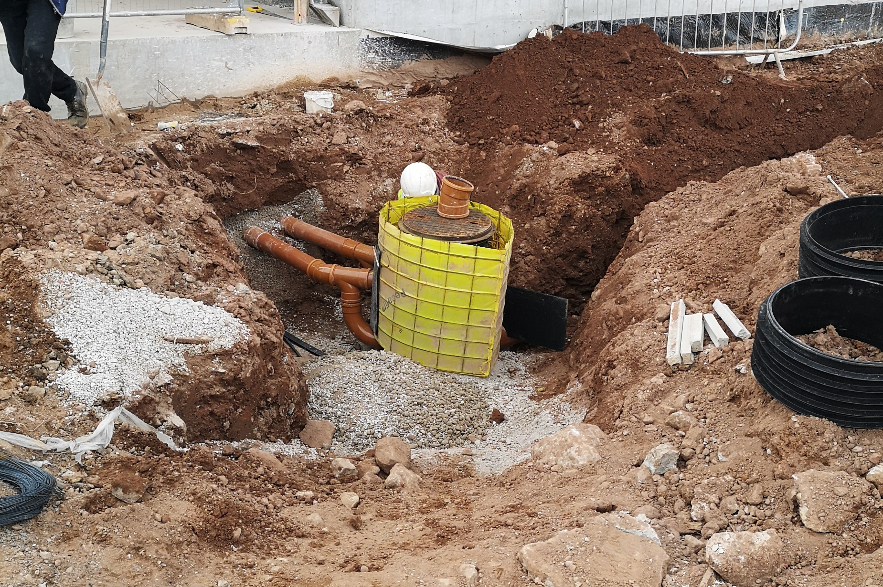
4212 Victoria Riverside
IMAGE SIZE
09.08.2022
IMAGE SIZE
09.08.2022

