Slide 1
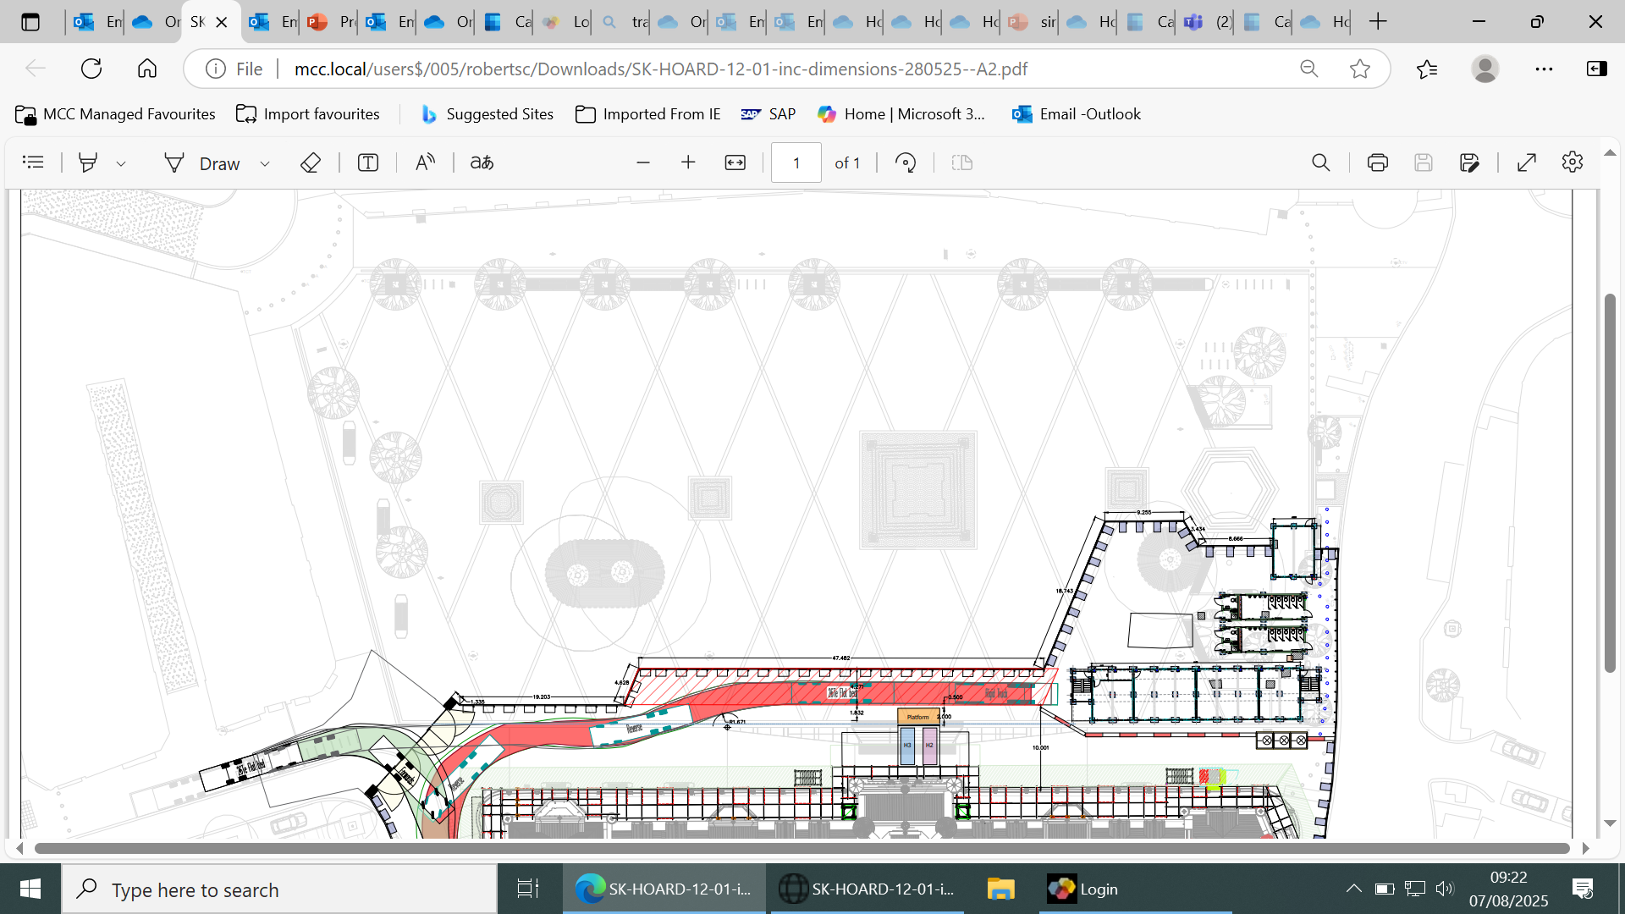
Delivery Route
Route closed at 9.15am
Delivery Route
Delivery Route
10m x 6m
Tree
Festive Lights
Festive Lights
6m
Attraction
8m
Attraction
24m x19.5m
Footprint
Festive Lights
12m Carousel
8m Swing Grill
48m Wheel Reach
Craft & Art
4x4
Food
4.5x3
Bar
7x3m Food
?
X10
3x2 Craft
3m Gap
10 x 3m Bar
3m Gap
BOH
20m(?) x 15m(?)
Structure
Seating Area
Deliveries in via Southmill Street out Via John Dalton Street
4.5mx
Food
F&B
F&B
8m
Helter
Bar
Can we create a seating area
under the trees + lights above
Illuminated
Arch Entry
X5 5x3m Food vacancies
9m x 5m F&B

Slide 2
Albert Square Delivery Routes
Install delivery route – in via Southmill Street and out Via Southmill and Lloyd Street (large vehicles)
Live dates – on Albert Square via Southmill Street and out via John Dalton Street. Bollards closed at 9.15 each morning.
De-rig - in via Southmill Street and out via Southmill Street/John Dalton Street

