Slide 1
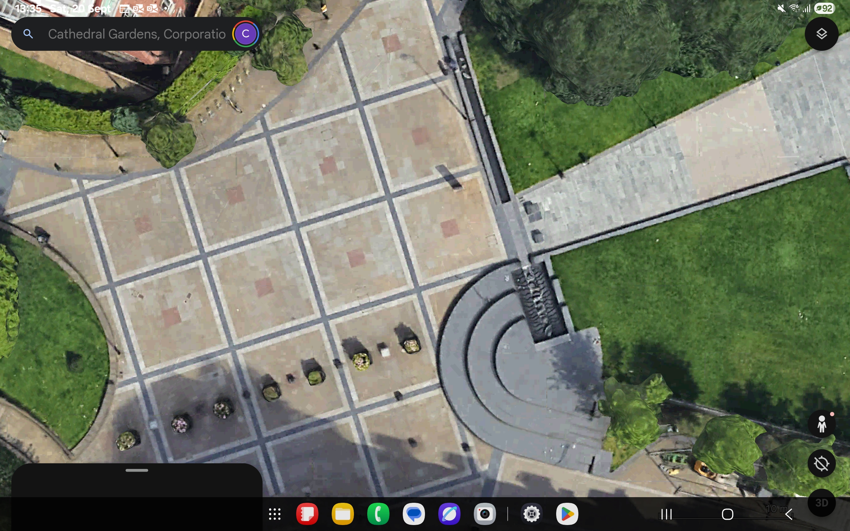
4m GAP
6x2.5m food
6x2 food
7x2.5m Bar
9m
6x2 food
4m GAP
Marquee 6x2m
DJ Area
7m Diameter
Bar
7x2m Sweet
stall
6x2m Food

Slide 2
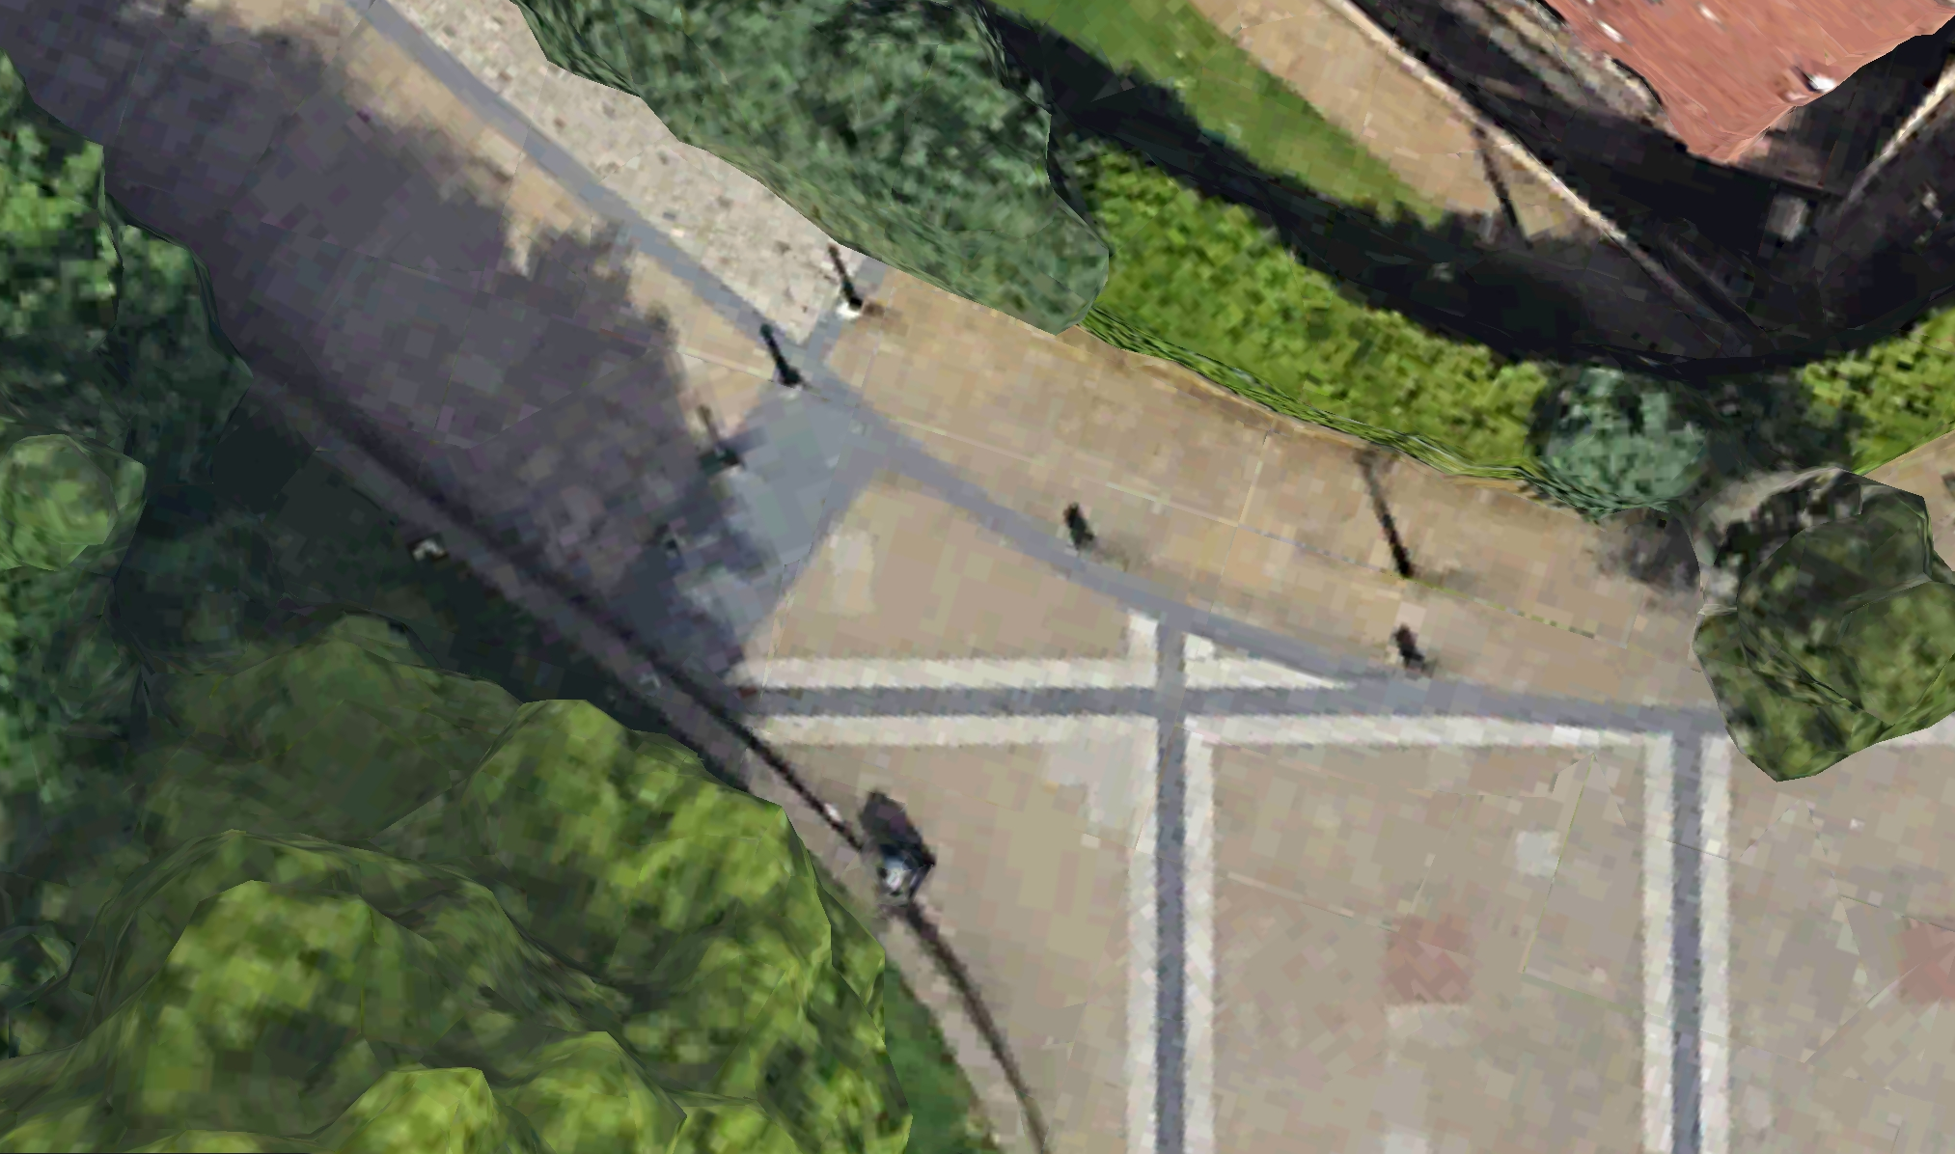
Emergency Vehicles Access
Entry route to Victoria Street
X2 fixed bollards 9 (denoted in red) and x2 removable bollards (denoted in green)
Gap of 3.9m once bollards are dismounted
Gap left by Christmas markets floor plan will be a 4m minimum Gap at entry points
3.9m GAP

Slide 3
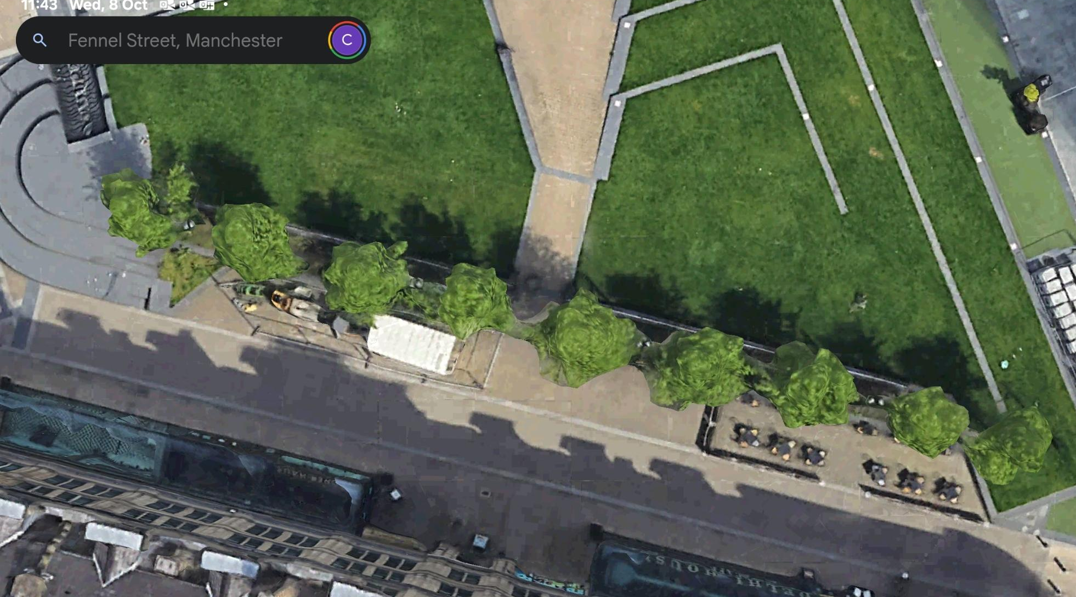
Waste
Area
Welfare & Medic unit

Slide 4
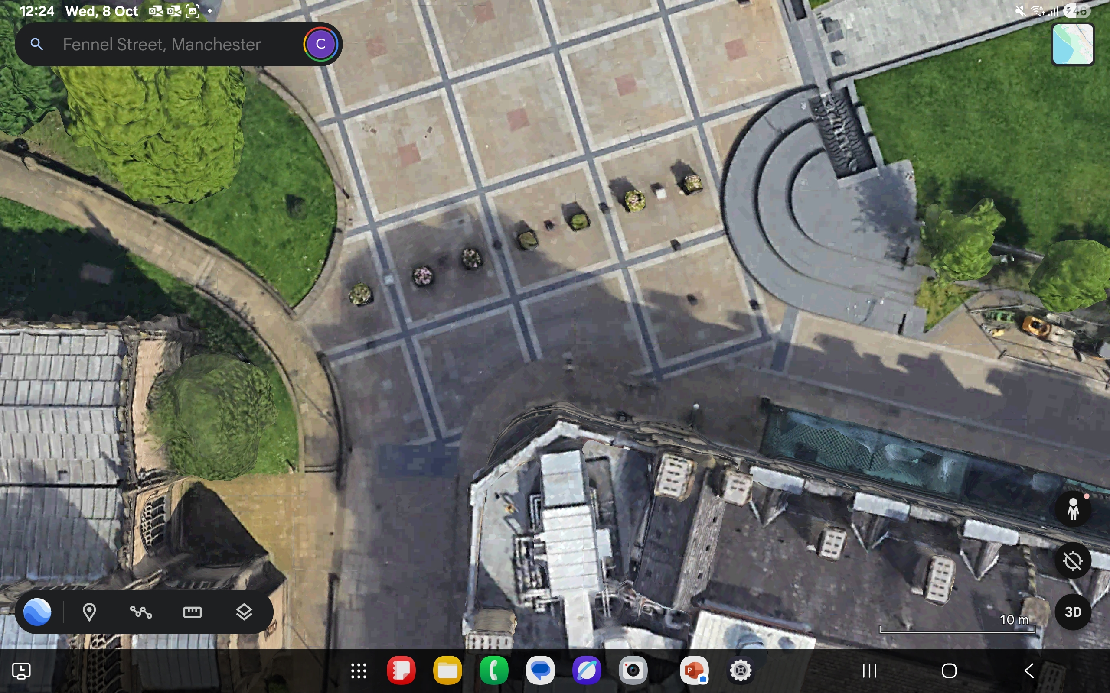
Marquee
DJ Area
Bar
7x2m Sweet
stall
Pancakes
WC Area

