Slide 1
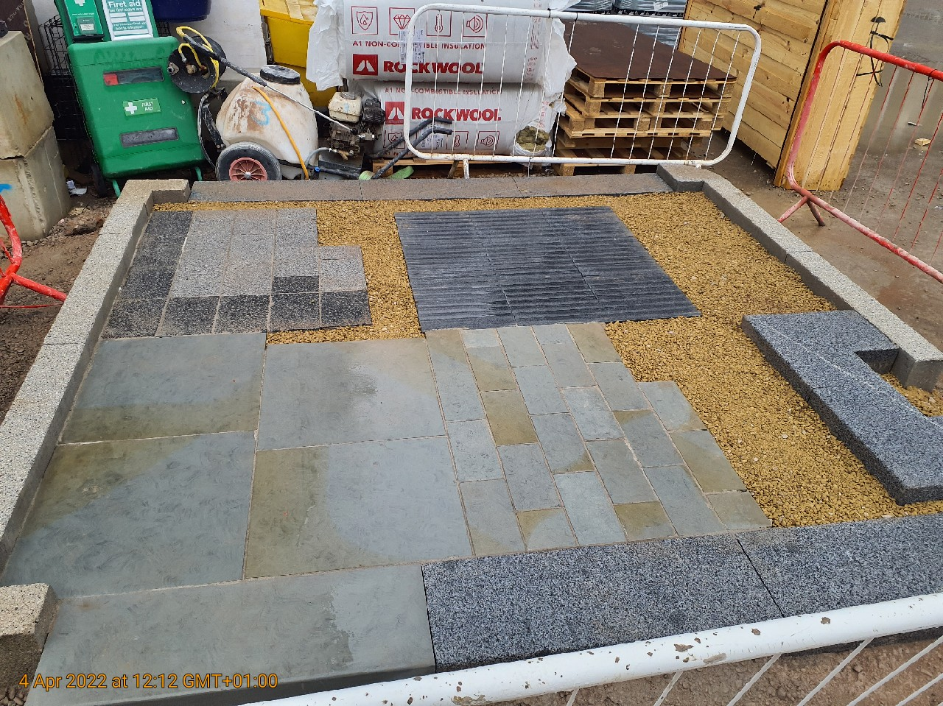
Granite Samples
Ref P6
Material: 'Kobra' Granite by Hardscape
Colour: Kobra
Finish: Flamed.
Unit size: 400mm (w) x 400mm (l) x 50mm (d)
Jointing: Steintec Tufftop - Mid grey. To supplier's recommendation.
Priming Mortar: Steintec Tuffbond to supplier's recommendation
Sample swatch photo attached
Ref K2
Material: 'Kobra' Granite by Hardscape
Colour: Kobra
Finish: Bush hammered.
Unit size: 300mm (w) x 900mm (l) x 160/250mm (d)
Notes: Nominal 60mm upstand to parking bay traffic barrier. Flush to Car Park entrance. Spec to match opposing side of Corporation Street
Sample swatch photo attached

