Slide 1
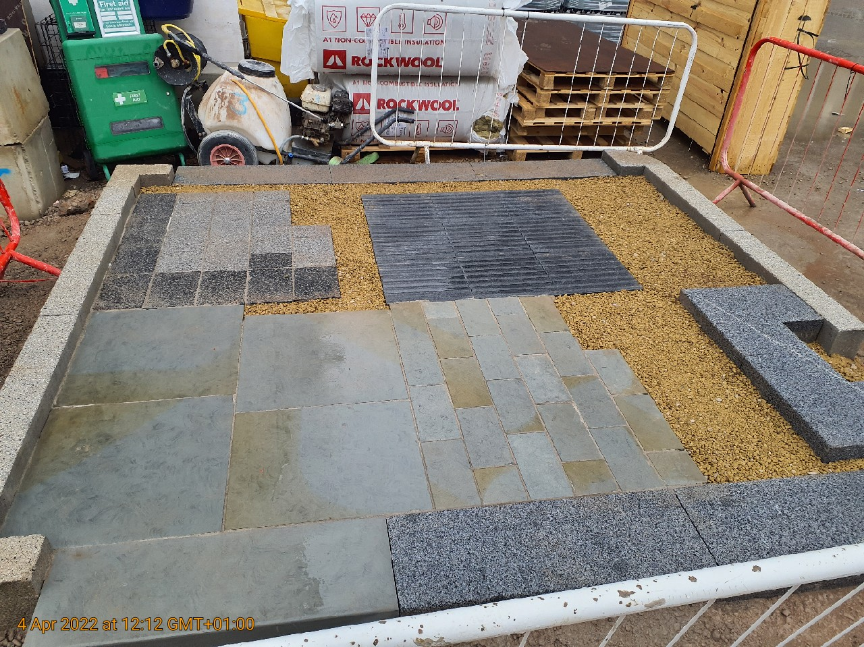
Exposed Aggregate Pre- cast Block Paving Samples
REF P4
Material: Kellen Breccia by Hardscape
Colour: Tagenta B (with Tagenta D double header)
Unit size: 200mm (w) x 300mm (l) x 80mm (d)
Laying: Stretcher Bond
Jointing: Steintec Tufftop - Mid grey.
To supplier's recommendation
Priming Mortar: Steintec Tuffbond to supplier's recommendation
Sample swatch photo attached

