Slide 1
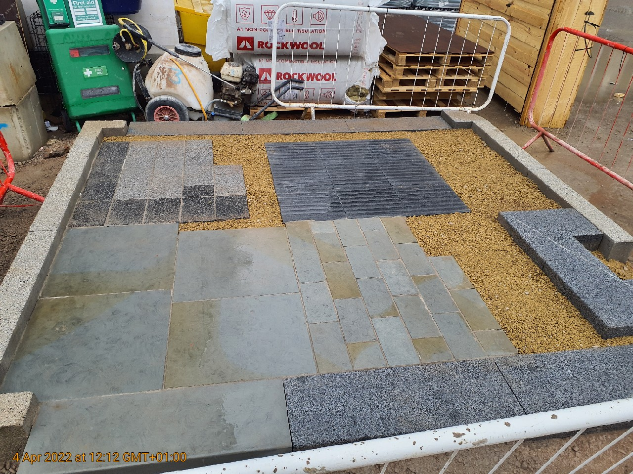
Yorkstone Samples
Ref P2
Material: 'Scoutmoor' Yorkstone by Marshalls
Finish: Diamond Sawn.
Colour: 50% Grey, 50% Buff
Unit size: 140mm (w) x 140-280mm (l) x 75mm (d)
Ref P1
Material: 'Scoutmoor' Yorkstone by Marshalls
Finish: Diamond Sawn.
Colour: 50% Grey, 50% Buff
Unit size: 600mm (w) x 400-600mm (l) x 75mm (d)
Ref K1
Material: 'Scoutmoor' Yorkstone by Marshalls
Finish: Diamond Sawn. Colour: Grey Buff
Unit size: 300mm (w) x 900mm (l) x 160/250mm (d)
Spec to match opposing side of Corporation Street

