Slide 1
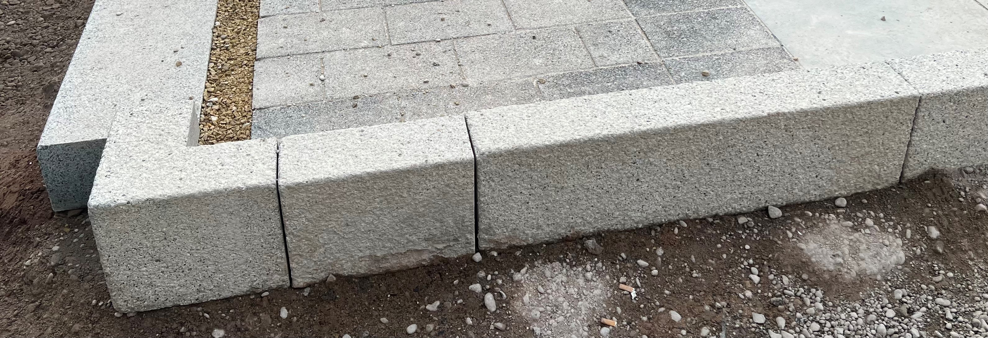
Textured Concrete Kerb
Ref K3
Material: Conservation Kerb by Marshalls
Colour: Silver Grey
Unit size: 145mm (w) x 900mm (l) x 255mm (d) Notes: 125mm upstand

